Slide 1
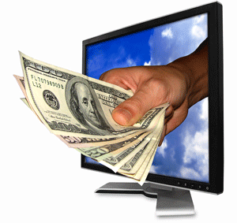
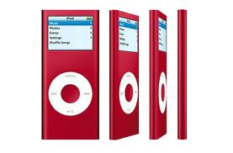
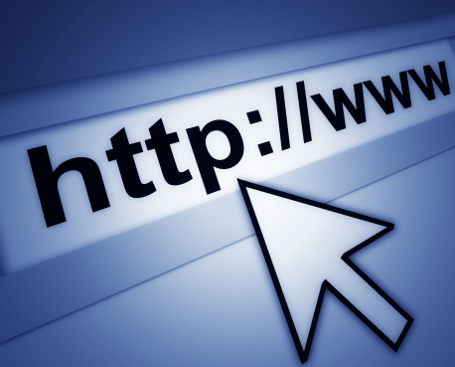
What is Marketing?
Everything it takes to get a product from the producer to the consumer…
**Products include both goods and services
Planning what product you sell
Pricing your product
Finding a place to sell your product
Promoting your product

Slide 2
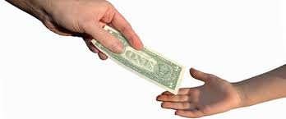
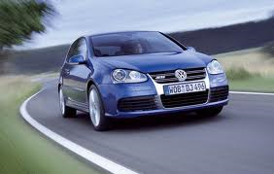
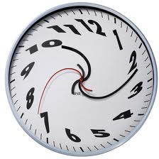
You are a Product!
You market yourself to employers
You market yourself to colleges
You market yourself to your parents

Slide 3
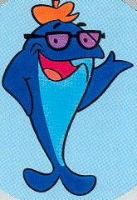
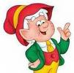
Do you know these brandmarks?

Slide 4
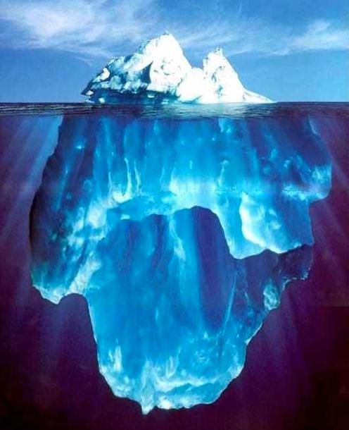
The iceberg represents a business’ BRAND.
The 10% above the water is the brand’s message
i.e. advertising campaign, logo, etc.
The 90% below the surface is your experience
with the brand.
It’s what is below the surface that sinks the ship.

Slide 5
The Titanic was given FIVE iceberg warnings. How does this relate to building a brand? Consider “brand names” such as Lindsay Lohan and Tiger Woods?
Notes:
Our busyness distracts us from looking within. A smaller problem becomes big…i.e gaining weight, embezzeling. It starts a trajectory. Below the surface is your character.

Slide 6
Why is marketing important to our economy?
Marketing of products/services add utility or usefulness
Marketing helps lower prices because of competition
Marketing provides for new and improved products
4 out of 5 jobs require Marketing skills
Everyone uses persuasive selling skills
More CEO’s reach the top of their organizations through marketing and sales

Slide 7
Your name is your brandmarK!
Everything you are reflects the brand that is “YOU”.
You can shape the brand you want to be.
Your qualities or characteristics make you stand out—they are your brand.
How can you grow your brand? Remember you can make image changes at any time…but it can take others awhile to notice sometimes.

Slide 8
What is your Brandmark?
What do you like to do in your spare time? Think of what you enjoy, your hobbies, your talents, etc.
Find a picture online or in a magazine, or draw one, that exemplifies your talents, special interests, or values.
If your friends were to describe you, what adjectives would they use?
CREATE YOUR BRANDMARK!

