Slide 1
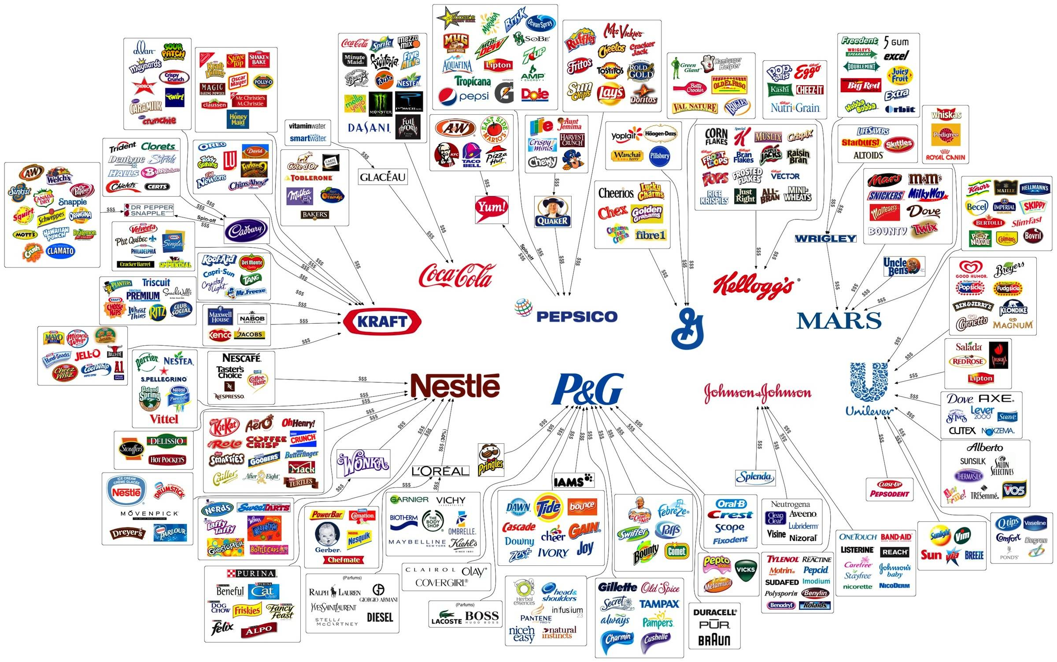

Slide 2
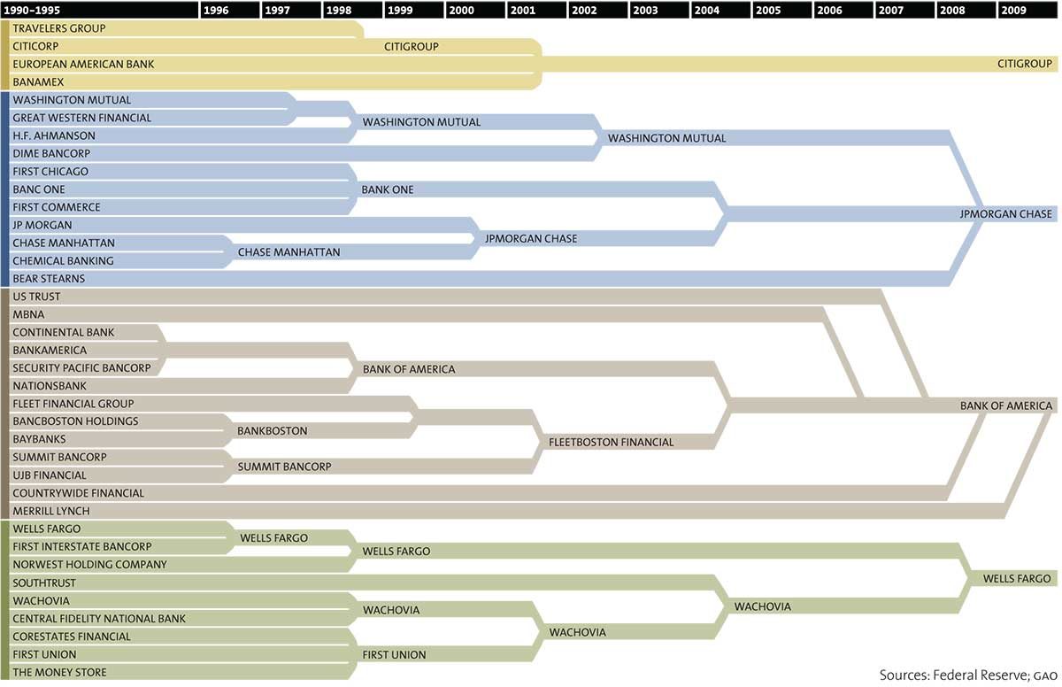
It gets even more macro, too: 37 banks have merged to become just four — JPMorgan Chase, Bank of America, Wells Fargo and CitiGroup in a little over two decades, according to this Federal Reserve map.
The nation's 10 largest financial institutions hold 54% of our total financial assets; in 1990, they held 20%. As MotherJones reports, the number of banks has dropped from more than 12,500 to about 8,000.

Slide 3
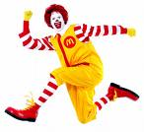
Branding- A name, term, design, symbol or any other feature that identifies one seller's good or service as distinct from another’s.
Brand name –.
Brand mark-
Trade Character –
Trade mark-
Trade name -

Slide 4
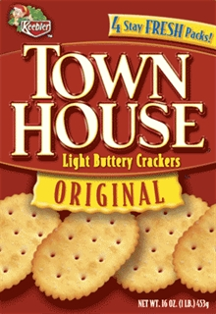
Brand Mark
Trade Character
Trade Name
Brand Name
Brands…names, terms, symbols that identify products and distinguish them from competitors products.
Find the brand mark, the brand name, the trade name and the trade character.

Slide 5
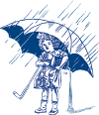
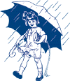
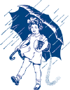
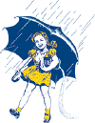
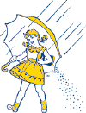
Salt may never become obsolete, but the package and brand must be kept up to date
1914 1929 1935 1941 1956 Present
What is the brand?

Slide 6
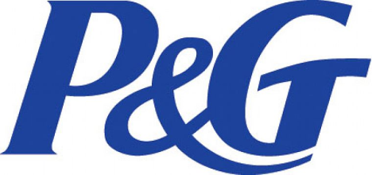
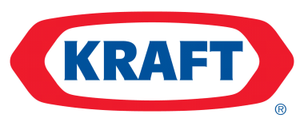
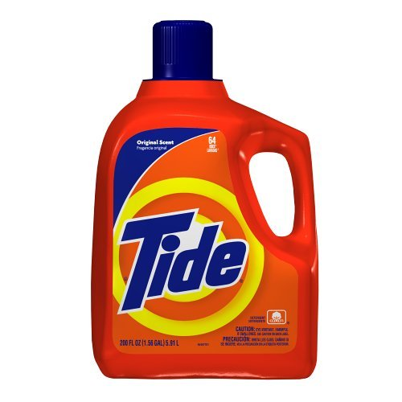
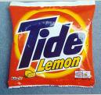
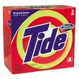
Branding Policies
Branding policies are:
Individual Branding:.
Overall Family Branding:
Line Family Branding:
Brand Extension Branding

Slide 7
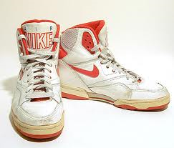
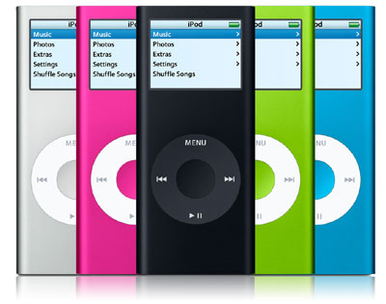
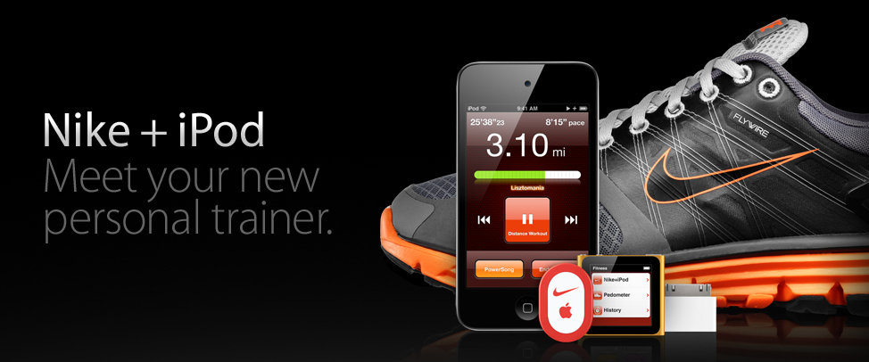
Borrowing Brand Equity
Also called co-branding
When two or more brands create a synergistic effect by their cooperation.

Slide 8
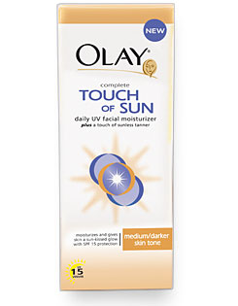
.
PG Individual Branding
PG Line Family Branding
REVIEW!

Slide 9
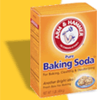
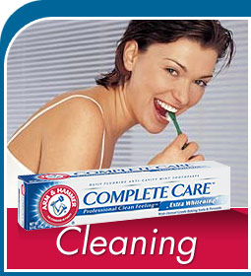
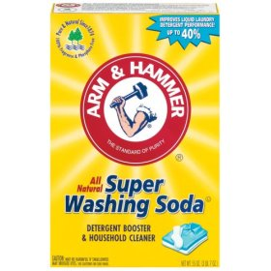
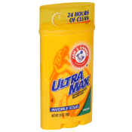
Brand Extension Branding- the original product has been used to extend the brand in a variety of new products that consumers trust.

Slide 10
Stages of Brand Loyalty
I know that brand
Recognition
Preference
Insistence
I prefer that brand but I’d take a substitute if it were on sale
I must have that brand. A substitute won’t do

Slide 11
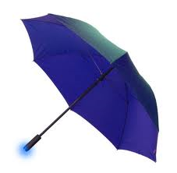
Branding is part of Product Planning
Product planning includes—
What
What
How to package and label a product
What
What services and warranties are offered
Whether new products are offered
Whether products are changed or deleted

Slide 12
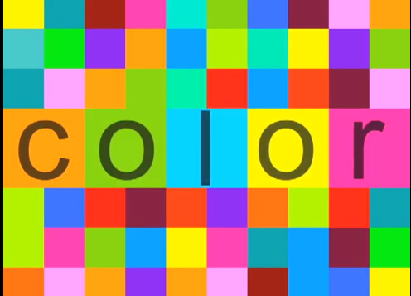

Slide 13
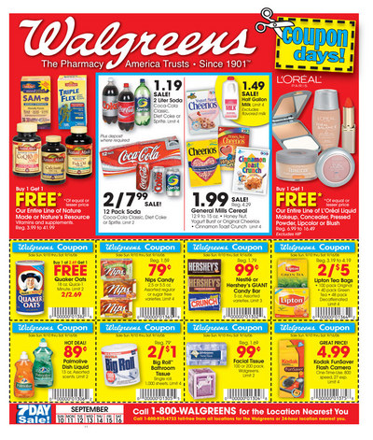
Product Mix
All the products that a retailer carries:

Slide 14
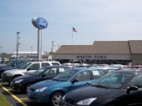
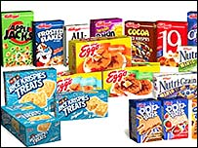
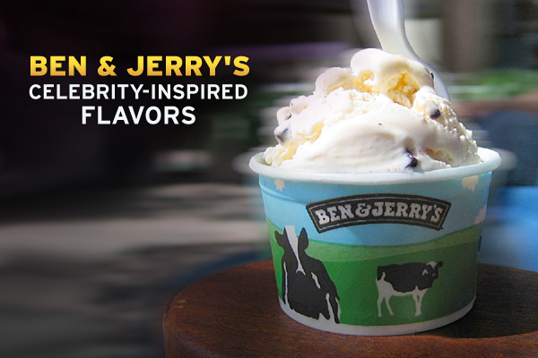
Product Line
Group
Ford Cars
Kellogg’s Cereals
Proctor and Gamble’s Hair Care Line
Celebrity products

Slide 15
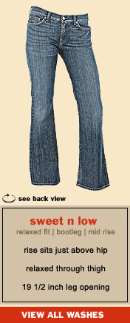
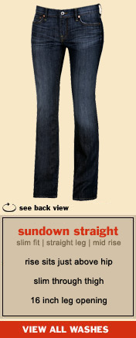
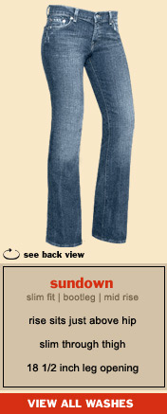
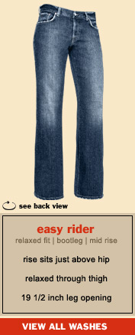
Product Item
Specific
Dell Computers
Lucky jeans
Size
Style
Color
cut

Slide 16
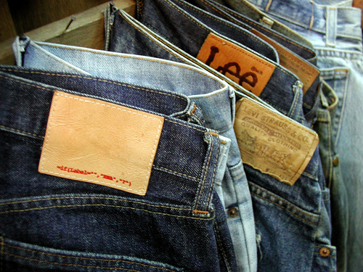
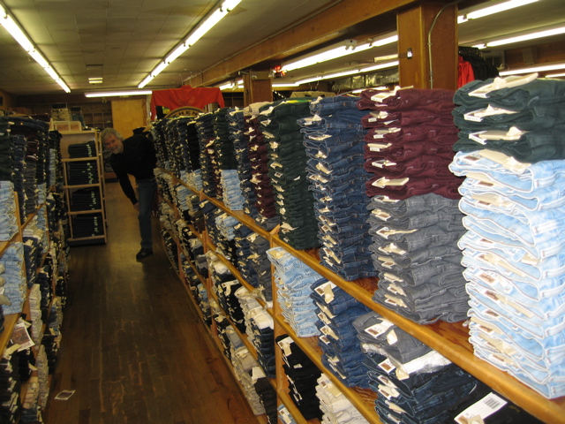
Product Width & Depth
Width:
#
Depth:
#

Slide 17
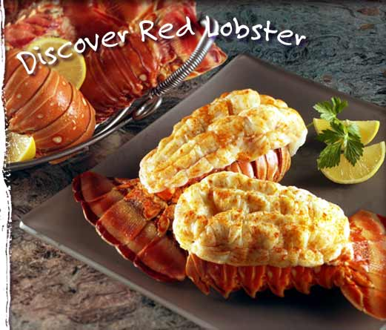
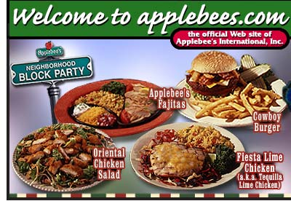
Width and depth
Red Lobster
Specialize in seafood
Great depth within a narrow product line
Applebees
Broad menu featuring chicken, steak, pasta, and seafood
Great width but less depth than red lobster

Slide 18
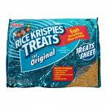
Product Mix Strategies
Developing New Products (seven steps)
Developing Existing Products—line extensions or product modifications
Deleting a Product or Product Line—obsolete, lack of profit, loss of appeal
What do you do if your product is in the decline stage?
Sell
License
Discount
Alter

Slide 19
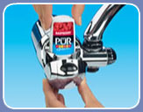
Six steps to New Product Development
1
2
3
4
5
6
Flavored Water Straight From the Tap ve,
Proctor and Gamble now offers flavor cartridges to its "Pur Water Filtration System", so that your tap water can have fruit flavors. The Pur Water Filtration System is just one of those water filters that fits on to your water faucet. The new flavor cartridges plugs into the water filter. When you turn on the water, you can press a button to add flavoring to the water. Flavor cartridges come in Strawberry, Peach, and Raspberry, and provide up to 75 glasses worth of flavoring. The flavoring contains no sugar, no fat, and no carbs.

