Slide 1
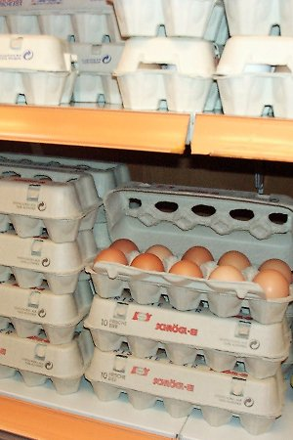
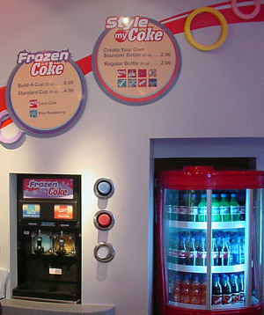
Product Packaging
Physical ______ or ______Functions:
Provides Information
Nutrition, ______, hazards, ______, how to open
______
Shipping, ______, display, ______
Promote and ______
Point of ______
____________ to the package and brand

Slide 2
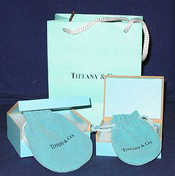
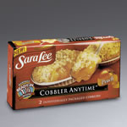
Product Packaging
______
Define product identity
Smuckers checkered lid for jellies and preserves
Ensure safe use
______, tamper resistant, ______f
Meet customer needs
______
Bulk
______
microwaveable

Slide 3
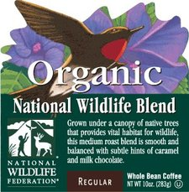
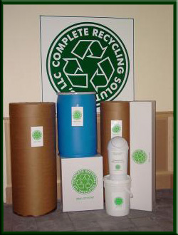
Contemporary Packing
______
Promote social or political issues
Ben & Jerry’s- rainforest
The Body Shop- Amnesty International
Risk: ______
______
Less wasteful
Reusable, recyclable
______
Socially conscious consumer will pay more

Slide 4
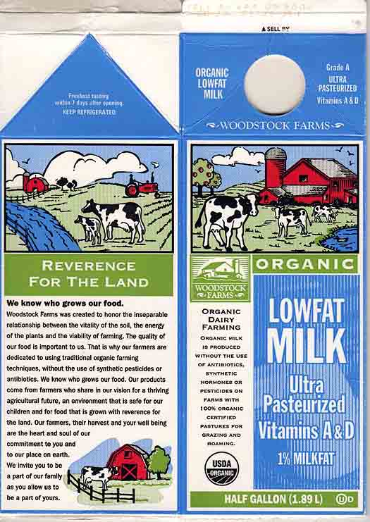
Package Labeling
Functions:
___________________
__________________
Contains:
Brand and trade marks/names
Ingredients
Directions
Special promotional messages

Slide 5
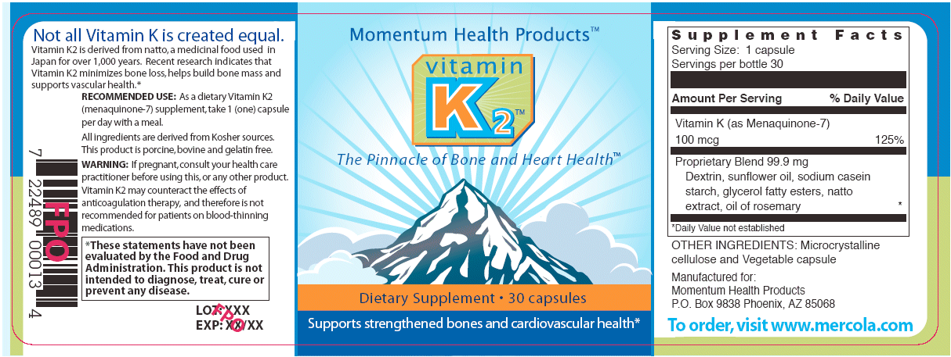
Claims/Marketing
Brand Name
Directions for use
Name of Manufacturer
Safety
Address of manufacturer
Size
Type of Product
Barcode

Slide 6
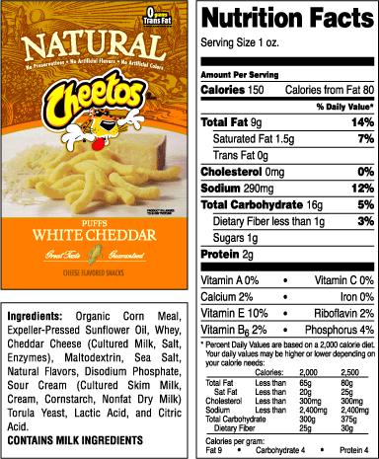
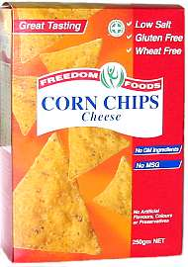
Package Labeling
Anything labeled "free" must only contain tiny amounts of the ingredient in each serving. For example, "trans-fat free" or "fat-free" products can have only 0.5 mg of trans fats or fat.
One serving of a "low-fat" food can have a maximum of 3 grams of fat.
A serving of a "low-calorie" food can have a maximum of 40 calories.
A serving of a food labeled "reduced" must have 25% less of the ingredient (such as fat) than a serving of the regular version.
One serving of a "light" food must have 50% less fat or 1/3 fewer calories than the regular version.

Slide 7
Protective Laws
____________ ______ (1966)
Protects from deceptive labeling
__________________
Requires health warnings
Alcohol
cigarettes

