Slide 1
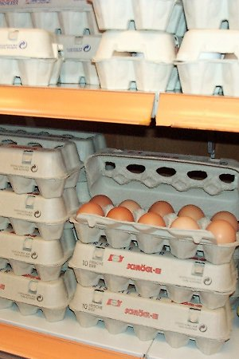
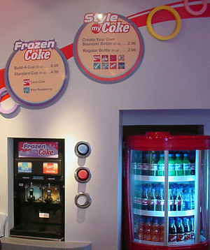
Product Packaging
Physical container or wrapping
Functions:
Provides Information
Nutrition, contents, hazards, directions, how to open
Protection
Shipping, storage, display, breakage/spoilage
Promote and sell the product
Point of purchase
Customer reaction to the package and brand

Slide 2
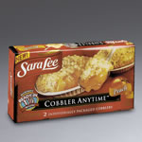
Product Packaging
Functions continued
Define product identity
Provoke prestige, convenience, status
Advertising component
Smuckers checkered lid for jellies and preserves
Ensure safe use
Plastic containers, tamper resistant, childproof
Meet customer needs
Multipacks
Bulk
Single servings
microwaveable

Slide 3
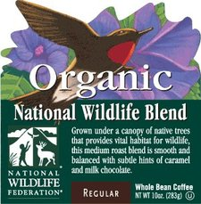
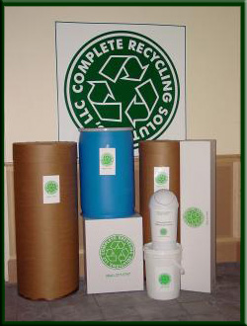
Contemporary Packing
Cause
Promote social or political issues
Ben & Jerry’s- rainforest
The Body Shop- Amnesty International
Risk: the consumer may not share the same views
Environmental
Less wasteful
Reusable, recyclable
Safer
Socially conscious consumer will pay more

Slide 4
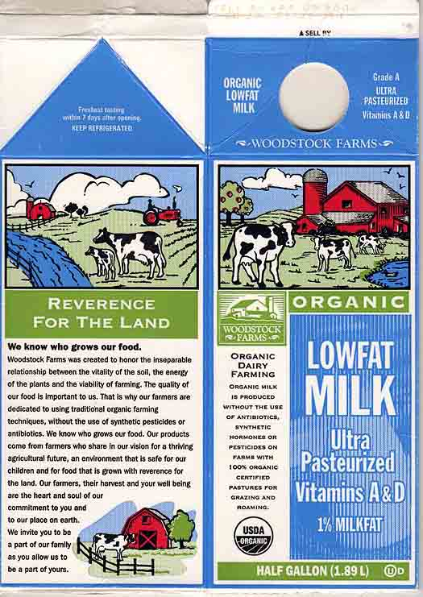
Package Labeling
Functions:
Inform customers about a product’s contents and its use
Product a business from legal liability
Contains:
Brand and trade marks/names
Ingredients
Directions
Special promotional messages

Slide 5
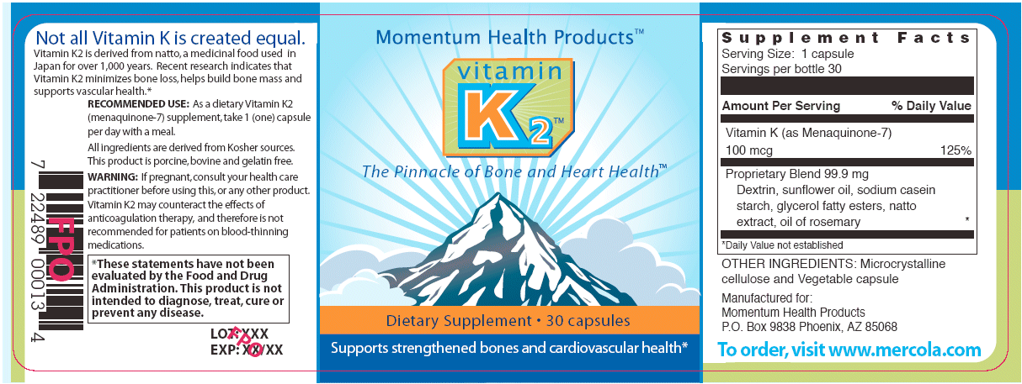
Claims/Marketing
Brand Name
Directions for use
Name of Manufacturer
Safety
Address of manufacturer
Size
Type of Product
Barcode

Slide 6
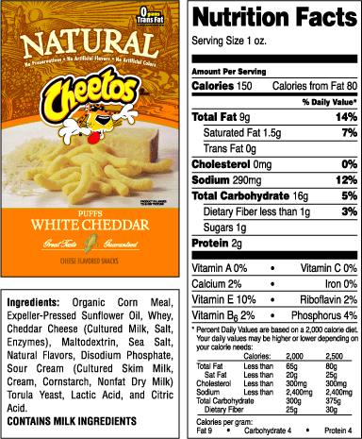
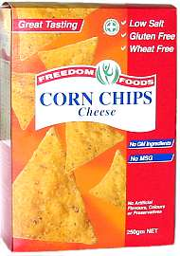
Package Labeling
Anything labeled "free" must only contain tiny amounts of the ingredient in each serving. For example, "trans-fat free" or "fat-free" products can have only 0.5 mg of trans fats or fat.
One serving of a "low-fat" food can have a maximum of 3 grams of fat.
A serving of a "low-calorie" food can have a maximum of 40 calories.
A serving of a food labeled "reduced" must have 25% less of the ingredient (such as fat) than a serving of the regular version.
One serving of a "light" food must have 50% less fat or 1/3 fewer calories than the regular version.

Slide 7
Protective Laws
Federal Fair Packaging and Labeling Act (1966)
Protects from deceptive labeling
Food and Drug Administration
Requires health warnings
Alcohol
cigarettes

