Slide 1
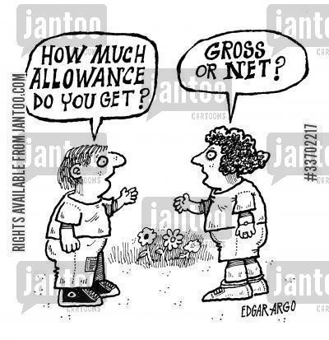
Where does your money come from?

Slide 2
forms of Income
Earned Income
Money you earn while working
Subject to taxes
Several different forms
Depends on your career
Unearned Income
Private Sources
Government Transfer Payments
In-cash Payment
In-kind Payments

Slide 3
Earned Income

Slide 4
Wages
What a person is paid for each hour worked.
Minimum Wage in NE
$8.00/hour
Department of Labor
Overtime Pay
Pay for hours worked in addition to regular hours.
(Usually is time and half)

Slide 5
Salaries
What you get paid for the position you hold.
- Don’t keep track of hours
- Don’t punch a time card
- Often work more than 40 hours/week
- Flexible schedule
- Usually self-managed positions

Slide 6
Tips and Commission
Tip
Gift of money
Usually a % of the bill
Subject to tax
Commission
Set fee or % of Sale

Slide 7
Bonuses
Additional money you get based on job performance
Can be based on…
Sales
Profits
Customers
Years of Service

Slide 8
Professional Fees
These are fees paid to a professional for work done
Accountants
Solicitors
Architects

Slide 9
Self Employed
Advantages
Make decisions
Products
Hours
Employees
Profits
Disadvantages
Risky
Loss of personal money
Loss of family money
Long hours
Tight finances

Slide 10
Employee Benefits
Pay without work
Paid Vacation/ Sick Leave
Educational benefits
Free tuition
Perks
Discounts
Insurance
Retirement Plans
Stock Options
Health Spending Plan
Optional Deductions
Daycare Flex Spending

Slide 11
Opportunity Cost
What you give up when you make one decision over another.
Example: What are 3 choices you can do with your life after high school graduation?
Pros
Cons
Opportunity Cost

Slide 12
Opportunity cost
Practice Activity

Slide 13
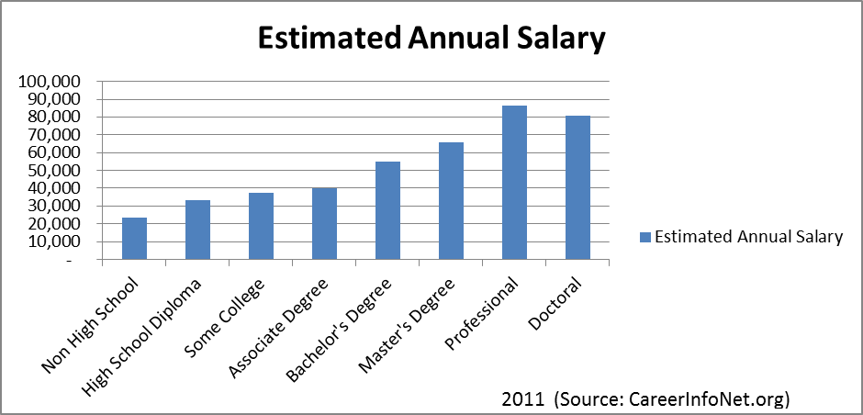
Earning potential

Slide 14
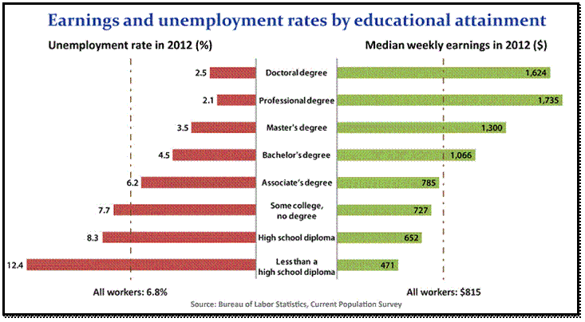
Earning Potential (second glance)

Slide 15
Unearned Income

Slide 16
Private Sources
Interest/ Dividends
Capital Gains
Gambling Winnings
Alimony
Social Security benefits
Pension
Annuities
Unemployment Compensation
Royalties

Slide 17
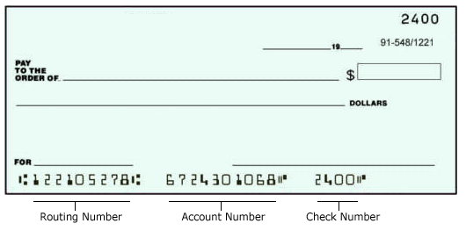
Government In-cash Payments
Direct payment given to those in need of assistance
Can be in the form of…
Cash
Check
Debit Card
Usually given to people after a natural disaster.
Usually requires an application to be verified.

Slide 18
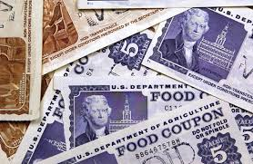
Government In-kind Payments
Payments are made indirectly on the persons behalf.
Paid to business in a form other than money.
Some Examples…
Food Stamps
Rent subsidies
Vouchers
Medicaid
There is also an application.
Must be verified.

