Slide 1
Work Ethic:
Soft Skill
of the Week
TAK
C H A R G E

Slide 2
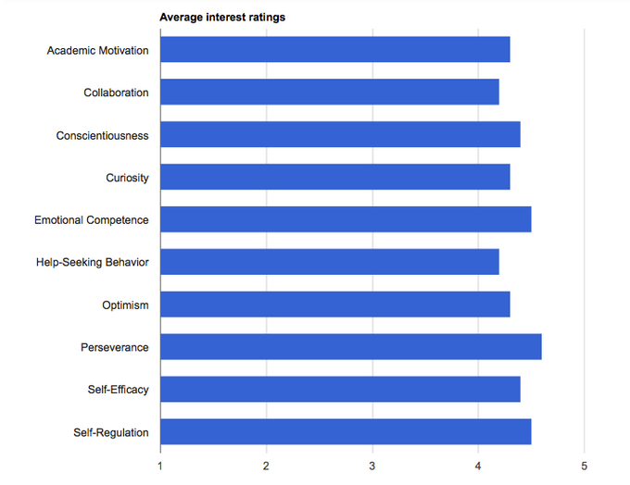
Perseverance garners most attention in soft skills poll

Slide 3
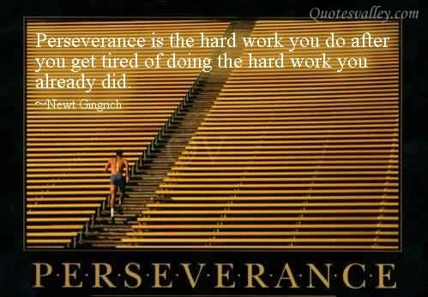
Perseverance
The capacity to stick to a goal or complete a task despite difficulties.
Qualities like grit, tenacity, delayed gratification, self-discipline, self-control, and passion for long-term goals.

Slide 4
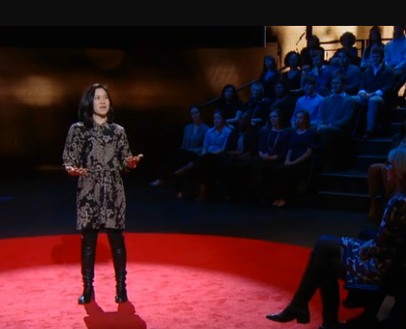
Personal Grit as Key to Success
Passion, perseverance, and stamina outweigh IQ
as a predictor of success.
GRIT
Self-control
Motivation

Slide 6
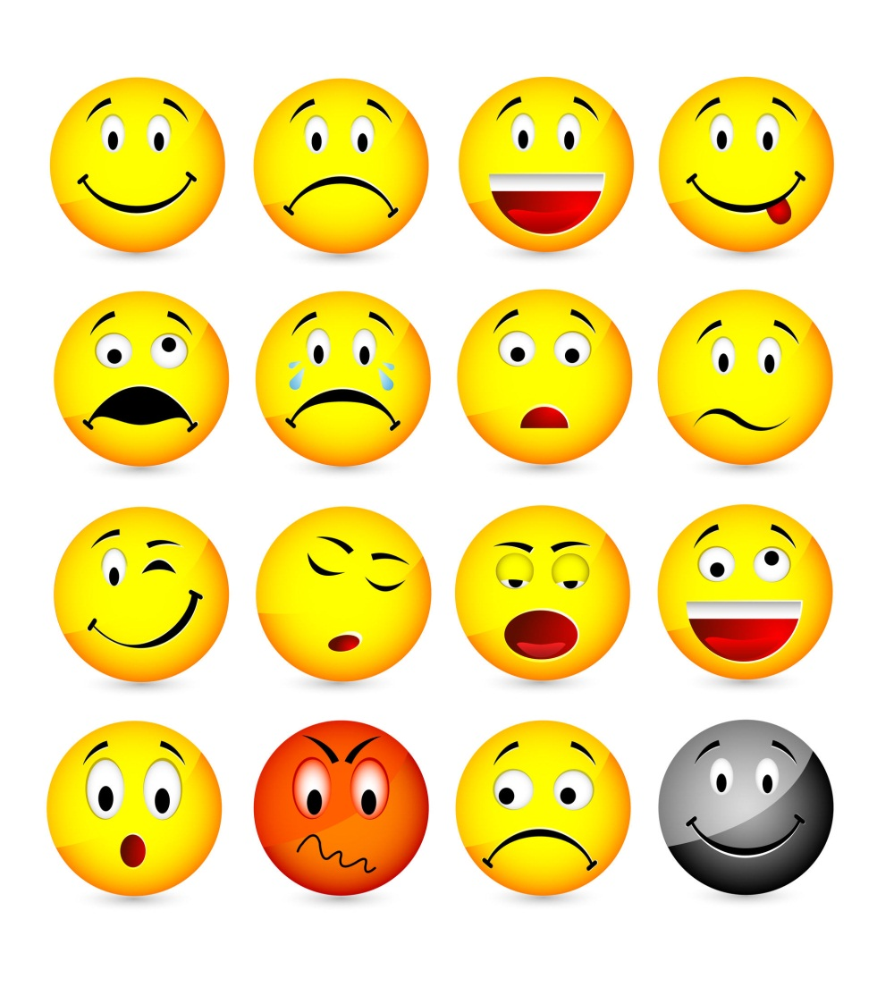
Emotional Competence
The capacity to experience and express feelings in ways that are appropriate and effective in a given situation as well as the capacity to understand and sympathize with the feelings and experiences of others.
Emotional competence includes empathy, emotion management, self-awareness, and social awareness.

