Slide 1
Chapter 13
Section 3
Aggregate Demand & Aggregate Supply

Slide 2
Aggregate Demand
The total of all planned expenditures in the entire economy
Cannot be individual prices
Averages all the prices measured
Notes:
SECTION 3
-347-
In this section we will be looking at how economists study the economy as a whole in terms of supply/demand
AGGREGATE means a summation of all the individual parts in the economy
Note that Aggregate Demand is similar to the Basic Demand we studied in Chapter 7
Remember the LAW OF DEMAND, and apply it to AGGREGATE DEMAND

Slide 3
Remember Law of Demand?
Aggregate Demand is similar in how/why it works
As the price level in the economy goes DOWN
Quantity of real domestic output goes UP
Notes:
Economic rule stating that the quantity demanded and the price move in opposite directions

Slide 4
Aggregate Supply
the real domestic output of producers based on the rise and fall of the price level
Notes:
-349-

Slide 5
Remember the Law of Supply…
If the price level goes UP with wages & other costs of production staying constant, profits will also go UP
Price level goes UP
Real domestic output goes UP

Slide 6
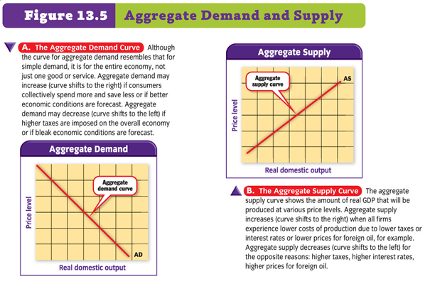
Notes:
-348-349-

Slide 7
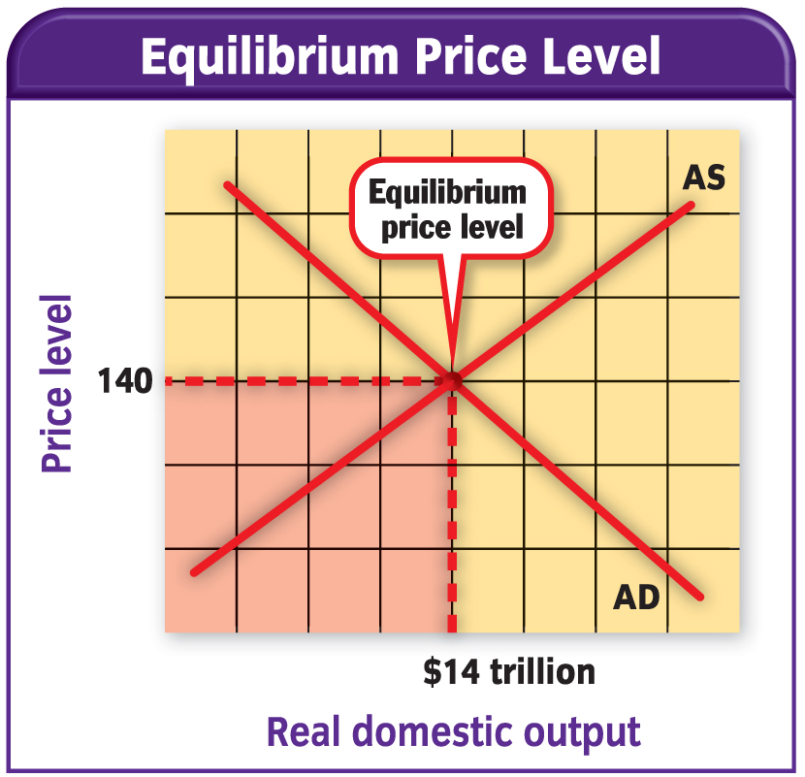
Putting it All Together
EQUILIBRIUM PRICE LEVEL
Where the AD CURVE crosses the AS CURVE
If AD pushes out faster than AS
Equilibrium Price Rises
If AS pushes out faster than AD
Equilibrium Price Falls
Notes:
-350-

