Slide 1
Chapter 13
Section 2
Correcting Statistics for Inflation
Notes:
Economists look at a variety of factors to assess the growth and performance of a nation’s economy.
Ask the students if they are familiar with the way the nation’s economy is measured?

Slide 2
Activity
Look up the cost of the following products in the year 1955…
Milk
Bread
Gasoline
Postage Stamp
Oreo Cookies

Slide 3
Activity
Look up the cost of the following products in the year 1955…
Product | Today’s Cost | 1955 Costs
Milk | $3.39 | $0.92
Bread | $1.42 | $0.18
Gasoline | $2.75 | $0.23
Postage Stamp | $0.49 | $0.03
Oreo Cookies | $2.98 | $0.39
Notes:
1955 prices - http://fiftiesweb.com/pop/prices-1955/

Slide 4
The Purchasing Power of Money
The nominal value of GDP must be adjusted for changes in the purchasing power of money to determine changes in real output.
INFLATION
Prolonged rise in the general price level of final goods/service
Must be taken into account
Happens naturally in an economy
Better than deflation
Causes purchasing power to decrease
DEFLATION
Prolonged decline in the general price level of goods/services
Has rarely happened in modern times
Notes:
SECTION TWO
-341-

Slide 5
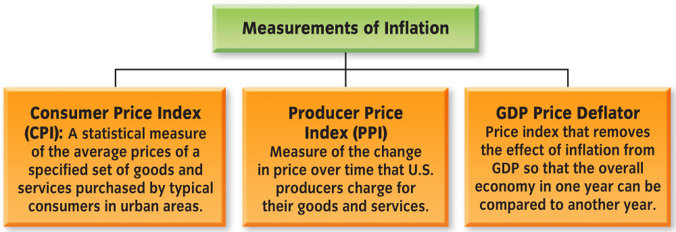
Measures of Inflation
Inflation is measured…
By calculating changes in different price indexes
In several ways – 3 most common measurements are…
Notes:
-343-
Why does inflation need to be measured?
so we know the price of goods

Slide 6
Consumer Price Index (CPI)
a statistical measure of the average of prices of a specified set of goods and services purchased by typical consumers in city areas
MARKET BASKET
Representative group of goods/services used to compile CPI
Consist of approx. 80,000 goods/services
Categories include:
Food, Housing, Transportation, Clothing, Education, Recreation, Medical Care, & Personal Care
Updated every 10 years to include new goods/services

Slide 7
Consumer Price Index (CPI)
Compiled monthly by the Bureau of Labor Statistics
Always start with a BASE YEAR
Year used as a point of comparison for other years in a series of statistics
Offers a point of comparison for current-day prices
Current “Base Year” used by BLS is an average of prices from 1982-1984
Notes:
-343-
SEE THE EXAMPLE…(highlighted in teacher edition) about how they calculate CPI
REMIND THE STUDENTS…of the lesson they did with JA involving CPI

Slide 8
Notes:
-342-

Slide 9
Producer Price Index (PPI)
Measures the change in price over time that U.S. producers charge for their goods and services
Customers are NOT just consumers
Could be other producers purchasing crude materials for further processing
PPI usually increases before CPI
People watch PPI to get an early estimate of what inflation will be in CPI
Notes:
-344-
EXAMPLE of PPI changing before CPI
Apple producers that have a weak crop will charge more to purchasers of their scarce supply of apples
If purchaser is a bakery then they will increase the price of their apple products to consumers
THUS, PPI increases first (sale from farmer to bakery) AND THEN CPI (bakery to consumer)

Slide 10
GDP Price Deflator
Price index that removes the effect of inflation from GDP so that the overall economy in one year can be compared to another year
Applying the Price Deflator to GDP creates a new figure called REAL GDP
GDP adjusted for inflation by applying the price deflator
The current base year for Real GDP is 2000
Notes:
-343-
SEE THE EXAMPLE (highlighted in the teacher’s guide) for how Real GDP is calculated

Slide 11
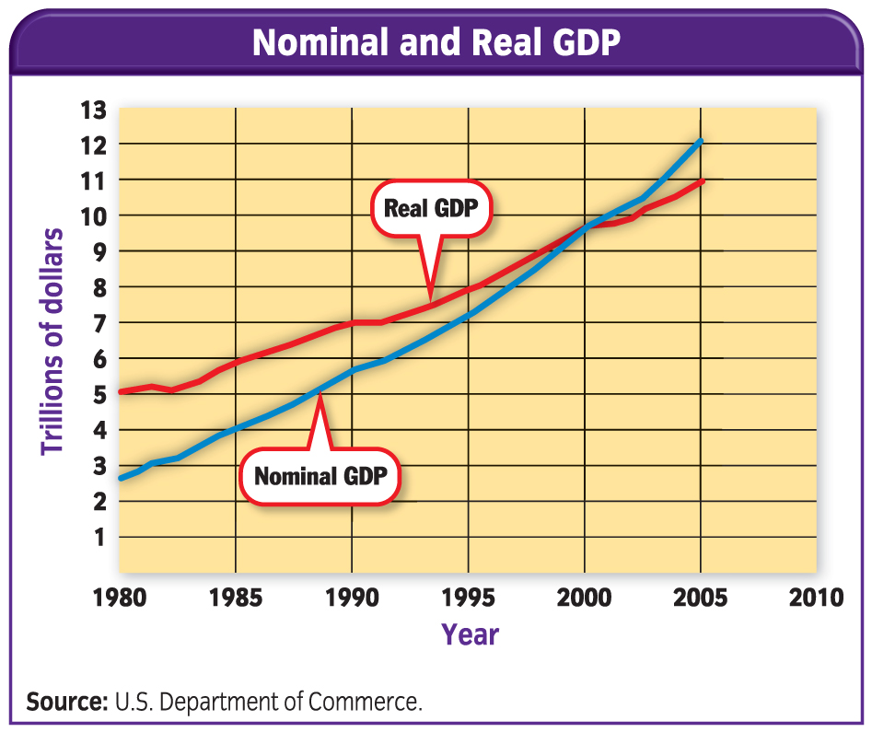
Notes:
-344-
Assign students Reteaching Activity 13 (10 minutes to complete) then grade as a class and turn in

