Slide 1
Chapter 13
Section 1
National Income Accounting
Notes:
Economists look at a variety of factors to assess the growth and performance of a nation’s economy.
Ask the students if they are familiar with the way the nation’s economy is measured?

Slide 2
Learning Objectives
Understand how economist calculate the success of a nation’s economy
Understand what price inflation is & how it is measured
Understand how laws of supply & demand apply to the economy as a whole
Understand how forces cause fluctuations in the American economy
Understand how economists explain & predict changes in the economy

Slide 3
Measuring Performance
NATIONAL INCOME ACCOUNTING
Measurement of the national economy’s performance, dealing with the overall economy’s output and income
This is the way we usually measure the economy's performance
Notes:
SECTION ONE
-336-
Just like a doctor uses different instruments to measure your health, economist have their own instruments for measuring the health of our economy

Slide 4
5 Major Characteristics Measure National Economy
Gross domestic product
Net domestic product
National income
Personal income
Disposable income

Slide 5
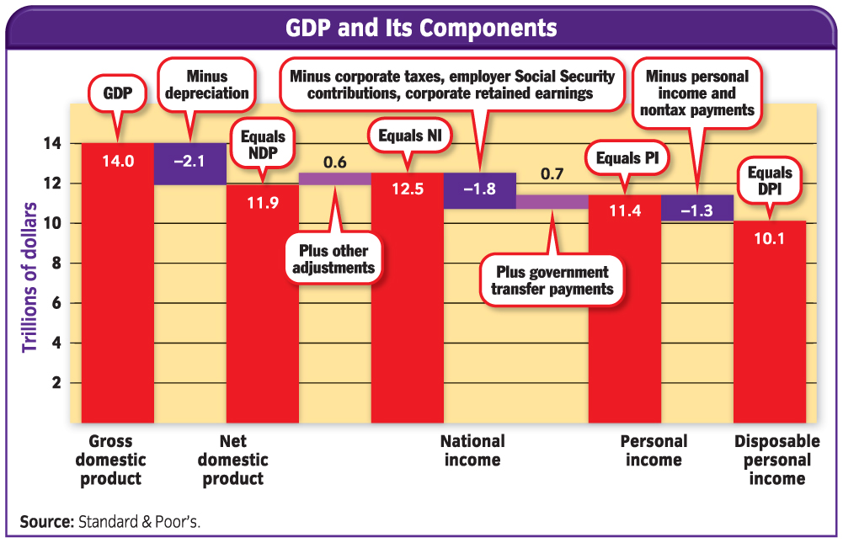
Notes:
-336-

Slide 6
Measuring GDP
GROSS DOMESTIC PRODUCT
Total dollar value of all final goods & services produced in a nation a single year
Key word: VALUE…
Have to know the dollar value of each item created to measure it’s impact on our economy
Always expressed in dollars
Key word: FINAL…
Goods that are produced to be an input in another good are not counted
This eliminates double counting
Notes:
-337-
GDP is the broadest measure of our economy’s size
Items must be produced IN OUR NATION’S BORDERS
Items must be made available for purchase WITHIN THAT YEAR
EXAMPLE FOR FINAL
Microchips that are produced to be sold to computer companies to put in their computer are NOT counted
Microchips that are produced for sale on the open market to individuals ARE COUNTED

Slide 7
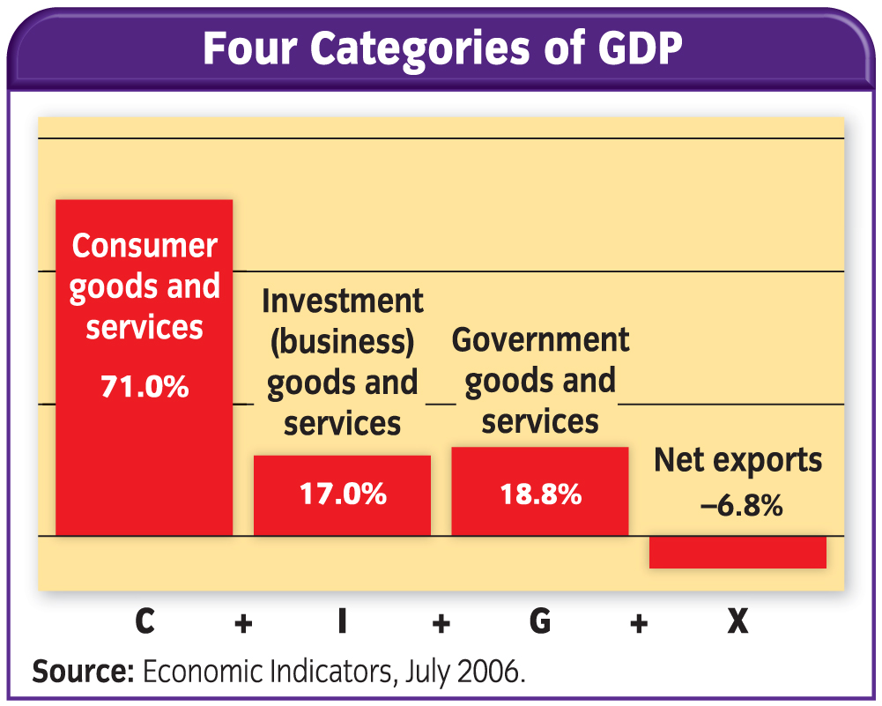
GDP = C+I+G+X
Notes:
-338-
A nation’s gross domestic product (GDP) is the total dollar value of all final goods and services produced annually.
TAKE NOTE OF THE FORMULA!!!

Slide 8
4 Economic Categories
C = Consumer Sector
Goods & Services bought directly by consumers
I = Investment Sector
Business purchases of items used to produce other goods
G = Government Sector
Goods & Services bought by the government
X = Net Exports
Difference between what the nation sells & what it buys from other countries.
Positive Number = More Exports than Imports
Negative Number = More Imports than Exports

Slide 9
Measuring NDP
NET DOMESTIC PRODUCT
Value of the nation’s total output (GDP) minus the total value lost through depreciation on equipment
DEPRECIATION
Loss of value in durable & capital goods due to wear & tear
Notes:
What are some goods that lose value due to depreciation?
why are they losing value?

Slide 10
Measuring National Income
NATIONAL INCOME (NI)
Total income earned by everyone in the economy
Broken down into 5 different categories
(Visual on next slide)

Slide 11
5 Categories when measuring National Income…

Slide 12
Measuring Personal Income
PERSONAL INCOME (PI)
Total income that individuals receive before personal taxes are paid
Derived from NI through a 2-step process
ITEMS ARE SUBTRACTED
Corporate Income Taxes
Profits businesses reinvest in the business to expand
Social Security contributions made by the employer
ITEMS ARE ADDED
Government Transfer Payments
Welfare, Unemployment Compensation, Social Security, & Food Stamps
Notes:
-340-
Why do they exclude the items in STEP ONE?
Because the money is not available for individuals to spend
Why do they include the items in STEP TWO?
Because the money is added to an individual’s income even though they are not exchanged for any current productive activity.

Slide 13
Measuring Disposable Income
DISPOSABLE PERSONAL INCOME (DPI)
Income remaining for people to spend or save after all taxes have been paid
Important because it shows the actual amount of money people have to spend in the economy
THIS IS THE NET PAY FROM YOUR JOB!!
Spending is what makes the economy go
Calculated with this formula:
PI – Personal Taxes = DPI
Notes:
-340-

Slide 14
Notes:
-336-

