Slide 1
The American Labor Force
CHAPTER 12
Section 3
Southwest High School
Notes:
SPOTLIGHT VIDEO
http://www.glencoe.com/video_library/index_with_mods.php?PROGRAM=9780078747663&VIDEO=3948&CHAPTER=12&MODE=2

Slide 2
Negotiations…
COLLECTIVE BARGAINING
Notes:
PAGE 321

Slide 3
Companies want to keep labor cost low…
Unions want increased wages & benefits…

Slide 4
Contract Issues include…
Working Hours
Fringe Benefits
COST-OF-LIVING ADJUSTMENTS (COLA)
Normally concluded in a friendly manner
Both sides feel satisfied with results
Notes:
PAGE 321

Slide 5
What if things are not friendly?
MEDIATION
ARBITRATION
Notes:
PAGE 321
Note on Mediation & Arbitration from BUSINESS LAW class
Mediation is NOT legally binding.
These are SUGGESTIONS done by a third party, but the decisions of a mediator do not have to be followed if a party does not wish.
Arbitration IS LEGALLY BINDING.
These are not just suggestions but what both sides MUST DO since they agreed to the decisions of the arbitrator. Even if they are not completely satisfied.

Slide 6
What if that doesn’t resolve it?

Slide 7
Strike
Notes:
PAGE 322 (Strike is defined on p 317)
No there is not a 3 strikes your out system in union/management talks ☺
Keep in mind that a strike does not just hurt the company…
ASK THE STUDENTS TO THINK ABOUT WHO ELSE GETS HURT BY A STRIKE?
Union employees
This is a sacrifice for them. They are not on a “paid vacation”
They may receive some compensation from the union, but not the same as what they would get if they were working
Non-union employees
Although they are going to work, there is only so much they can do without the union employees there
If it last long enough they might be put on unpaid leave until the contract has been negotiated and the business can resume normal operations
If the strike shuts down the business permanently they will lose their jobs due to the actions of others
The community
Employees not earning money will not spend money (or as much of it as before)
Less revenue for other businesses and for the government via sales tax

Slide 8
PICKETING

Slide 9
Getting the Community Involved
BOYCOTT
MAY PERMANENTLY LOSE CUSTOMERS TO THEIR COMPETITORS!!!
Notes:
Page 322
Ask the students why a boycott might not be a good idea??
-ENTER-
MAY PERMANENTLY LOSE CUSTOMERS TO COMPETITORS!!!
Asking customers to go to another company for a good…they may have never tried the other company’s good until they had to
If they like it better, you just lost a customer forever
If the strike lasts too long they may get tired of waiting and may decide not to buy that product again just because of the inconvienence
Believe it or not…customer care grudges…and they remember!!

Slide 10
Tactics Used by Management
LOCKOUTS
NBA, NFL, MLB, NHL
INJUNCTIONS
Taft-Hartley Act
Allows the President to delay/halt a strike
Only if it will endanger the nation’s safety/health
Notes:
PAGE 323
Ask students where they have heard the term “lockout” before?
-ENTER-
Ask students which Labor-Management Act allows the President of the US to get involved and under what reasons
-ENTER-

Slide 11
Accomplishments of “The Modern Union Era”
Union and Non-Union Workers have BOTH gained…

Slide 12
Decline of Unions
Because of these accomplishments…
Nature of the economy has changed
Some believe…
Employers argue union rules decrease productivity
Notes:
PAGE 324
Also notes that corruption among labor leaders, at times, have damaged the reputation and credibility of organized labor

Slide 13
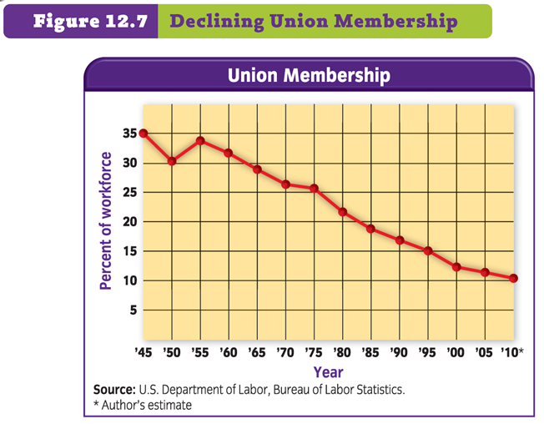
Notes:
PAGE 324

