Slide 1
The American Labor Force
CHAPTER 12
Section 3
Southwest High School
Notes:
SPOTLIGHT VIDEO
http://www.glencoe.com/video_library/index_with_mods.php?PROGRAM=9780078747663&VIDEO=3948&CHAPTER=12&MODE=2

Slide 2
STARTER…
Partner up…
You represent workers at a fast-food restaurant and they are about to negotiate income and work conditions
Your partner represents management
Notes:
They should find someone next to them
Discuss & write down their answers to the prompts
Discuss as a class
Go around the room and grade for completion

Slide 3
What would you ask for as their agent?
What will the management ask for?
How will you compromise?
How does this relate to supply/demand? Factors of Production?

Slide 4
Negotiations
COLLECTIVE BARGAINING
Process by which unions & employers negotiate the conditions of employment
Notes:
PAGE 321

Slide 5
Companies want to keep labor cost low
Unions want increased wages & benefits
Low cost = low price to consumer
Helps stay competitive with other companies
Increases employee morale
Increases livelihood of employees & families

Slide 6
Contract Issues include…
Working Hours
Fringe Benefits
COST-OF-LIVING ADJUSTMENTS (COLA)
Provision calling for a wage increase each year if the general level of prices rise
Normally concluded in a friendly manner
Both sides feel satisfied with results
Notes:
PAGE 321

Slide 7
What if things are not friendly?
MEDIATION
Next level of negotiation if talks break down
Neutral person tries to get both sides to reach an agreement during negotiations
Federal Mediation & Conciliation Services provides mediators free of charge via the federal government
Notes:
PAGE 321
Note on Mediation & Arbitration from BUSINESS LAW class
Mediation is NOT legally binding.
These are SUGGESTIONS done by a third party, but the decisions of a mediator do not have to be followed if a party does not wish.
Arbitration IS LEGALLY BINDING.
These are not just suggestions but what both sides MUST DO since they agreed to the decisions of the arbitrator. Even if they are not completely satisfied.

Slide 8
What if things are not friendly?
Arbitration
Third Party
Union & Management submit the issues they cannot agree on
Third Party makes final decision
Both sides agree in advance to accept the arbitrator’s decision as final

Slide 9
1, 2, 3 Strikes…YOU’RE OUT!!
STRIKE
Deliberate work stoppage by workers to force an employer to give in to their demands
Usually happens if the union & management cannot come to terms
Notes:
PAGE 322 (Strike is defined on p 317)
No there is not a 3 strikes your out system in union/management talks ☺
Keep in mind that a strike does not just hurt the company…
ASK THE STUDENTS TO THINK ABOUT WHO ELSE GETS HURT BY A STRIKE?
Union employees
This is a sacrifice for them. They are not on a “paid vacation”
They may receive some compensation from the union, but not the same as what they would get if they were working
Non-union employees
Although they are going to work, there is only so much they can do without the union employees there
If it last long enough they might be put on unpaid leave until the contract has been negotiated and the business can resume normal operations
If the strike shuts down the business permanently they will lose their jobs due to the actions of others
The community
Employees not earning money will not spend money (or as much of it as before)
Less revenue for other businesses and for the government via sales tax

Slide 10
PICKETING
Striking union members walk in front of a workplace
Carry signs stating their disagreement with the company
Done for 3 reasons
Encourage non-union members not to go to work
Gain public support of their cause
Embarrass the company

Slide 11
Getting the Community Involved
BOYCOTT
Economic pressure exerted by unions urging the public not to purchase the goods/services produced by the company
May also encourage politicians to get involved & voice support for the union
MAY PERMANENTLY LOSE CUSTOMERS TO THEIR COMPETITORS!!!
Notes:
Page 322
Ask the students why a boycott might not be a good idea??
-ENTER-
MAY PERMANENTLY LOSE CUSTOMERS TO COMPETITORS!!!
Asking customers to go to another company for a good…they may have never tried the other company’s good until they had to
If they like it better, you just lost a customer forever
If the strike lasts too long they may get tired of waiting and may decide not to buy that product again just because of the inconvienence
Believe it or not…customer care grudges…and they remember!!

Slide 12
Tactics Used by Management
LOCKOUTS
Management prevents workers from returning to work until they agree to a new contract
NBA, NFL, MLB, NHL
INJUNCTIONS
Court order preventing an action
Used by management to limit picketing or prevent a strike
Taft-Hartley Act
Allows the President to delay/halt a strike
Only if it will endanger the nation’s safety/health
Notes:
PAGE 323
Ask students where they have heard the term “lockout” before?
-ENTER-
Ask students which Labor-Management Act allows the President of the US to get involved and under what reasons
-ENTER-

Slide 13
Accomplishments of “The Modern Union Era”
Establishment of AFL in 1886
Beginning of modern union era
Union & Non-Union Workers have BOTH gained
Better wages & working conditions
Sense of security in the workplace
More order & fairness in the workplace
Made clear the rights & responsibilities of management and employees

Slide 14
Decline of Unions
Because of these accomplishments…
Non-union workers see little to gain from joining a union
Nature of the economy has changed
More jobs are opening in white-collar & service sectors
Less blue-collar jobs due to automation
Some believe…
Unions have lost touch with member needs
Increased wages have been passed on to consumers
Employers argue union rules decrease productivity
Slows the intro of technology into a company
Require more employees than necessary for jobs
Notes:
PAGE 324
Also notes that corruption among labor leaders, at times, have damaged the reputation and credibility of organized labor

Slide 15
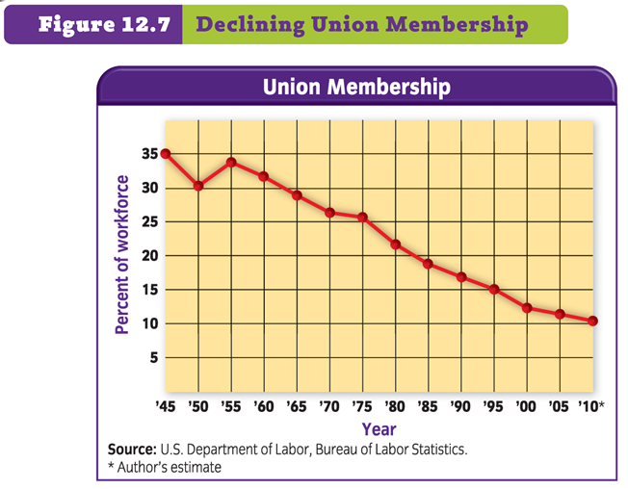
Notes:
PAGE 324

