Slide 1
The American Labor Force
CHAPTER 12
Section 2
Southwest High School
Notes:
SPOTLIGHT VIDEO
http://www.glencoe.com/video_library/index_with_mods.php?PROGRAM=9780078747663&VIDEO=3948&CHAPTER=12&MODE=2

Slide 2
DFS Trans 2
Notes:
ANSWER TO 1:
Downward trend (fewer people in the workforce are becoming union members)
What might be the reason for this?
Perhaps workers feel like the law does a good enough job of protecting them

Slide 3
Development of Labor Unions
Working conditions in the 1800s
Poor lighting
Poor ventilation
Dangerous machinery
Long workweeks
Low wages
No such thing as benefits
No healthcare, vacation days, sick leave, or holidays
You did as you were told if you wanted to keep your job
Notes:
PAGE 316

Slide 4
Development of Labor Unions
To better their working conditions workers began to form LABOR UNIONS
Association of workers organized to improve wages & working conditions for its members
Unionization was fought against
State legislatures banned unions
Courts upheld state laws
Businesses refused to hire union members
Employees that joined unions were fired
Notes:
PAGE 316

Slide 5
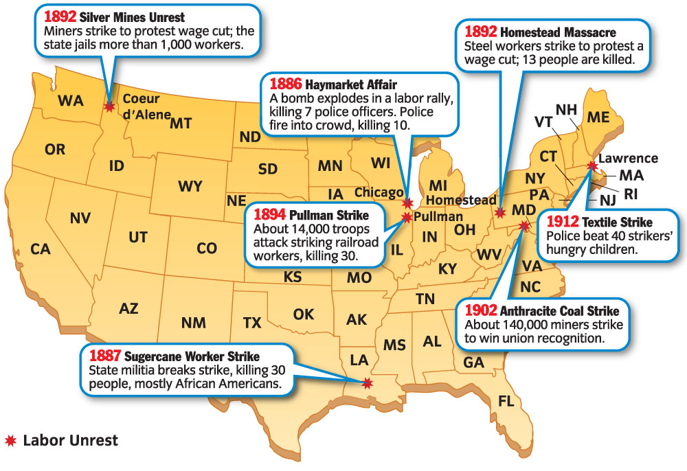
Notes:
PAGE 316
Congress didn’t begin passing laws to regulate labor-management relations until the mid-1930s!!!

Slide 6
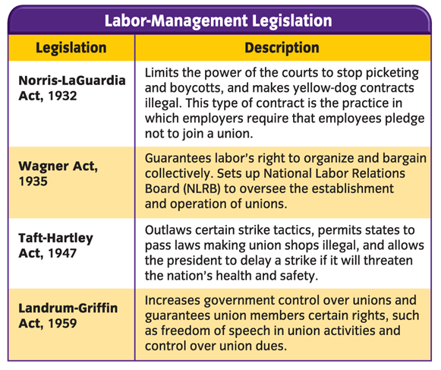
Notes:
PAGE 317

Slide 7
Organized Labor in the US
CRAFT UNION
Skilled workers in a specific trade or industry
American Federation of Labor (AFL)
First permanent organization of craft unions
Founded by Samuel Gompers
INDUSTRIAL UNION
All the workers in an industry regardless of job or skill level
Congress of Industrial Organizations (CIO)
First significant effort to unionize unskilled & semiskilled labor
Notes:
PAGE 317

Slide 8
AFL v. CIO
Late 1930s and Early 1940s
AFL and CIO had a rivalry
Both sides trying to gain more members
Both sides setting up unions in the other’s primary area of interest
1955
AFL-CIO merger
Notes:
PAGE 317

Slide 9
Union Organization
3 levels: Local, National, & Federation
LOCAL UNION
Members in a particular factory, company, or geographical area
Duties of a Local Union
Negotiating contracts
Ensuring contracts are kept
Amount of influence a local union has depends on the membership policy it has negotiated with management
Notes:
PAGE 318
START HERE ON MONDAY!!!

Slide 10
Local Union Membership Types
CLOSED SHOP
Company where only union members can be hired
Outlawed by the Taft-Hartley Act (1947)
UNION SHOP
Requires new employees to join a union after a specific period of time (3 months)
Taft-Hartley Act allows states to ban these
AGENCY SHOP
Employees are not required to join the union, but must pay union dues
Notes:
Ask students…
What would you think about working in an “Agency Shop” if you did not want to be part of the union?
Answers will vary but…
Might point out that people should not have to pay dues to an organization they do not want to be a part of
Why do supporters of Agency Shops believe this is an OK practice?
Because they benefit from contracts the union negotiate

Slide 11
Restriction to Local Union Membership
RIGHT-TO-WORK LAWS
State laws forbidding unions from forcing workers to join and pay union dues
Employees who work in the railway or airline industries are not protected
Employees who work on a federal enclave may not be protected
Nebraska’s Right-to-Work Law
http://www.nrtw.org/c/nertwlaw.htm
Notes:
PAGE 318
Additional information provided by National Right to Work Legal Defense Foundation, Inc
http://www.nrtw.org/rtws.htm
EXPLAIN TO STUDENTS → Right-to-Work Laws in place within LPS

Slide 12
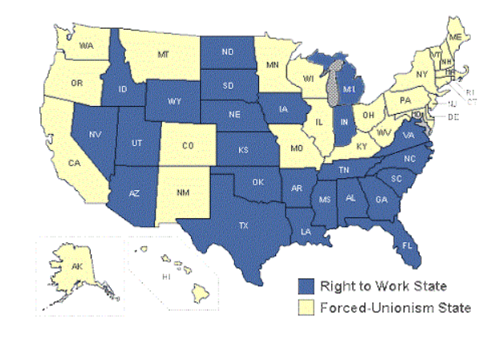
Notes:
This image courtesy of National Right to Work Legal Defense Foundation, Inc
http://www.nrtw.org/rtws.htm

Slide 13
Union Organization
NATIONAL UNIONS
Represents local Unions nationwide
Send organizers
Help negotiate contracts
Provide lawyers
(Certain industries) Negotiate for the entire industry
When a majority of members accept a contract it goes into effect for all members
Notes:
PAGE 319
Unions that have members in Canada or Mexico are called “International Unions”
Some of the largest unions are:
International Brotherhood of Teamsters
United Automobile Workers
United Steelworkers of America

Slide 14
Union Organization
FEDERATION LEVEL
AFL-CIO
Made up of more than 50 national & international unions
Approximately 9 million members
Change to Win Federation
Started in 2005
Composed of 7 unions
Seeks to promote & increase US union membership
Notes:
PAGE 319

