Slide 1
The American Labor Force
CHAPTER 12
Section 1
Southwest High School
Notes:
SPOTLIGHT VIDEO
http://www.glencoe.com/video_library/index_with_mods.php?PROGRAM=9780078747663&VIDEO=3948&CHAPTER=12&MODE=2

Slide 2
What you will learn…
How workers are categorized
How their wages are determined
What labor unions are
Their history
How they are organized
Their role today
How management & unions work together
Notes:
During this chapter we will be focusing on the “Labor” or “Human Resources” portion of the 5 Factors of Production

Slide 3
Vocabulary Activity
Split kids into groups
Had each group write a term on the white bard
Taught each other the vocabulary
Wrote into first page of notes

Slide 4
Civilian Labor Force
CIVILIAN LABOR FORCE
Total number of people 16 years old or older who are either employed or actively seeking work
Does NOT include:
Those not looking for work
RETIRED, FULL-TIME STUDENTS, STAY-AT-HOME PARENTS
Those not able to work
DISABLED, PEOPLE IN PRISON, PEOPLE IN MENTAL INSTITUTIONS
Notes:
PAGE 308
Ask students…
What does it mean “actively seeking” who would not be included in this?
ENTER FOR NEXT LINE
Give me an example of people that would not be looking for work
ENTER FOR NEXT LINE
RETIRED, FULL-TIME STUDENTS, STAY-AT-HOME PARENTS
How about people not able to work
ENTER FOR NEXT LINE
DISABLED, PEOPLE IN PRISON, PEOPLE IN MENTAL INSTITUTIONS

Slide 5
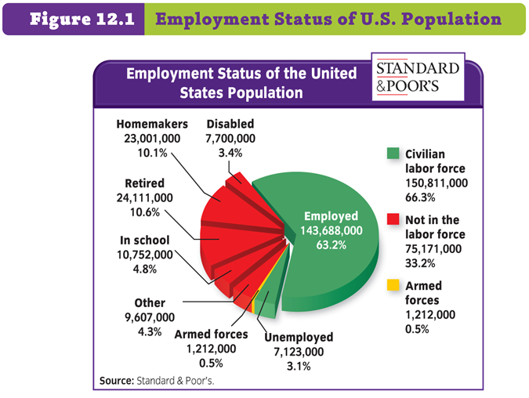
Notes:
PAGE 308

Slide 7
What is the Unemployment Rate?
Why is it important?

Slide 8
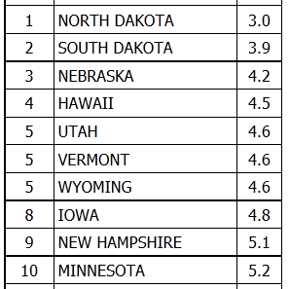
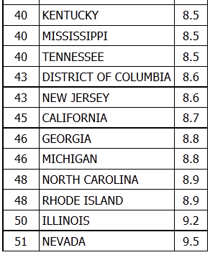
Current Unemployment in the US
10 LOWEST RATES
10 HIGHEST STATES
Notes:
Information provided by the Bureau of Labor Statistics:
http://www.bls.gov/web/laus/laumstrk.htm
BE SURE TO UPDATE!!!
LINCOLN 3.3% ~ OMAHA 4.3&
(According to Google ~ Stats are April 2013)

Slide 9
US Compared to Other Selected Nations
Japan 3.4%
Germany 5.5%
Australia 5.7%
Canada 6.2%
Netherlands 6.9%
United States 7.6%
United Kingdom 7.8%
Sweden 8.0%
France 10.7%
Italy 12.2%
Notes:
Information provided by the Bureau of Labor Statistics:
http://www.bls.gov/fls/intl_unemployment_rates_monthly.htm
BE SURE TO UPDATE!!!

Slide 10
Classifications of Workers
Blue Collar
Employed in crafts, manufacturing, & non-farm labor
Typically work outdoors, or indoors in dirty conditions, work with hands, physical work
White Collar
Employed In office, sales, or professional positions
Typically work indoors, at desks/offices.

Slide 11
Classification of US Workers
SERVICE WORKERS
People who provide services directly to individuals
Can work in many different settings, but usually work where there are a lot of people (Stores, Salons, Dry Cleaners, etc.)
Notes:
PAGE 309
http://en.wikipedia.org/wiki/Collar_workers
Late 1800s & early 1900s many farmers moved to urban areas to take the higher paying BLUE-COLLAR positions…
Name examples of these types of workers
ENTER
WHITE-COLLAR positions make up the largest sector of our work force…
Name examples of these types of workers
ENTER
In recent years we have shifted away from blue-collar jobs to SERVICE WORKERS
Name examples of these types of workers
ENTER

Slide 12
Skill Levels
UNSKILLED WORKERS
Jobs require no specialized training
No Degree needed (High School Diploma not necessarily needed)
Example: Waiters or Custodians
SEMISKILLED WORKERS
Jobs require some training
Often uses modern technology
Certificate
Example: Nursing Aids
Notes:
PAGE 310
UNSKILLED ~ Require some skills…such as patience, ability to pace oneself, work according to a schedule. Most also require the ability to work with other people.
HAVE STUDENTS NAME EXAMPLES OF THESE CAREERS
SEMISKILLED ~ HAVE STUDENTS NAME EXMAPLES
Nurse’s Aid, Para-educator, Para-legal, Technicians
other positions that would assist “professionals”
SKILLED ~ HAVE STUDENTS NAME EXMAPLES
Police, Electricians, Draftsmen, Firefighters, Plumbers, Carpenters, etc.
PROFESSIONALS ~ HAVE STUDENTS NAME EXMAPLES
Teachers, Doctors, Lawyers, CPAs, Nurses,
<<<<<ENRICHMENT ACTIVITIES P12 ~ Requires a Computer Lab>>>>>

Slide 13
Skill Levels
SKILLED WORKERS
Have learned a trade/craft though either education or experience
Associates Degree
Electrician
Police Officer
PROFESSIONALS
Highly educated with college degrees
Usually additional education/training
Bachelors, Masters, PhD
Doctors, Lawyers, Teachers, Architects

Slide 14
SUPPLY & DEMAND 3 Factors Affecting Our Wages
FACTOR #1…
SKILL ~ Talent, Education, Training
Example: Professional Athletes/Actors
COMPARE SCARCITY & WAGES
Doctors v. Supermarket Cashier
Notes:
PAGE 311
Ask the students…
Who is represented by SUPPLY? Laborers/Employees
Who is represented by DEMAND? The Company
What is represented by PRICE? The Wages & Benefits Paid

Slide 15
SUPPLY & DEMAND 3 Factors Affecting Our Wages
FACTOR #2…
JOB TYPE
What is required of an employee in their job
Dangerous & Unpleasant Jobs PAY MORE
Notes:
PAGE 312
Ask students to name some examples of “Dangerous Jobs”
Coal Mining, Oil Rigs, Policemen & Firefighters, Demolition Specialists
Ask students to name examples of “Unpleasant Jobs”
- Trashman, wow…can’t think of anymore today :/

Slide 16
SUPPLY & DEMAND 3 Factors Affecting Our Wages
FACTOR #3…
LOCATION
Where are people hiring for that career?
If finding qualified workers is scarce in an area
Employers will pay more to attract workers
If finding qualified workers is not scarce
Employers will pay less because supply is plentiful
Notes:
PAGE 312
LOCATION EXAMPLE:
Teachers in Alaska
Can the students think of any other jobs/careers where location is a factor?

Slide 17
Restrictions on Wages
If labor markets were perfectly competitive…
Wages would shift constantly based on the supply/demand ratio of that industry
Notes:
PAGE 313
Wage Negotiations
Take into consideration things such as…
The company’s ability to pay higher wages
Length of the negotiated contract
Seniority
Minimum Wage Laws
Designed to protect/help the workers, but some studies show it does the opposite
Increases in minimum wage causes some companies to hire fewer low-skilled workers
This delays the acquisition of job skills by “unskilled workers”
OTHER FACTS ABOUT MINIMUM WAGE
$7.25 – Current Minimum Wage
$2.13 – Current Minimum Wage for Tipped Employees

Slide 18
2 Factors that Restrict Supply & Demand…
Wage Negotiations
Between management & employee labor unions
Minimum Wage Law
Set by the government
http://www.dol.gov/whd/state/tipped.htm

Slide 19
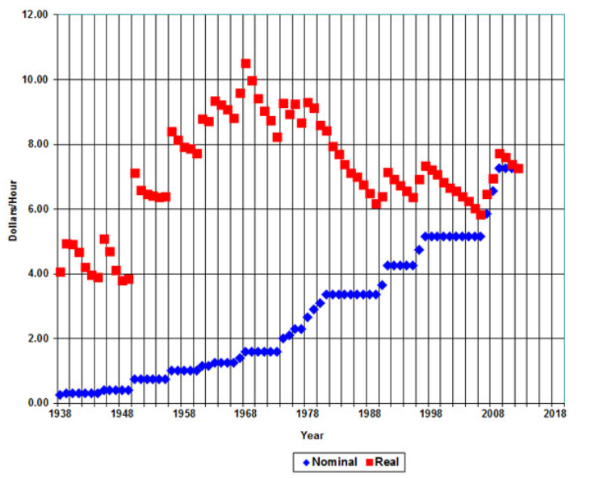
Notes:
Graph provided by Oregon State University: http://oregonstate.edu/instruct/anth484/minwage.html
INFORMATION ABOUT THIS GRAPH
A federal minimum wage was first set in 1938
The graph shows nominal (blue diamonds) and real (red squares) minimum wage values.
Nominal values range from $0.25/hr in 1938 to the current $7.25/hr.
The graph adjusts these wages to 2012 dollars (red squares) to show the real value of the minimum wage.
Calculated in real 2012 dollars, the 1968 minimum wage was the highest at $10.51.
The real dollar minimum wage (red squares) falls during periods Congress does not raise the minimum wage to keep up with inflation.
The minimum wage increased in three $0.70 increments--to $5.85 in July, 2007, $6.55 in July, 2008, and to $7.25 in July 2009.
The 2012 minimum wage is equal to what was paid in 1960.

