Slide 1
Business economics - CHAPTER 2
Economic Systems and the American System

Slide 2
What you will learn
4 basic types of Economic Systems
3 questions answered by each Economic Systems
Major Characteristics of a Market Economy
Goals of the American Free-Enterprise System
Difference between Socialism and Capitalism

Slide 3
Class Starter
Write down the following:
Make a list of your daily activities from the moment you wake up until the time you go to bed at night
If there are different things you do on the weekend (i.e., job), add that to your list
Now add any goods or services you’ve bought recently (hair cut, dr’s appt, etc)
Last, place a star next to any items on your list that you believe are affected by the government
  Answers could include: public schools, buses, sales tax, income tax, drivers licenses, minimum wage laws, roads/bridges,

Slide 4
Main idea:
All economic systems face the same basic questions.
But first…
What is an Economic System?
  The way in which a nation uses its resources to satisfy its people’s needs and wants

Slide 5

Three basic questions:
Notes:
3 questions all governments have to answer

Slide 6
What Should be Produced?
What goods/services should be produced utilizing our limited resources that would most benefit society
  Each economy type has it’s own way of answering this question
    Remember: Our world revolves around scarcity & trade-offs.
      If we make one thing we give up the opportunity to make something else with those same factors of production
Notes:
Think back to your group activities in Chapter One. What decision did you have to make in regards to production?
(Whether or not to produce hats)
Examples
You decide to buy new clothes; you have less money to use to go out with friends
Ford decides to build more Tauruses they have less resources to build Focuses
Local government hires more police officers fewer funds are available to hire more teachers
National government decides to build new roads which means fewer resources to maintain national parks

Slide 7
How Should it be Produced?
What is the best combination of inputs to produce the goods/services
  Human Resources v. Capital Resources
  Human Resources
    Skilled Laborers v. Unskilled Laborers
      Do they need the “E” Factor???
  Natural & Capital Resources
    Expensive v. Inexpensive Materials
Notes:
Every decision has different trade-offs that would apply
Goal is to use the best combination of inputs to make a product with the lowest cost
The “E” Factor – Experience and/or Education make you a skilled laborer

Slide 8
For Whom Should it be Produced?
Determined by the type of economic system you live in
  The American economic systems distributes:
    Public goods to everyone
    Private goods via the price system
  Other distribution systems include
    Majority Rule
    Lottery
    First-Come/First-Serve
    Military Force

Slide 9
TYPES OF GOODS
PUBLIC GOODS
PRIVATE GOODS
Everyone has the same accessibility
  Education
  Roads
  Police/Fire Protection
  Parks
Only those that can afford it have access
  Private Education
  Houses
  Cars
  Clothing
  Restaurants
  Concerts
  DVDs
  TVs

Slide 10
Types of economic systems
Command economy
Mixed economy
Market economy
System in which economic decisions are based on customs and beliefs that have been handed down from generation to generation
Government controls the factors of production & makes decisions about their use
Combines the characteristics of the command & market economies
Individuals own the factors of production & make economic decisions through free interactions
Traditional economy

Slide 11
Traditional economy
The “way it’s always been done”
Your career will be whatever your parents is now
Advantage
You know what is expected of you – you will produce what your parents produced
Strong family and community ties
Disadvantage
Change in economy is discouraged and sometimes punished
Rarely have an increase in material well-being
Examples
Democratic Republic of Congo
Aborigines of Australia
Tribes in Africa
Few choices for goods & services
Turn to page 36
Notes:
The Mbuti of the Democratic Republic of the Congo in central Africa retain the elements of a traditional economy. They are hunters-gatherers, and the roles of the group members are set by custom and tradition.

Slide 12
TRADITIONAL ECONOMIES
Why do you think leaders in Traditional economies discourage or even punish change?
  Fear of outside influence
  Lack of understanding of alternative modes of production
  Determination to preserve culture
  Power structure tied to tradition and custom
Notes:
BEFORE DISPLAYING THE ANSWERS…make sure you give students a chance to guess

Slide 13
Command system (CONTROLLED)
Disadvantages
Individuals paid according to what central planners decide.
Lack of consumer choices
Might not be able to choose own career.
Lack of incentive to work hard
Examples
North Korea
Parts of the People’s Republic of China
Turn to page 37
Notes:
The book does not give any advantages…but can you think of any?
Will see what they can think of…I’ve got nothing off the top of my head today ;)

Slide 14
Command system
AUTHORITARIAN SOCIALISM
Democratic socialism
Supports revolution as means to overthrow capitalism
Entire economy controlled by a central government
Can be found today in
  China
  Cuba
  Many Latin American nations
Works within the constitutional framework of a nation
Socialist officials are elected to office
Government only controls some areas of the economy
Can be found today in
  France
  Germany
  Italy
  Select European nations
Notes:
Strong command
State makes all economic decisions and controls all resources for the common good
Countries: China, Cuba, Many Latin American countries
Moderate command
The state owns major resources, while some businesses are privately owned
Countries: France, Sweden

Slide 15
market system (capitalism)
MARKET – A voluntary exchange of goods and services between buyers and sellers
  Economic decisions are made in the marketplace according to the laws of supply and demand.
  Prices signal what is bought and sold – High (scarce) or low (abundant)
Advantages
Individual Choices
Competition provides choices and better products
Choices, choices, choices
Disadvantages
Old, young, and sick that can’t work – who provides for them?
Careers, how to spend money, own property, option to take risks and earn profits
Examples: United Kingdom, India, Sweden

Slide 16
Mixed economy
Combines elements of both pure market and command systems
Most countries have a mixed economy –
including the United States
Individual Level:
Your own money situations – spending, investing, etc.
Local, State & Federal Government
Make laws protecting private property & regulating parts of business
Environmental protections, Safety guidelines, and consumer protection
Individuals can own property and make decisions but have government regulations to follow

Slide 17

Circular flow model
Businesses Sell goods and services to individuals
Individuals pay for goods and services they buy from business
Businesses Pay Taxes
Individuals Pay Taxes
Gov’t benefits to businesses
Gov’t benefits to individuals
Businesses pay for resources they buy from individuals
Individuals sell resources to businesses
Page 39

Slide 18
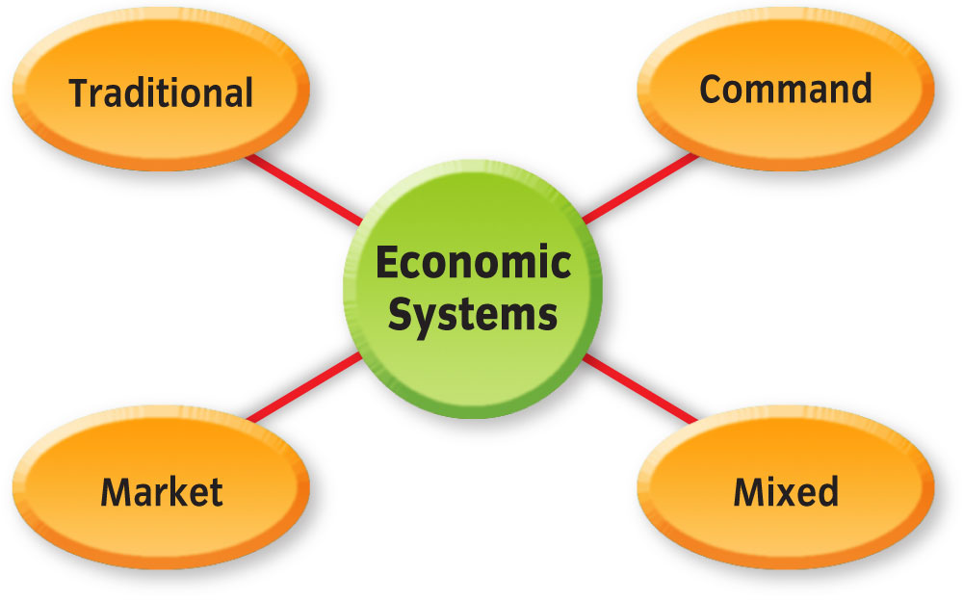
Who controls factors of production for each system?
Notes:
Traditional – Based on Customs/Beliefs
Command – Government
Market – Private Individuals
Mixed – Both Individuals & Government

Slide 19
Characteristics of U. S. Economy
US Economy
Limited Role of Government
Competition
Private Property
Freedom of Enterprise
Freedom of Choice
Profit Incentive

Slide 20
Limited RolE of Government
Governmental Role has increased since 1880’s in the U.S.
Often called “Laissez Faire” when pure capitalism exists -- which is French for “let it be”
Capitalism as practiced in the U.S. today would be best defined as an economic system in which private individuals own the factors of production but use them within certain legislated limits
  Includes regulations, laws and taxation
    Govt regulates the quality of various food & drugs, watch over nation’s money & banking system, tax revenues, Social Security, etc.
Notes:
LEAD WITH:
In Adam Smith’s 1776 book, Tan Inquiry into the Nature & Causes of the Wealth of Nations, he descirbes a system in which government has little to do with a nation’s economic activity.
He said that individuals left on their own would work for their own self-interest. In doing so, they would be guided as if by an “invisible hand” to use resources efficiently and thus achieve the maximum good for society

Slide 21
Freedom of Enterprise
You are allowed to own your own business
  However must follow any government guidelines
You are able to earn a profit or lose everything
  No guarantees or insurances by the government
How many Lincoln businesses can you name that are owned by local citizens?
  Union Bank, B&R Stores, Runza, Amigos, Cornhusker Bank, Art & Soul…and many more!!
Notes:
Another “nickname” of the American economic system is the “Free Enterprise” system

Slide 22
FREEDOM OF CHOICE
Buyers make the decisions about what should be produced
  Government does intervene to protect consumer rights
    Safety standards on toys, cars, etc.
    Public utilities (government might regulate prices)
Think of an item you purchased but did not like
  Did you ever purchase it again?
Have you ever wanted to purchase an item but could not find it?
  Buyers determine if a product will remain on the market or not
Notes:
Your actions in the market play into the “big picture”!
When you purchase an item or do not purchase an item you are basically voting for/against the item
Businesses look at how well their items sell (not sell) when deciding what they should produce in the future

Slide 23
Profit Incentive
Profit – an amount left after all costs of production have been paid
Profit Incentive – the desire to make a profit
  Motivates entrepreneurs/businesses to produce new goods/services & improve existing ones
  Encourages businesses to be competitive!!
Losses also help the economy
  Signals to businesses it is time to shift resources to fulfill other needs/wants in the economy

Slide 24
Competition
Leads to efficient use of resources
  Prices must stay low to attract consumers
    Must efficiently use of resources to keep costs low
The more businesses in an industry the better
  Monopolies are not allowed in the US
        Another government intervention on our economy…but a good one
Notes:
Muffin Game – 3 Volunteers – Ask Sam what this is??
Name a product that has a lot of competition.
Name a product that has little or no competition.
Without competition, consumers have little or no choice in products.
What is a monopoly?

Slide 25
Private Property
One of the most important characteristics!!
  Recognized by Our Founders in our Constitution
An invisible engine for creating wealth & prosperity for all citizens
Government cannot take your property…
  Unless they pay for it
    Eminent Domain allows the government to force you to sell your property if by taking your property it will benefit the good of society as a whole.
Notes:
Even though you own your property you must still abide by government rules/regulations.
Make a list of items that you own
Place a star next to any items that you could use to “generate wealth”
How many of you own a car? How does the government regulate your use of this property?
Require you to license and register your vehicle
Require you to have a personal driver’s license (and pass their test) to drive
Require you to have adequate insurance coverage
Houses…government regulates what you do on your own property
Name some ways the government regulates your home
Property taxes
Must follow city guidelines for home repairs/addditions
May regulate your ability to tend your yard…2012 summer water restrictions

Slide 26
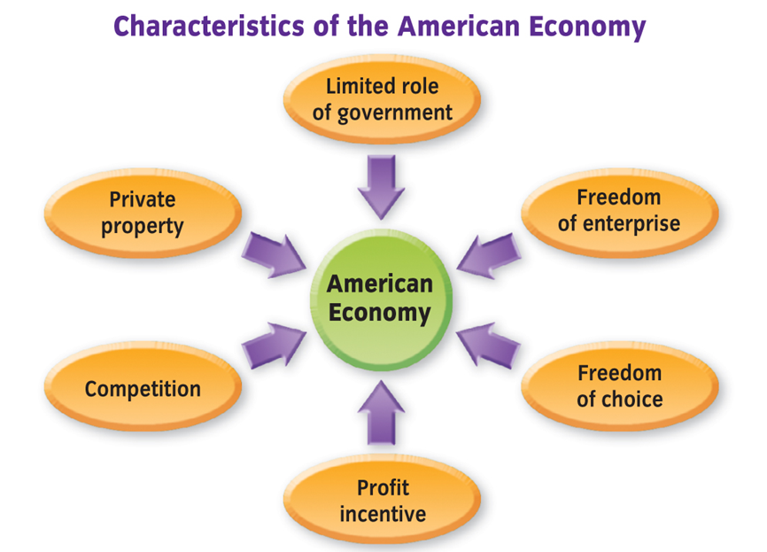
Notes:
Demonstrates how the market system works

Slide 27
Goals of Free Enterprise
Freedom
Efficiency
Equity
Security
Stability
Growth

Slide 28
Freedom
We have one of the highest degrees of freedom in the world
  Start business
  Own private property
  Make decisions in marketplace
  Pursue other economic choices
Notes:
Probably one of the highest levels in history (well pre 9/11)
We as individuals must face the consequences of our freedom choices
Freedoms sometimes make us susceptible to attacks or other problems.

Slide 29
Economic Efficiency
Wise use of available resources to obtain the greatest benefits
  Helps keep resource scarcity in check

Slide 30
Economic Equity
Attempt to balance economic policy so everyone benefits fairly
Encourage policy makers to pass laws
  Equal pay for equal work
  Fair hiring practices
  Help for disabled workers

Slide 31
Economic Security
Protection against risks beyond our control
Our system provides security through a number of government social programs
  On the job accidents
  Natural disasters
  Poverty in old age
Protection provided through both government social programs & private companies
Notes:
Social Programs – FEMA, Social Security, Medicare/aid
Private Companies – Insurance (Home, Auto, Disabled)

Slide 32
Economic Stability
Goal is to reduce extreme ups and downs in standard of living
Standard of Living is how well we live
  Measure by value of goods/services used in given time period
    US has more individuals enjoying a high standard of living than almost anywhere else in world
  Rich Man, Poor Man

Slide 33
Economic Growth
Expansion of the economy to produces more goods, jobs & wealth
  As our population increases our economy must also expand
All nations have economic growth as a goal

Slide 34
Rights & responsibilities
You have the RIGHT TO…
  Work as much or as little as you want
  Enter any career/job that you want
  Live where you want
  Purchase the goods/services you want
You are RESPONSIBLE FOR…
  Supporting yourself & your family
  Getting & using an education to become an active member of our society/economy
  Electing responsible government officials

Slide 35
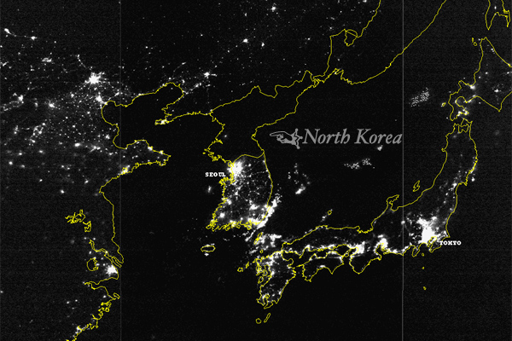
Socialism v. capitalism
To see the difference…
…you may need a taller chair.

Slide 36
Pure socialism
Economic System in which the government:
  Owns almost all the factors of production
  Attempts to manage production & distribution of goods
Very little private property

Slide 37
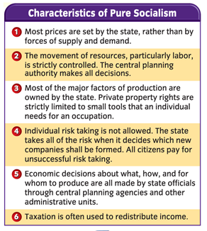
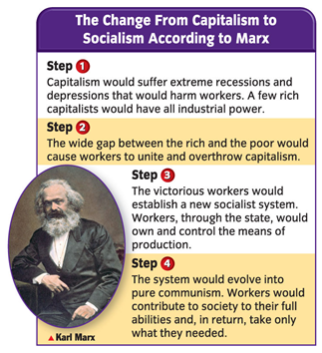
The pure Socialism 411
Notes:
KARL MARX
Viewed history as a struggle between classes in society
CAPITALIST vs. PROLETARIAT
Believed Capitalist exploited the proletariat
Believed profit made from products belonged to the proletariat not the Capitalist
Believed Capitalism was doomed to fail
Predicted the evolution of Socialism into Communism
Ideally Communism is a system with no need for a government
Ironically Communist systems are heavily controlled by the government

Slide 38
CAPITALISM
BENEFITS
MOST CRITICIZED FOR
More efficient marketplaces
Greater rates of economic growth
Highly planned economy which involves:
  Private Firms
  Individuals
  Elected Government officials
Unequal distribution of income
Not enough publicly funded schools & museums

Slide 39
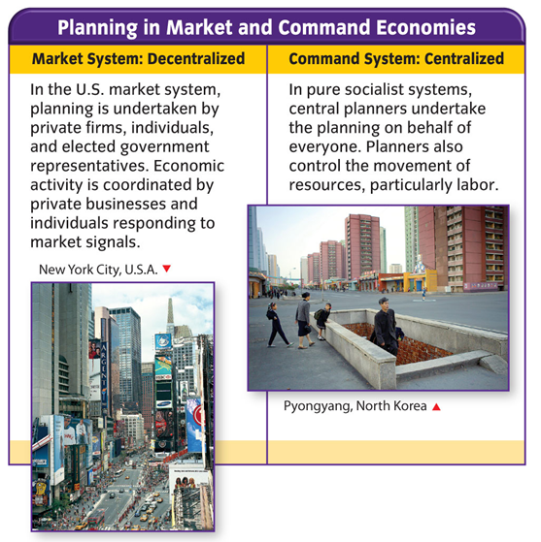
Planning is unavoidable, no matter what the economic system
The United States has a highly planned economy.
The difference between economic planning in the United States and in command economies is who does the planning.
Notes:
PLANNING IN COMMAND ECONOMIES
- The Olympics were hosted in Beijing in 2008. The area in Beijing where they were hosted was revamped and cleaned up prior to the games coming to town. Chemicals were even shot in the air to clear away the smog!!
Government was highly involved in this planning!!
PLANNING IN MARKET ECONOMIES
The Pinnacle Bank arena, while owned by the city, is a good example. While the city laid out the groundwork for the Arena they brought in private companies to build it and will bring in a private company to run the day-to-day operations.
The city also made changes to zoning and other restrictions in the Haymarket area that would allow for more businesses to come in and be part of the new arena area…this will foster growth not only in the Haymarket but throughout Lincoln!

