Slide 1
Chapter 18 Trading with other Nations
Business Economics
Mr. Jarosz

Slide 2
Chapter Objectives
At the end of this chapter you will
Understand the importance of trading with other nations
Know how nations convert their different currencies in order to trade more easily with each other
Know about recent international trade agreements and restrictions
Notes:
Have the students write a paragraph in their notes on the following prompt:
“What are the benefits and the drawbacks of a nation trading their goods/services with another nation?”
5 Minute writing time
5 Minute discussion
Read “Places in the News” on page 465

Slide 3
The Benefits of Trade
Goods sold to other nations makes up 15% of the US GDP
Imports
Goods bought from other countries for domestic use
Coffee, chocolate, and pepper are all items not available in the US
60% of radios, TVs, and motorcycles bought in the US are foreign
Exports
Goods sold to other countries
40% of US engineering & scientific instruments are sold to foriegn consumers
Notes:
SECTION ONE
465-466
BULLET ONE
REVIEW…what is GDP again?
Gross Domestic Product…the total value of all the goods produced and bought in our economy in a year.
What would happen to American jobs if we did not sell our goods to other countries?
After Imports/Exports Bullets
Ask students for the factors that encourage nations to trade with one another
Factors of Production
Different nations have different resources/factors of production
America is known for abundant resources, highly skilled labor, large amounts of capital (equipment/machines)
Other countries could have similar natural resources, but if they don’t have access to the same human and capital resources their economy would look very differently
Don’t always have everything that they need for their economy

Slide 4
Absolute Advantage
Ability of one country to produce more output per unit of an input than another country
LAYMAN’S TERMS…
A country can produce more of an item at a cheaper cost than another
No nation on Earth can completely provide for themselves at the cheapest costs
Opportunity Costs must be taken into consideration
Only so many resources available (even in the US)
SPECIALIZATION is required for nations to be truly successful in international trade
Notes:
467 (468 Specialization)
Ask the students to think of their strengths and weaknesses…
Do they benefit from working with other students/people?
Do their weaknesses make them less apt to work with others?
REVIEW OPPORTUNITY COST…
The cost of an item that is given up for the item that was chosen
Have the students name off things that other nations (or states) can produce better than another
Book Example: Bananas: Brazil v. France – Brazil’s tropical climate and cheaper labor costs make give it an advantage
Oil: OPEC v. US – The abundant resources that they have and the network of distribution they have developed give OPEC AA
Leisure & Pineapples: Hawaii v. Nebraska
Corn & Beef: Nebraska v. Florida
Ask students what SPECIALIZATION means and why it is important?
A nation produces and exports a limited assortment of goods for which it is particularly suited for
Must have the resources…see above in Absolute Advantage
It is good because it allows a country to use the resources it has effectively and efficiently
Allows a country to trade those goods for other goods they need

Slide 5
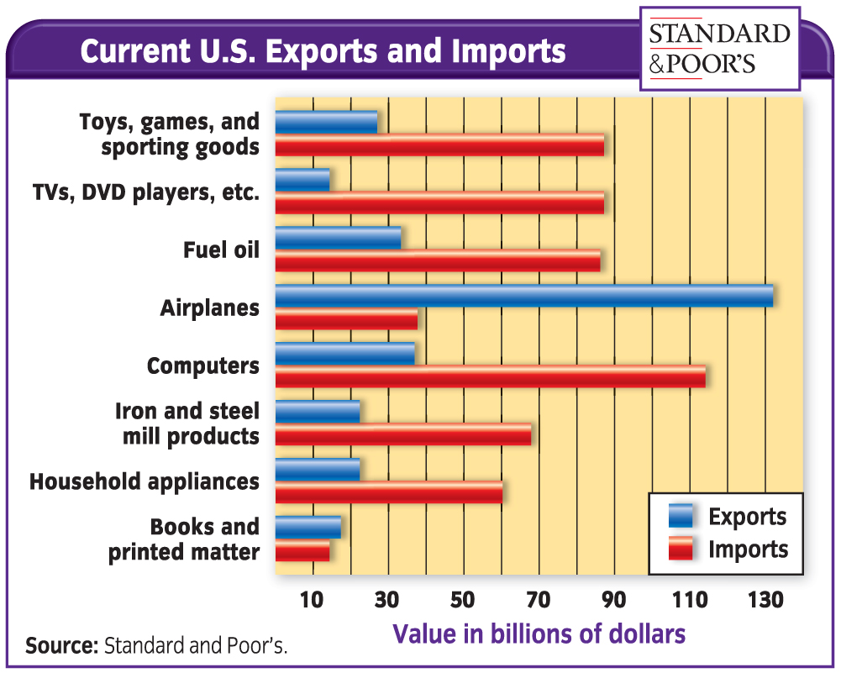
Notes:
467

Slide 6
Comparative Advantage
Ability of a country to produce a product at a lower opportunity cost than another country
A nation does not need ABSOLUTE advantage to successfully export
It only needs a COMPARATIVE ADVANGATE
READ PAGES 468-469
Notes:
468-469
Have the students read out loud the information on the above pages. As they go put the statistics for both countries on the board
Pause intermittently to explain
Why Alpha has an absolute advantage in both Corn & Soybeans
Why Beta has a comparative advantage in Soybeans

Slide 7
End of Section One
What is the United States #1 Export?
What is our #1 Import?
Who is our #1 Exporting Country?
Who is our #1 Importing Country?
http://atlas.media.mit.edu/
Notes:
CREATE A NEW WORKSHEET…
Divide students up into 6 groups
Each group will be a continent
Each member of each group must select a different nation on that continent
Each member will use the website above to find the “Top 3” to the answers listed above
Each group will then put together a poster board displaying the “Top 3 items from all of their countries listed in order of most to least
Each group’s poster should include pictures of items that are most imported/exported (Top 3 of each continent)
TERM 2 2013 – Lab A220 second half of Blocks 1 & 2 on Tuesday 10th
8:52 & After Lunch…may have to finish up the posters on Wednesday morning

Slide 8
Exchange Rates
The price of one nation’s currency in terms of another nation’s currency
LAYMAN’S TERMS…
How much your money would be worth in another country
EXAMPLE…
$1 American would be worth only .73€
1€ would be equivalent to $1.37
FOREIGN EXCHANGE MARKETS
Markets dealing in buying/selling foreign currency for businesses that trade internationally
http://www.xe.com/currencyconverter/
Notes:
SECTION TWO
471
470 – Have the students read out loud about David Chu…ask the students question #2…why did he go back to work after he retired???
471 – Read the “Issues in the News”
Consumers who need to exchange currency before/after travel can do so at select banks
You can also use ATMs while travelling
You will receive the currency of the current nation you are in
It will bill your US bank account in US dollars
International Fees & Standard ATM Fees apply

Slide 9
Fixed Rate of Exchange
System under which a national government sets the value of its currency in relation to other currencies
Foreign Exchange Markets operated with Fixed Rates of Exchange from 1945-early 1970s
Advantages
Importers/Exporters knew exactly how much of a foreign currency they could purchase with their own nation’s currency
Allowed central banks to affect the level of exports/imports by devaluing the currency of other nations
Was supported by the International Monetary Fund
Notes:
473
Advantage #1
If the rates were not fluctuating daily you would be able to easily make decisions about whether you wanted to invest in foreign currencies
Advantage #2
Banks did not make the decision to devalue another nation’s currency…government officials made that call, but banks would have to follow
This would make it easy for the government to influence individual investors into buying/not buying things from certain countries
IMF – Agency whos e members once were obligated to keep their foreign exchange rates more or less fixed; today it offers monetary advice and provides loans to developing countries.

Slide 10
Notes:
473
DEVALUATION – Lowering a currency’s value in relation to other currencies by government order.
Discuss with the students why a country might want to devalue the currency of another nation
How would this example influence the import of MP3 players from China?
It would encourage more imports from China
What could we do if we wanted to discourage the import of MP3 players?
Increase the valuation of the Chinese Yuan
What would this devaluation mean for Americans traveling to China for a vacation?

Slide 11
Flexible Exchange Rates
Arrangement in which the forces of supply and demand are allowed to set the price of various currencies
Fixed Exchange Rates came to an end on August 15, 1971
President Richard Nixon’s “Address to the Nation Outlining a New Economic Policy: ‘The Challenge of Peace’.”
DEPRECIATION happens when there is a fall in the price of a currency due to supply & demand
This has taken the place of DEVALUATION in the “Flexible Exchange Rate” system
Notes:
474
Many interesting pieces that can be looked at in Nixon’s speech that are applicable to what we have covered in class. For this specific portion scroll down to the text in blue
- Discuss with students the different pieces in his speach

Slide 12
Flexible Exchange Rates
EXAMPLE:
Amt of $ wanted by Mexican Exporters > Qty of $ Supplied by Amer. Importing Mx goods
Demand > Supply
American Dollar becomes more expensive than the Mexican Peso
Mexican Peso depreciates in value
Currency now fluctuates on a daily basis
http://www.oanda.com/currency/historical-rates/
Notes:
474
After Example
Explain to the students how the opposite would work. If Supply of American dollars to buy Mexican goods was greater than the Amount of money Mexican exporters demanded the Peso would APPRECIATE in value
Website
Select the date from the same day in 1998 (didn’t go back any further than that when I tried today)
Show students how the value of the dollar has changed against the Euro
Ask them what this would mean as far as trade goes between the nations at different points?
Ask how this would affect travel plans (tourists) visiting from Europe to America and vice versa?

Slide 13
Balance of Trade
Difference between the value of a nation’s exports and its imports
If a nation’s currency depreciates, or becomes “weak”
Nations will likely export more goods because products become cheaper for other nations to buy
If a nation’s currency appreciates, or becomes “strong”
Nations will likely import more goods because products become more expensive for nations to buy
Positive Balance of Trade
Imports > Exports
Negative Balance of Trade
Exports > Imports
Notes:
475-476
Important to realize that a continued trade deficit is not necessarily a bad thing
Deficit continues because there are opportunities for foreigners to invest in the US economy
Many Japanese automobile companies have build factories in the US to satisfy the US demand for Japanese cars
Creates supporting industries that benefit US citizens by providing many domestic jobs

Slide 14
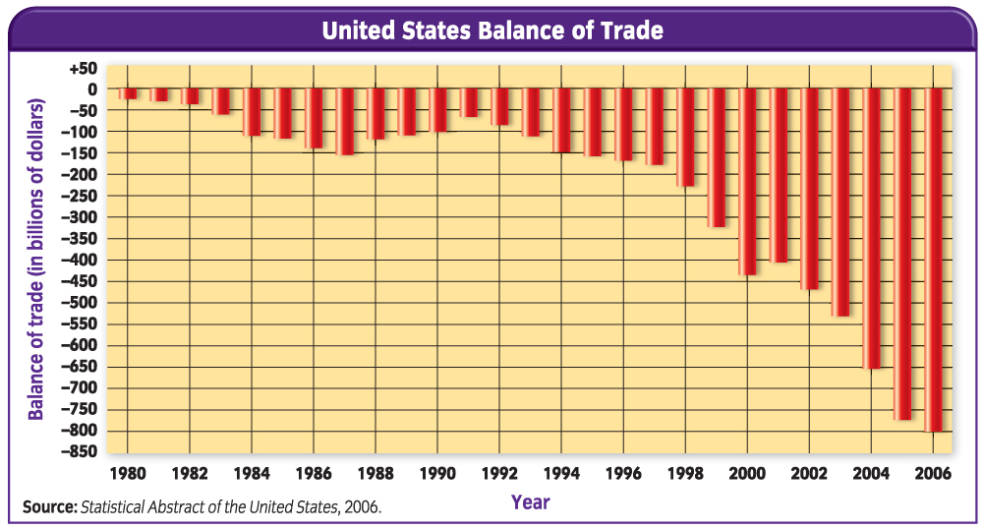
Notes:
475
http://blog.bea.gov/category/trade-deficit/
12/7/2013
The U.S. monthly international trade deficit decreased in October 2013 according to the U.S. Bureau of Economic Analysis and the U.S. Census Bureau. The deficit decreased from $43.0 billion in September (revised) to $40.6 billion in October as exports increased more than imports. The previously published September deficit was $41.8 billion. The goods deficit decreased $2.2 billion from September to $60.2 billion in October; the services surplus increased $0.1 billion from September to $19.6 billion in October.

Slide 15
Barriers to Trade
Besides Currency there are other things that restrict trade between nations.
What are some other restrictions?
Linguistic
Cultural
Logistical
Governmental
Notes:
SECTION THREE
477
Read the “Issues in the News”
What do the students think about “quotas”? Should we bring them back? What would happen to consumers if we did that?

Slide 16
Ways to Restrict Imports
Governments will use different tactics to restrict imports coming into their nation
TARIFFS
Tax placed on an imported product
TWO TYPES OF TARIFFS
Revenue
Used to raise money for the government without restricting imports significantly
Protective
Used to raise the cost of imported goods & protect domestic producers
Rates have been as high as 62% of the value of the imported goods
Notes:
478
Tariffs count for only 2% of the national government’s income. They were the major soucce of funding until the early 1900s
AFTER REVENUE
It says that it will not significantly restrict the imports, but do you think it has a major factor?
Yes because when prices are higher for an item people are less likely to buy them (supply & demand)
AFTER PROTECTIVE
Could have the students pick one side or the other and write a short response as to why they would/would not like protective tariffs
Ask students for some reasons to have protective tariffs
Ask for reasons not to have protective tariffs
Discuss the above for al ittle bit before switching to the next slide

Slide 17
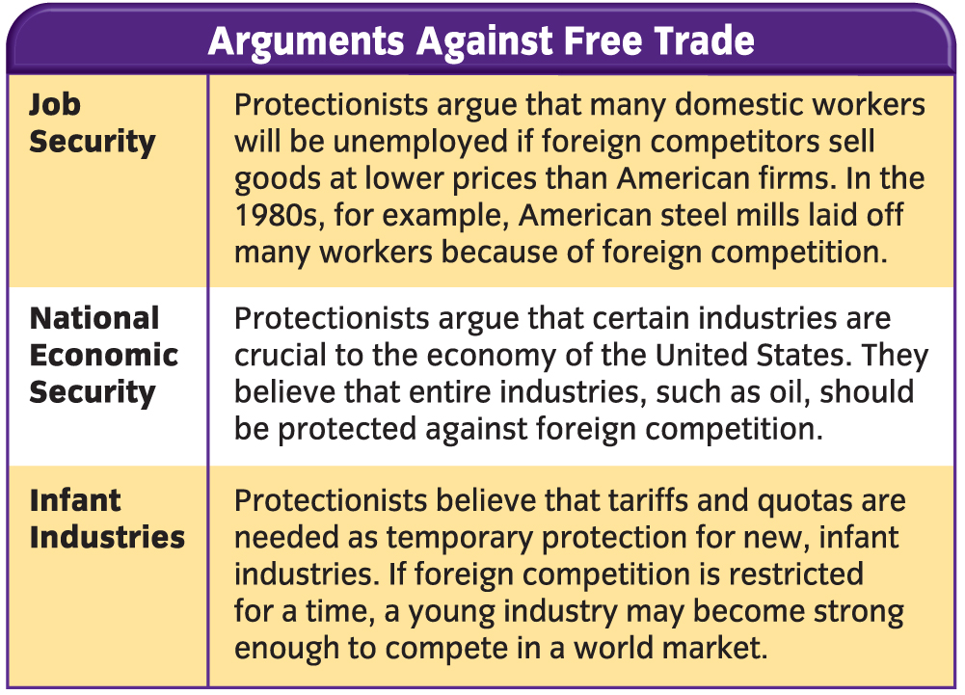
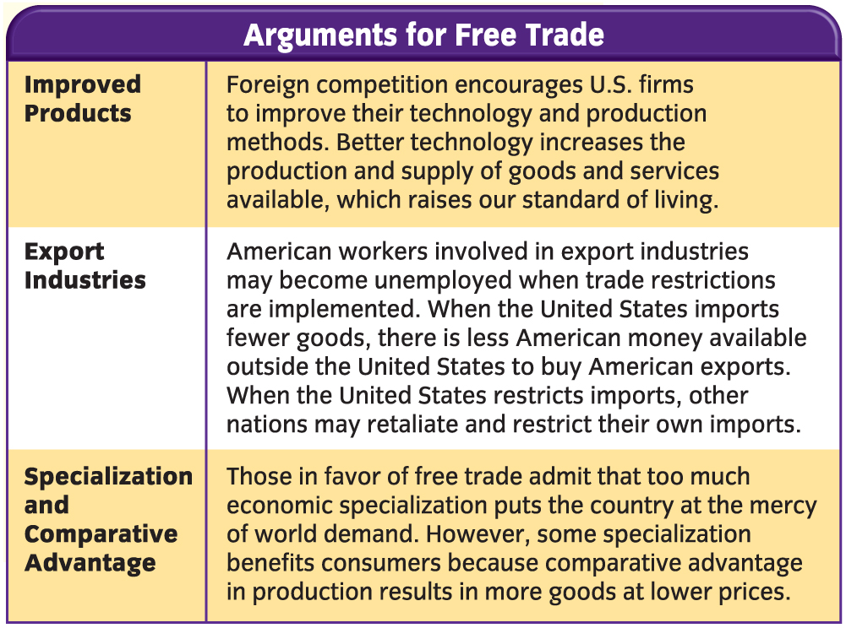
Notes:
478-479
**Text from the Book ~
Free trade makes more products available to consumers at the best prices, but it also exposes domestic workers to greater foreign competition. Most Americans are neither completely for nor completely against free trade. They recognize that it carries both benefits & drawbacks, both for Americans and for citizens of countries we trade with.
PROTECTIONIST – Are people who argue for trade restrictions to protect domestic industries
- Believe certain restricions are necessary to protect domestic industries

Slide 18
Ways to Restrict Imports
QUOTAS
Restriction imposted on the number of units of a particular good that can be brought into the country
EMBARGOES
Complete restriction on the import or export of a particular good (or goods) to/from a specific country
Usually put in place for political reasons
2003 against Syria for its support of terrorism
Against Cuba for over 4 decades
In December of 2013 Iran negotiated to have some restrictions removed from multinational embargoes imposed on it
Notes:
479
What did Iran plan to offer as a trade for the international community to ease up on embargoes?
Deregulate its nuclear industry…un-weaponize it

Slide 19
International Trade Agreements
WORLD TRADE ORGANIZATION
World’s largest trade agreement, currently with more than 150 member nations
Made decisions in the early 2000s that had a direct impact on the US Steel Industry
Currently working to break down trade barriers in agriculture
Notes:
480
International trade agreements are negotiated to reduce trade restrictions between countries.
There have been continuing and constant efforts worldwide to reduce tarrifs and encourage more world trade
Some would argue that not having trade restrictions will hurt some countries economies as they lose jobs to other countries that can do it at a cheaper price or more efficiently. What do you think about this?
In a complete free market economy (worldwide) this would be the best way to make sure resources are used most efficiently around the world
Jobs would not be lost so much as converted to jobs that would benefit that country the most and best use its resources

Slide 20
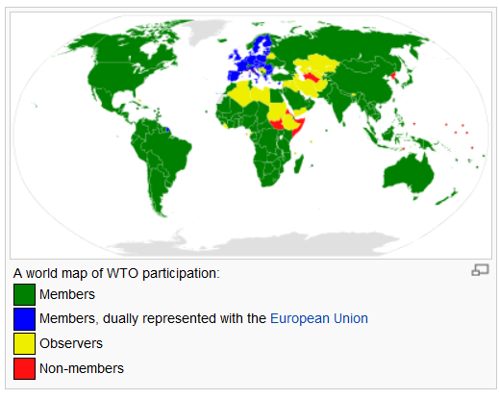
Notes:
FROM WIKIPEDIA…don’t judge :P
http://en.wikipedia.org/wiki/List_of_member_states_of_the_World_Trade_Organization
The WTO currently has 159 members^{[10]} (almost all of the 123 nations participating in the Uruguay Round signed on at its foundation, almost all of the rest of the GATT members followed,^{[12]} and 29 others became WTO observers and subsequently got membership). The 28 states of the European Union are dually represented, as the EU is a full member of the organization. Non-sovereign autonomous entities of member states are eligible for separate membership, since WTO members do not have to be full sovereign nation-members. Instead, they must be a customs territory with full autonomy in the conduct of their external commercial relations. Thus Hong Kong became a GATT contracting party, by the now terminated "sponsorship" procedure of the United Kingdom (Hong Kong uses the name "Hong Kong, China" since 1997), as did Macau. A new member of this type is the Republic of China (Taiwan), which acceded to the WTO in 2002, and carefully crafted its application by joining under the name "Separate Customs Territory of Taiwan, Penghu, Kinmen and Matsu (Chinese Taipei)"^{[13][14]} so that they were not rejected as a result of the People's Republic of China One-China policy.

Slide 21
Regional Trade Agreements
NORTH AMERICAN FREE TRADE AGREEMENT
NAFTA
Canada, Mexico, & United States
CENTRAL AMERICAN FREE TRADE AGREEMENT
CAFTA
Costa Rica, El Salvador, Guatemala, Honderas, Nicaragua, Dominican Republic & United States
EUROPEAN UNION
EU
28 Member Nations
Common Currency…the Euro
The EU Economic Zone now rivals the United States as far as economic wealth & production
Notes:
481
Regional trade agreements are designed to reduce and gradually eliminate tariffs between countries in a geographical area
Idea is that it will benefit all involved and allow all members to most effectively use their resources
CHECK OUT “BUSINESS WEEK” about Sweatshops on page 482
-end-

