Slide 1
Chapter 16
Government Spends, Collects, and Owes

Slide 2
Chapter Objectives
Realize how the size and spending of government at ALL levels have increase over the last century (16-1)
Understand the responsibilities of government (16-2)
Understand how the federal government prepares a budget and borrows funds (16-3)
Know the major principles and forms of taxation in the United States (16-4)
Notes:
As you will recall from Chapter 2 the United States is not a Pure Market Economy
Our government has various amounts of control in our lives
Have students review what the government has control of in our lives
Schools, transportation, property, local and national security, etc.

Slide 3
Government Growth
More than 22 million civilians work for the government
In 1929 only 3 million worked for the government
Represents a 735% growth in government jobs
US Population has doubled since 1929
123 million to 281 million
Growth attributed to
An increase in the population
An increase in government functions
Transportation
Education
Product Safety
Worker Safety
Taxation
Notes:
SECTION ONE
414-415

Slide 4
Government Growth
1960s
Most spending was done by the Federal Government
1970s
More responsibility was taken on by the State Governments
Currently
State spends more than Federal
Notes:
415

Slide 5
Government Spending
FEDERAL GOVERNMENT
STATE GOVERNMENTS
National Defense
Salaries of
Congress
Federal Judges
Employees of the Executive Department
PUBLIC WORKS PROJECTS
Publicly used facilities such as schools & highways. Built by federal, state, or local governments
Sewers
Roads
Schools
Prisons
Salaries of State Workers
State Guard Programs
Notes:
415
Can you imagine what the US would be like if we didn’t have government sponsoring of Public Works??

Slide 6
What Caused the Growth???
GREAT DEPRESSION
More need for government services
Government created “Public Works Projects”
Gave citizens the opportunity to get out of unemployment
WORLD WAR II
A BIG driver of the Economy
Equipment, ammunition, food, & other supplies
SINCE WWII
As the nation became richer
Greater demand of government services by poorer Americans
Attempt to equalize income inequalities
TODAY
19% of our GDP is Government Spending
Notes:
416-417
19% does not include interest payments on national debt or transfer payments (like welfare program)
If you included these it would be over 33%!!
GOOD OR BAD?
All government taxing/spending has opportunity costs associated with it
Would have to look at each item to decide if it is good or bad
Cannot decide as a whole

Slide 7
Public Goods
Goods/Services that can be used by many individuals at the same time without reducing the benefit each person receives
Provided for by various levels of government
Some services are provided by all levels of government
Court System
Correctional Facilities
Law Enforcement Agencies
Most important public good provided for in our country…
A Sound System of PROPERTY RIGHTS
Allows individuals to OWN the Factors of Production
Notes:
SECTION TWO
417

Slide 8
Merit v. Demerit Goods
MERIT GOODS
Goods that have been deemed socially desirable by government leaders
Museums, Ballets, Classical Music Concerts
Government may subsidize these goods to gain taxpayer support
DEMERIT GOODS
Goods that have been deemed socially undesirable by government leaders
Tobacco, Alcohol, Gambling
Government may tax, regulate, or prohibit these items to deter taxpayers from manufacturing, selling, or using them
Notes:
419
Ask students to name other examples of both

Slide 9
Promoting General Welfare
Government function that provides for the public well-being of citizens in need of additional assistance
These citizens are unable to provide enough income for themselves to live at a “tolerable” level
Elderly
Ill
Poor
Accomplished through INCOME REDISTRIBUTION
Using tax receipts to assist citizens in need
Notes:
420

Slide 10
Promoting General Welfare
SOCIAL-INSURANCE PROGRAMS
Pay benefits to retired & disabled workers, their families, & the unemployed
Programs include:
SOCIAL SECURITY (Federal)
Income for individuals who are retired/unable to work
Generally not enough income for someone to live on fully
Citizens should plan ahead and save for their own retirement
WORKERS’ COMPENSATION (State)
Extends payments for medical care to workers injured on the job
UNEMPLOYMENT INSURANCE
Provides temporary assistance to people who are unemployed through no fault of their own
Does not apply to people who quite voluntarily
Recipients are expected to be actively seeking new employment
Notes:
420-421

Slide 11
Promoting General Welfare
PUBLIC-ASSISTANCE PROGRAMS
Make payments to citizens based on need
Does not matter what the person’s age is or if they have paid taxes into the system already
Programs include:
SUPPLEMENTAL SECURITY INCOME (Federal)
Includes food stamps and payments to the disabled and aged
Makes payments to those who have little or no income
Provides for basic needs such as food, clothing, shelter
TEMPORARY ASSISTANCE FOR NEEDY FAMILIES (State)
Provides assistance and work opportunities to needy families raising young childiren
MEDICAID (Federal & State)
Helps pay health care costs for low-income & disabled persons
Notes:
421
What is the difference between social insurance and public assistance programs?
social – pay benefits using taxed that workers and employers have paid into programs
public – make payments based on need, regardless of whether a person has paid taxes into the program
Page 424 case study

Slide 12
Regulation & Economic Stability
Notes:
422
Ask students how the government is involved in each of these four areas
Have students write down how the government is involved in each of these
Go around the room to watch for participation
Call on students to share what they have one of the four items
Protecting Consumers ~ All the programs that help regulate safety in manufacturing and distribution (FDA)
Promoting Competition ~ Restricting monopolies to help keep businesses competitive, prices low, and customers happy
Supervising Labor/Management ~ Laws that have been put in place to allow/restrict Unions
Regulating Negative By-Products ~ EPA

Slide 13
Regulation & Economic Stability
Regulating Economic Activity
Government intervenes in the Economy to
Protect Consumers
Promote Competition
Supervise Labor & Management Relations
Regulate Negative By-Products – a.k.a. EXTERNALITIES
Externalities affect an uninvolved third party either negatively or positively
Ensuring Economic Stability
Smoothing the ups/downs in the nation’s overall business activity
Sought to shield citizens from the harmful effects of business fluctuations
Unemployment
High Inflation
Recessions/Depressions
Notes:
423
Ensuring Economic Stability – CHAPTER 17 focuses a lot on this topic
Critics of Government Involvement
Merit goods should be provided by private organizations instead of being funded by taxpayer dollars
This would allow people to pay fewer taxes & have more disposable income
What do you think about this?
Opponents of REDISTRIBUTION PROGRAMS think government assistance…
Discourages personal initiative
Afffects incentives
Harms self-development
Critics of GOVERNMENT REGULATION believe…
Regulation raises the prices of goods/services
A better approach would be to encourage market solutions
Do you think businesses would regulate their pollution output if not mandated by government?
BE SURE TO HAVE STUDENTS READ ABOUT JOHN MAYNARD KEYNES!!

Slide 14
Budget-Making Process
Preparing the Nation’s annual budget requires COMPROMISE
Similar processes take place at state and local levels
Ideally, government would operate like any other business
Any business that operates in the “RED” would CLOSE
The Federal Government’s FISCAL YEAR begins on October 1st
12 month period by which accounts are kept
LPS’s fiscal year runs September 1st – August 31st
Federal Government starts preparations 18 months prior to the start of a fiscal year!
See PAGE 427 in your textbook and view the “Steps in the Budget Process” diagram
Notes:
SECTION THREE
425-426
IF YOU DID NOT LOOK AT JMK on page 424…make sure you do so!!
Check out the “Issues in the News” (425)
Look at the live debt clock

Slide 15
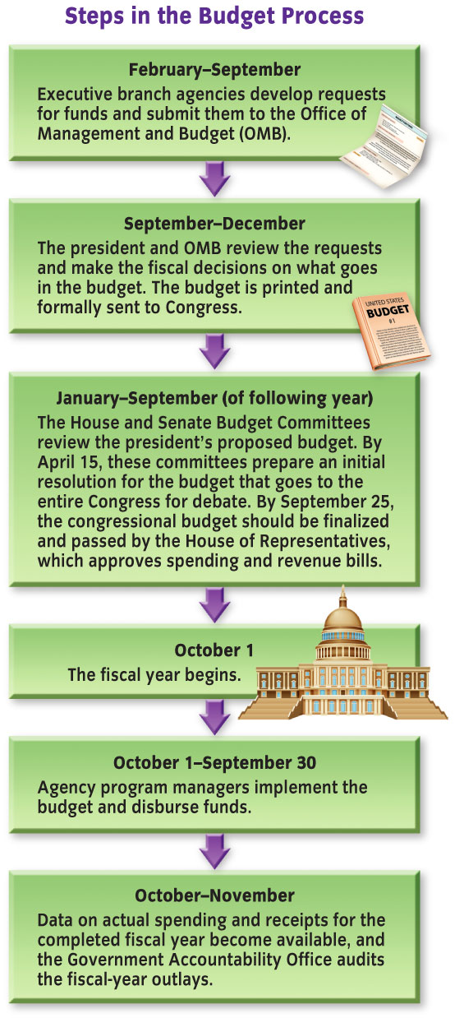
Steps in the Budget Process
Notes:
427
Items that are discussed when creating a budget are:
Will the budget increase/reduce federal spending?
Which federal programs will be cut/expanded?
Should taxes be raised/lowered?
Fiscal years sometimes start without a budget due to the fact that congress/the president may not agree upon a budget on time
Government must operate on the basis of a “continuing congressional resolution”
Agencies that allocate funds can continue spending as they spent the year before until the new budget resolution is passed

Slide 16
Notes:
426
The goal of the budget-making process is to balance what the government takes in with what it spends
If the government takes in more than it spends, there is a budget surplus
If it spends more that it takes in, there is a budget deficit
Have the students look at the two graphs to see what our biggest spending and receipt items are

Slide 17
National Debt
Notes:
428-429
Government revenues are usually not equal to expenditures
Most years our SPENDING is more than our REVENUE
Creates a Budget Deficit
Occasionally our REVENUE is more than our SPENDING
Creates a Budget Surplus

Slide 18
National Debt
Most years:
Government SPENDING > Government REVENUE
CREATES A BUDGET DEFICIT
Occasionally:
Government SPENDING < Government REVENUE
CREATES A BUDGET SURPLUS
1998
Federal government had a surplus ☺
Projected $5.6 trillion in surpluses over the next 10 years
9/11
Terrorist attacks increased government spending on defense
Surplus went away; Deficits returned ☹
Notes:
429

Slide 19
Taxes, Taxes, & More Taxes
Levied in various ways to support our government
Justified via two different principles:
BENEFITS-RECEIVED PRINCIPLE
Those who use a particular government service support it with taxes in proportion to the benefit they receive
Gasoline tax used for highway construction/repair
ABILITY-TO-PAY PRINCIPLE
Those with higher incomes pay more taxes than those with lower income, regardless of the number of government services they use
Property tax is paid based on the size/value of your home/property
Wealthier people generally have more expensive homes
Pay more in taxes
Property tax usually supports local public schools
Does not matter if property owner has students or not
Notes:
SECTION FOUR
430
Ask students if they can think of any other taxes that would qualify under either of these principes

Slide 20
Other Types of Taxes
PROPORTIONAL TAX
Takes the same percentage of all incomes; as a income rises the amount of tax paid also rises
“Flat Tax” – everyone pays the same amount
PROGRESSIVE TAX
Takes a larger percentage of higher incomes than of lower incomes; justified on the basis of the ability-to-pay principle
Federal Income Tax System
REGRESSIVE TAX
Takes a larger percentage of lower incomes than of higher incomes
Sales Tax System
More examples available on the next slide & P 432
Notes:
433

Slide 21
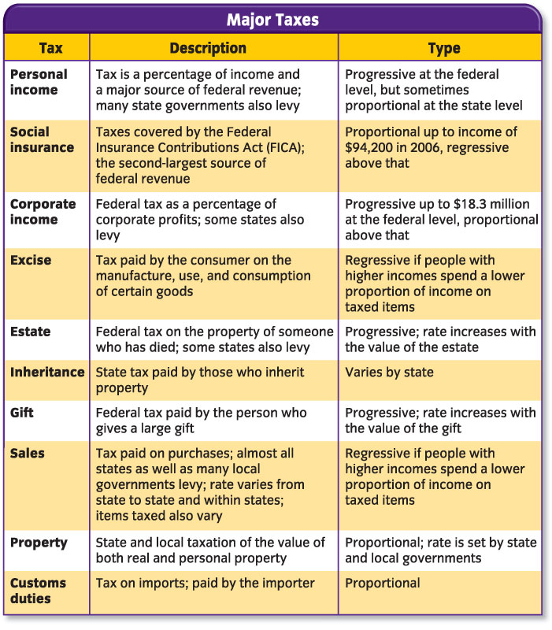
Notes:
432

