Slide 1
Chapter 15
The Federal Reserve and the Monetary Policy

Slide 2
Chapter Objectives
Know how the Federal Reserve System (Fed) is organized
Know the Fed’s role in determining the nation’s monetary policy
Know how the Fed controls the money supply and interest rates
Be able to name the tools the Fed uses to control the size of the US money supply

Slide 3
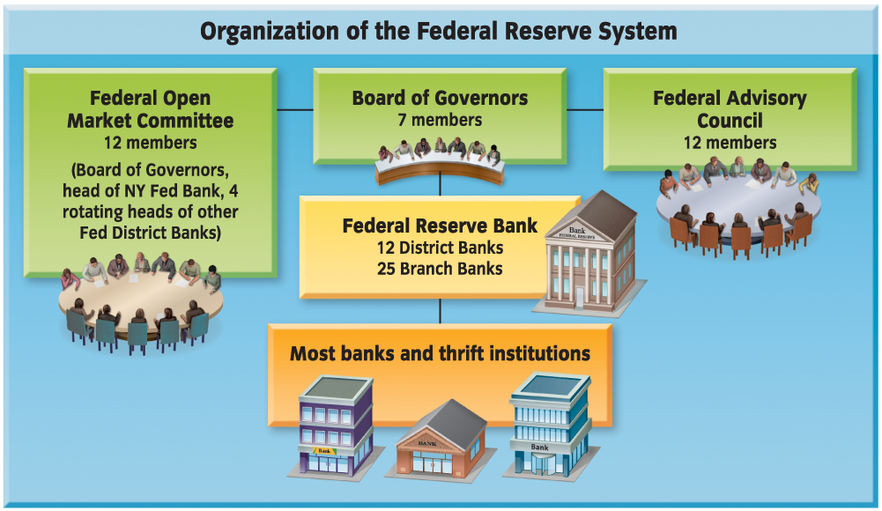
Notes:
393
The Fed is made up of a Board of Governors and assisted by
The Federal Advisory Council
The Federal Open Market Committee
12 Reserve District Banks
25 Branch Banks
Thousands of Banks & Thrift Institutions

Slide 4
Organization of the Federal Reserve System
The Federal Reserve System, a.k.a. the Fed is a system/network of banks
Power is shared; not centralized
Responsible for monetary policy in the United States
MONETARY POLICY - involves changing the rate of growth of the supply of money in circulation
Directly affects the cost and availability of credit
Thus affecting business activity in the economy
Notes:
392
Are you familiar with the Federal Reserve System?
“The main bank” is headquartered in the Washington, DC
Fed: the Federal Reserve System created by Congress in 1913 as the nation’s central banking organization

Slide 5
Organization of the Federal Reserve System
The Board of Governors
Consisting of 7 full-time members
Each member serves for 14 years
Appointed by the president
Cannot be reappointed
Decisions are not subject to the approval of the president or congress
Directs the operation of the Fed
Assisted by the Federal Advisory Council (FAC)
12 members elected by the directors of each Federal Reserve district bank
Meet at least 4 times each year
Notes:
393
Why is it important that members of the Federal Advisory Council can be from different parts of the country?
Business conditions can be different in different regions
The Fed must take into account what is best for the nation’s economy as a whole

Slide 6
The Federal Open Market Committee (FOMC)
Consists of 12 voting members
Each member comes from a different Reserve District
Meets 8 times a year
Decides the course of action to control the money supply
Decides whether to raise or lower interest rates
Rate changes affect the whole financial world
Implements the monetary policy of the Federal Reserve
Notes:
393
Why do rate changes have an affect on the whole financial world?
LOWER RATES – Will help to encourage growth and spending
HIGHER RATES – Will help to slow down the economy if it is growing too fast/inflation too rapid

Slide 7
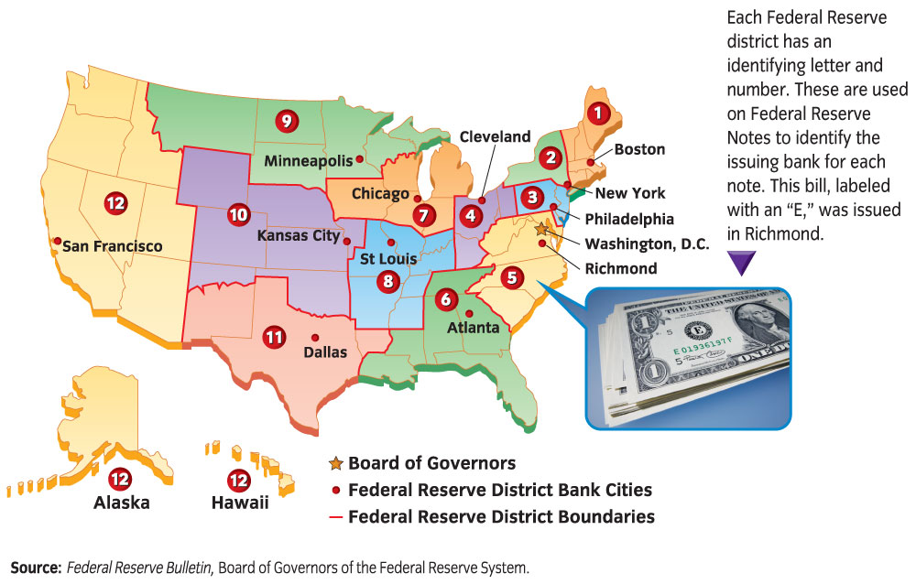
Notes:
394
12 Federal Reserve district banks serve our nation’s banks
Trillions of dollars a year pass through the Fed as it processes billions of checks
Headquarters is in DC

Slide 8
Federal Reserve Districts
12 Federal Reserve Districts
25 Federal Reserve Branch Banks
Each District is set-up as a corporation
Owned by its member banks
All National Banks are required to be members
Members receive dividends on their stock in the Fed
Allowed to vote for 6 of the 9 District Board Members
State-chartered banks may join if they choose
Banks are required to keep a percentage of their total deposits in their district bank
Notes:
394

Slide 9
Notes:
396

Slide 10
Functions of the Fed
Control the money supply (PRIMARY)
Determines the amount of money in circulation
Affects interest rates & availability of credit
Acts as the Federal Government’s fiscal agent
Financial Adviser to the Federal Government
Keeps track of federal deposits of tax revenue
Holds a checking account for the US Treasury
Tax Refunds
Veterans’ Benefits
Social Security Benefits
Supervising Banks
Regulates state banks that are members of the Fed
Notes:
395
Primary function of the federal Reserve is to control the money supply

Slide 11
Functions of the Fed, cont’d
Regulating the money supply
Holds reserves of checkable deposits
Sets reserve requirements
Supplies & maintains paper currency
Sets standards for certain types of consumer legislation
Truth-in-Lending
Truth-in-Savings
CHECK CLEARING
Method by which a check that has been deposited in one institution is transferred to the issuer’s depository institution

Slide 12
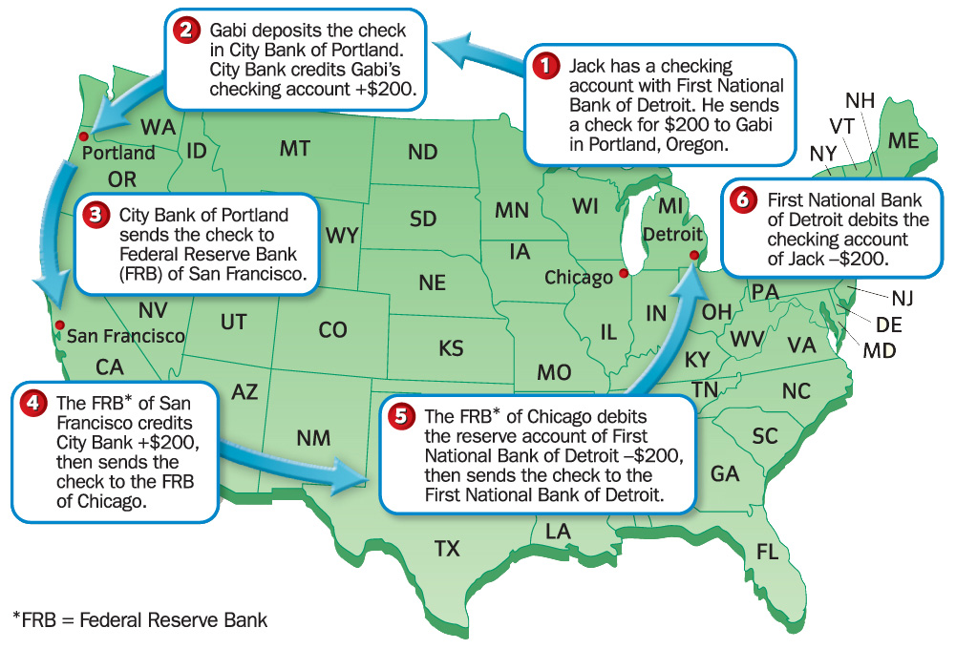
Notes:
395
Have students read 397 about Ben Bernanke & Discuss

Slide 13
Loose and Tight Money Policies
The goal of monetary policy is to promote economic growth and employment without causing undue inflation
A loose money policy…
Is expansionary
Credit is abundant and inexpensive to obtain
Possibly leading to inflation
A tight money policy…
Is contractionary
Credit is in short supply and is expensive to obtain
Slows the economy
Notes:
SECTION TWO
399
Credit, like any good or service, has a cost
The interest paid to obtain it

Slide 14
Notes:
399
loose money policy: monetary policy that makes credit inexpensive and abundant, possibly leading to inflation
tight money policy: monetary policy that makes credit expensive and in short supply in an effort to slow the economy

Slide 15
Fractional Reserve Banking
System in which only a fraction of the deposits in a bank are kept on hand, or in reserve; the remainder is available to lend
The Fed has established RESERVE REQUIREMENTS for all banks to follow
A percentage of checkable deposits banks must keep as cash in their own vaults or as deposits in their Federal Reserve district bank
Must keep 20% of their deposits
Half (10%) must be kept at their fed branch
Remainder (80%) can be used to generate “new money”
Notes:
400-401
Why do you think the Fed requires banks to hold on to 10/20% of their deposits?
So customer coming in to do withdrawals on standard business can have access to cash
The use of the non-required reserve portion of money deposits to make loans to businesses and individuals is known as the multiple expansion of the money supply.

Slide 16
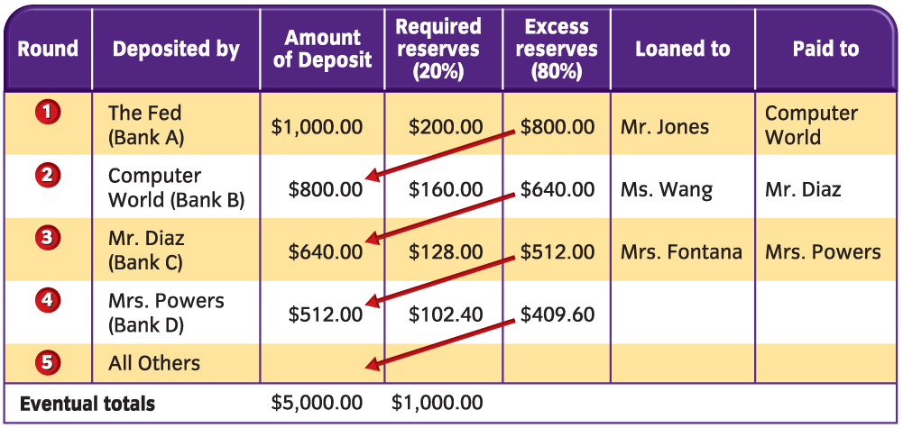
Notes:
400
See the chart w/ explanation in the textbook

Slide 17
Changing Reserve Requirements
The Federal Reserve can choose to control the money supply by changing the reserve requirements of financial institutions.
If the Fed…
RAISES the reserve requirements…
The amount of money in the economy would DECREASE
LOWERS the reserve requirements…
the amount of money in the economy would INCREASE
REMEMBER – Each bank is required to keep a certain percentage of deposits!
Notes:
SECTION THREE
403

Slide 18
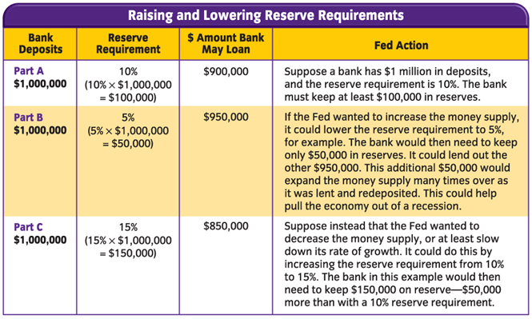
Notes:
403

Slide 19
Changing the Discount Rate
Banks may sometimes not have enough money on reserve
If there are a number of customers that borrow unexpectedly
If there are a number of customers that withdraw large amounts from their deposit accounts unexpectedly
Banks may borrow money from their district Federal Reserve bank
They are charged the DISCOUNT RATE to borrow this money

Slide 20
Discount Rate
Interest rate that the Fed charges on loans to commercial banks
If the rate is high…
It will discourage monetary growth and lending
If the rate is low…
It will encourage monetary growth and lending
When rates are low, many banks may borrow to help increase their lending power

Slide 21
Notes:
405
When you hear on the news about a rate hike or reduction by the fed they are referring to the federal funs rate
Federal funds rate is the rate that banks charge each other for short term loans.
This has an effect on how much both banks AND individuals borrow.

Slide 22
Open-Market Operations
Buying & selling of United States securities by the fed to affect the money supply
Federal Securities would include
Treasury Bills, Notes, & Bonds
The Fed controls the money supply primarily through this action
When the Fed buys securities…
It increases the bank’s reserves
Which increases the money supply
The opposite would be true when the Fed sells securities
Notes:
406

Slide 23
Open-Market Operations
No matter what tools the fed uses to affect the monetary supply
Results will be delayed
Months may pass before the full effects are seen in the economy
Criticisms of the Fed
Some believe…
The money supply should be increased at the same level each year
The Fed should not engage in monetary policy
Notes:
407

