Slide 1
Money and Banking
Chapter 14

Slide 2
Learning Objectives
Upon completion of this chapter you will…
Know the different uses, characteristics, & types of money
Know the important events in the history of US money & banking and about present-day banking services
Be able to distinguish between money and near money in the United States
Notes:
Money as you know it is vastly different from some of it’s earlier forms.
Some of the “currencies” that have been used in the past include…
Shells
Gold
Sheep
Rocks
Wampum (beads made from shells)
In this unit you will learn a little bit about what makes our current currency work!

Slide 3
The Functions of Money
Anything can be used as money as long as it meets one essential criteria:
People must be willing to accept in exchange for goods/services for sale
An effective form of currency has three key functions:
Medium of Exchange
Unit of Accounting
Store of Value
Notes:
SECTION ONE
368

Slide 4
The Functions of Money
MEDIUM of EXCHANGE
Use of money in exchange of goods or services
What would we do if we didn’t have our form of currency?
BARTER
Exchange goods/services for other goods/services
UNIT of ACCOUNTING
Use of money as a yardstick for comparing the values of goods and services
Price allows people to
Determine the better bargain
Keep accurate financial records
STORE of VALUE
Use of money to store purchasing power for later use
Makes it possible for you to get paid for the goods/services you provide to the economy NOW and make your own purchases later
What would it be like if we didn’t have money???
Notes:
368
Medium of Exchange
Name some reasons that using money is more efficient than bartering
bartering requires each party to want exactly what the other person has to offer
Unit of Accounting
Each country uses its own basic unit to measure the value of goods
The US uses the Dollar
Britain uses the Pound
Japan uses the Yen
Europe uses the Euro
Store of Value
Use the barter idea of getting paid in tacos to help explain the value of money
Tacos get cold and old
Money does not; holds its value

Slide 5
Characteristics of Money
Notes:
There are 6 characteristics that are essential to MODERN DAY CURRENCY

Slide 6
Notes:
370
Compare paper money to cattle, what are the advantages for each characteristic?

Slide 7
Types of Money
Various types of money could be used in an economy
3 most common types include
COMMODITY MONEY
Money that has a value as a commodity as well as a form of currency
Cattle, gems, precious stones, salt
REPRESENTATIVE MONEY
Money that is backed by an item of value
Gold, Silver
What type of money do we have?
Notes:
371

Slide 8
Types of Money
The United States currently uses
FIAT MONEY
Money that has value because the government has declared it as the legal tender of the nation
LEGAL TENDER
Money that by law must be accepted for payment of public and private debts
We have not always had a “fiat system”
http://www.kwaves.com/fiat.htm
Notes:
371

Slide 9
History of American Banking
When the US was first established it had no reliable banking system
The history of money in the US was closely tied to the development of the nation’s banking system
Instability in the banking system has contributed to business fluctuations
See Figure 14.3 in your textbook
Notes:
SECTION TWO
374
ABSOLUTELY MUST HAVE THEM READ THE “PrPDICTS In ThE NeWS”!!! (373)
Can you explain a change that you view as important in our nation’s monetary history?
coins to paper
barter system to currency
debit cards
world trade center (demolished our dollar’s worth)

Slide 10
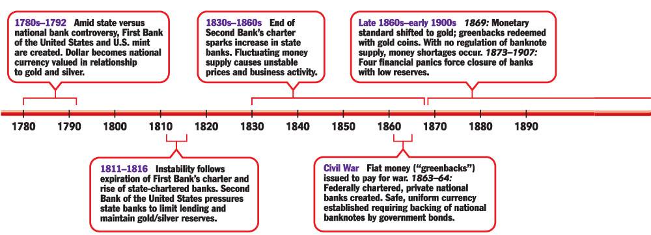
Notes:
374

Slide 11
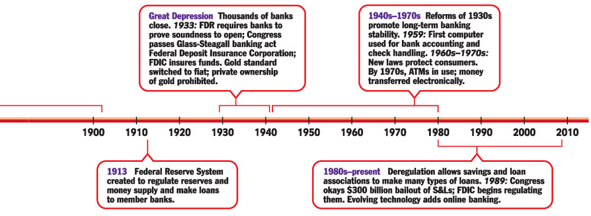
Notes:
375

Slide 12
Banking Services
Banks and savings institutions offer a wide variety of services, including:
Checking, Savings, & Certificate of Deposit Accounts
Automatic Deposit & Payment
Safe Deposit Boxes
Electronic/Online Banking
ELECTRONIC FUNDS TRANSFER (EFT)
System of transferring funds from one bank account directly to another without any paper money changing hands
OVERDRAFT CHECKING
Checking accounts that allow a customer to write a check for more money than what is in their account
Notes:
376
Banking changed greatly in the late 1970s with the computer
Electronic funds transfer (EFT) has increased speed and efficiency of banking
EFTs have some drawbacks and possible security concerns
Addressed by the Electronic Funds Transfer Act of 1978
EFT customers are responsible for only $50 in losses when someone steals or illegally uses their ATM cards, if they report the cards missing within 2 days
If you wait more than 2 days they could be responsible for as much as $500
Also protected against computer mistakes
Most common feature of EFT is the automated teller machines (ATMs)
The internet allows people to do their banking from home

Slide 13
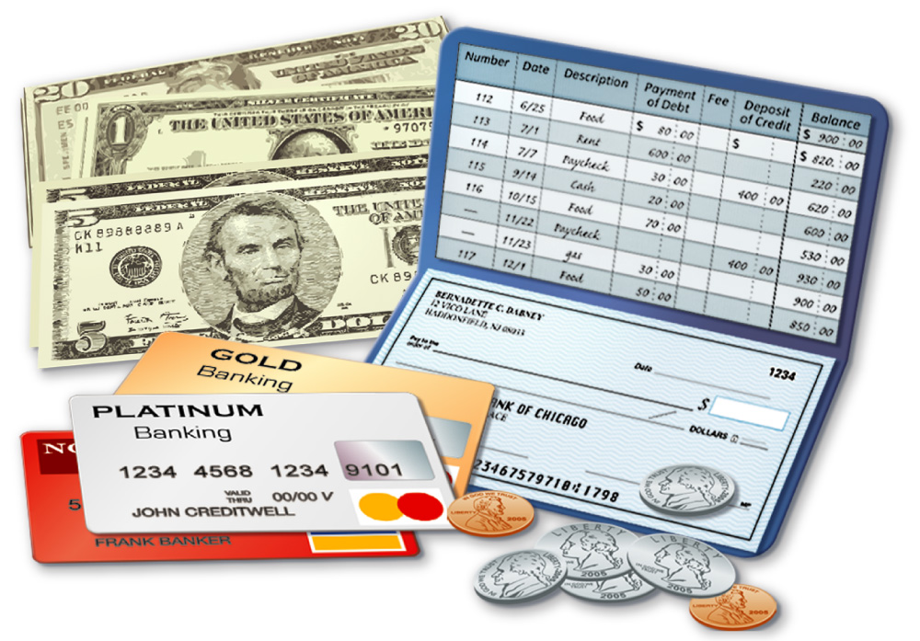
Money and Near Moneys
The money supply consists of not only bills and other coins, but also checking and savings deposits, credits cards, time deposits, and certain other liquid investments.
Notes:
SECTION THREE
378
Check out the “Issues in the News”
Questions…
How does redesigning the currency help? Can’t they still counterfeit the old design?
If they are counterfeiting it in other countries people tend to want the newest stuff, not the old.

Slide 14
Money
The Bureau of the Mint
Part of the Treasury Department
Makes all coins in the United States
About 5% of the currency in circulation is coin
The Bureau of Engraving & Printing
Designs & Issues Federal Reserve Notes
$1, $5, $10, $20, $50, $100 Denominations
Larger denominations not printed any longer
Not needed due to easier means of transfer
Harder for criminals to hide large amounts of cash
Notes:
379
Money today has several features to help prevent counterfeiting:
Can you name any of them?
Multicolored printing
Embedded devices such as strips, micro-printing, and color changing ink

Slide 15
Money
CHECKING ACCOUNT
Account in which deposited funds can be withdrawn at any time by writing a check
The largest part of the money supply in the United States consists of checkable deposits
DEBIT CARD
Device used to make cashless purchases; money is electronically withdrawn from the consumer’s checkable account and transferred directly to the store’s bank account
THRIFT INSTITUTIONS
Mutual Savings Banks, Savings & Loans, and Credit Unions that offer many of the same services as commercial banks
Notes:
380
Brokerage houses (Investment firms where you can buy stocks, bonds, mutual funds) also have started offering checking account equivalents to their customers.

Slide 16
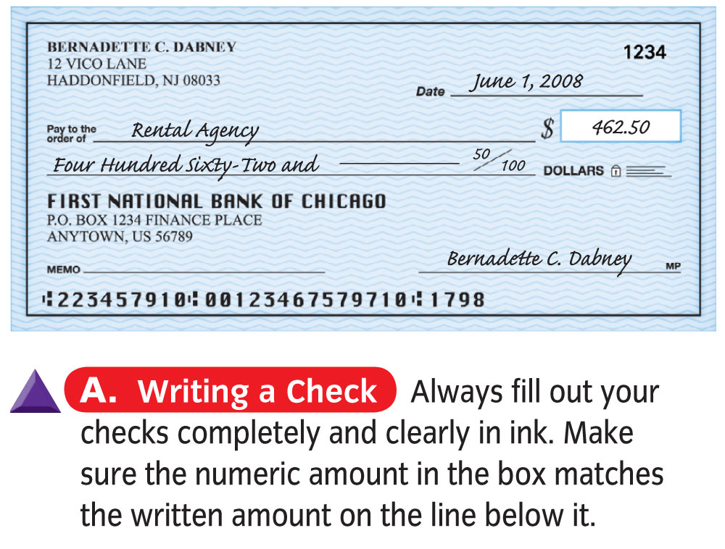
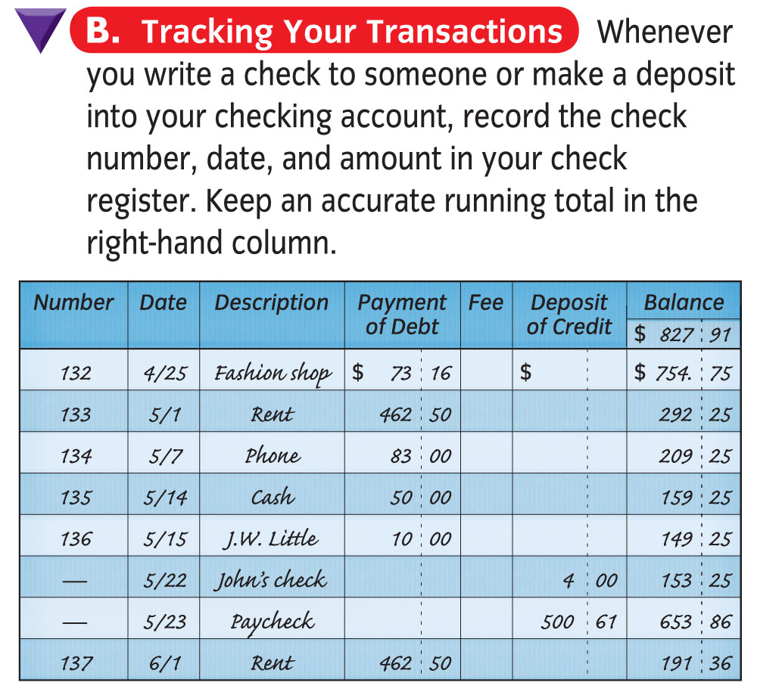
Notes:
380

Slide 17
Notes:
381

Slide 18
Credit Cards & Debit Cards
Credit Cards
Many people use them
IS NOT MONEY
Is not a Unit of Accounting or Store of Value
Is actually a loan (hopefully short term)
Debit Cards
Also not money
An easy & convenient way to access your checkable deposit funds
Notes:
381

Slide 19
Near Moneys
Assets, such as savings accounts, that can be turned into money relatively easily and without the risk of loss of value
Values stated in terms of money
High Liquidity when compared to other investments
Can be turned into currency easily
Examples include:
Savings Accounts & Time Deposits
Both easily converted to checking accounts or cash
Notes:
382
Ask students what LIQUIDITY MEANS
-ENTER-

Slide 20
The Money Supply
Two definitions are used to help define the Money Supply
M1
Narrowest definition of the money supply
Moneys that can be spent immediately & against which checks can be written
M2
Broader definition of the money supply
Includes all of M1 plus such near moneys as savings deposits, small –denomination time deposits, money market deposit accounts, & retail money market mutual fund balances
Notes:
383
Economist use both narrow and broad definitions of the money supply to measure the amount of money in circulation
Have students complete

Slide 21
