Slide 1
DEMAND & SUPPLY
Economic Perspectives
Notes:
OPENING >> Have students read the “Products In The News” (169)
Are there any other products they can think of that would get teens to line up & wait to buy? Skip school for?
http://www.glencoe.com/sites/ss_modules/videos/ss_ett_2008/ss_ett_2008.html

Slide 2
SECTION 1
DEMAND: The amount of goods/services consumers are willing & able to buy at various prices during a specified time period.
SUPPLY: The amount of goods/services producers are willing & able to sell at various prices during a specified time period.
How many sodas/beverages do you buy per week?
Notes:
PAGE 170
<<<Pass out laminated cardstock (lcs) to students for chapter activities>>>
Beginning of Chapter Graphing Exercise (CGE)
-Ask the students (on a piece of paper/lcs) to write down the number of pops (or any other beverage you buy on a consistent basis) they buy on a weekly basis currently. -Write down the price currently of pop.
-How many would you buy in a week if that price increased by 50 cents? $1? $1.50? $2
-How many would you buy in a week if the price decreased by 50 cents? $1? $1.50? $2
DISCUSS THE RESULTS ~ Tell students to leave the numbers on their lcs

Slide 3
SECTION 1
MARKET: Process of freely exchanging goods/services between buyers & sellers.
Stores, Services, Entertainment, Internet
VOLUNTARY EXCHANGE: Transaction in which a buyer & seller exercise their economic freedom by working out their own terms of exchange
Notes:
PAGE 170-171
A MARKET is anywhere that goods/services are being exchanged
-Not limited to “stores”
FIGURE 7.1 –Shows different markets

Slide 4
SECTION 1
LAW OF DEMAND: Economic rule stating quantity demanded & price move in opposite directions
Price has an inverse affect on demand
QUANTITY DEMANDED: Amount of a good or service that a consumer is willing and able to purchase at a specific price
Notes:
PAGES 172-173
Figure 7.2
-What do you do when price of something increases?
BUY MORE or BUY LESS
-What do you do when price decreases?
Quantity Demanded….
Not to be confused with DEMAND which shows ALL the price/quantity combinations at a specific instant in time.

Slide 5
SECTION 1
REAL INCOME EFFECT: Economic rule stating individuals cannot keep buying the same quantity of a product if its price rises while their income stays the same
SUBSTITUTION EFFECT: Rule stating if two items satisfy the same need and one has a higher price, people will buy more of the lower priced item
Notes:
PAGE 173
Does the Real Income effect have any impact on our Standard of Living?
Buying Power:
$100.00/month budget for gas.
Tank holds 17 gallons.
How many times can I fill my tank in one month if the price of gas is $.99/gallon? $3.00/gallon?
I can drive 375 miles on one tank of gas.
It is a 220 mile round trip to see my family.
How many trips per month could I take to visit my family when gas is $.99/gallon? $3.00/gallon?
Answers:
@ $.99/gallon I can get 6 (5.94) fill-ups on a $100 budget.
@ $3/gallon I can get 2 (1.96) fill-ups on a $100 budget.
6 tanks of gas = 2250 miles
@ 220 miles/round trip I can make 10 trips to visit family.
2 tanks of gas = 750 miles
@ 220 miles/round trip I can make 3 trips to see my family.
Substitution…Brand name vs. Store Brand (Best Buy)
How does substitution work for TRANSPORTATION? Have students provide examples…

Slide 6
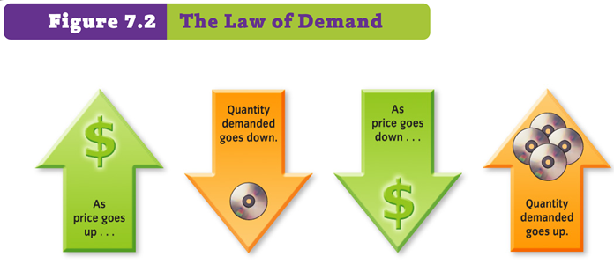

Slide 7
SECTION 1
UTILITY: Ability of any good/service to satisfy a customer’s wants
LAW OF DIMINISIHNG MARGINAL UTILITY: States that the additional satisfaction received from purchasing one more unit of a product will lessen with each additional unit purchased
Lemonade Example
Notes:
PAGE 174
It’s a HOT SUMMER DAY and you have been working outside in the yard. The neighbor kids are selling lemonade for $.50/ glass WOULD YOU BUY ONE? WHY?
-Yes, because you are thirsty and lemonade sounds good.
WOULD YOU BUY A SECOND ONE? A THIRD? A FOURTH?
-What would make you stop buying the lemonade?
-Not thirsty anymore
-Not thirsty enough to spend $.50 on another glass of lemonade
-Lemonade no longer sounds good to drink
You have used/heard used the term “It’s just not worth it”…this could be used to talk about the Utility of an item.
- Is it worth the hard work you put in at work to get that money to use it on that item????
Regardless of cost EVERYTHING eventually reaches a point where it “Is not worth it” to buy even one more.
(Use the “enough” graph from CF…draw on the board)
------------------------------------------------------------------
BUSINESSWEEK page 176
How many of you have pets? Given to your/did you buy it?
What factors determine the price of a dog?

Slide 8
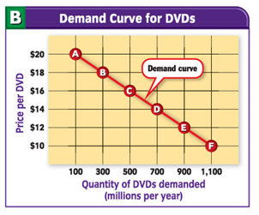
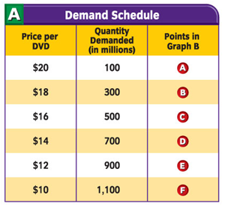
SECTION 2
DEMAND CURVE: A line showing the quantity demanded of a good/service at each possible price. Slopes downward…
PRETTY QUICK – PRICE QUANTITY
Price is always on the left (vertical axis)
Quantity is on the bottom (horizontal axis)
Notes:
Page 177
-Read Companies in the News…
-Why does this company want to cut production?
-TO KEEP DEMAND HIGH
-Why do they want to keep demand high?
-TO KEEP THE SELLING PRICE HIGH
PAGE 178-79
FIGURE 7.3 Shows an example of a demand schedule (table) and demand curve (graph)
THE CHIPOTLE DEMAND GRAPH
Poll the class about their interest in buying Chipotle burritos…who has the DEMAND for it today at the current price for lunch? (keep in mind you have to be WILLING & ABLE to make the purchase).
CREATE A DEMAND SCHEDULE
How many people would have a demand for chipotle if the price increased $1, $2, $3, $4, $5, etc
How many people would have a demand for chipotle if the price decreased $1, $2, $3, $4, $5, etc
CREATE A DEMAND CURVE…explain the parts
CGE CONTINUED
Now have the student create a demand curve on their lcs illustrating the demand they have for pop

Slide 9
SECTION 2
Moving Along the Demand Line…
CHANGE IN QUANTITY DEMANDED
Caused by a change in Price
Shift ALONG the Demand Curve
PRICE + /DEMAND - = Moves Left
PRICE - /DEMAND + = Moves Right
Moving the Demand Line…
CHANGE IN DEMAND
Caused by something other than a change in price
Shift of the WHOLE Demand Curve
DEMAND INCREASE line shifts RIGHT
DEMAND DECREASE line shifts LEFT
Notes:
Change in Price
-Snow blowers go on sale at Big G
-Demand increases due to PRICE
-Move ALONG the line to the Right
If Demand changes due to a DETERMINANT then the full line shifts
-Snow starts falling in NE
-Demand for shovels increases
-Line Shifts Right

Slide 10
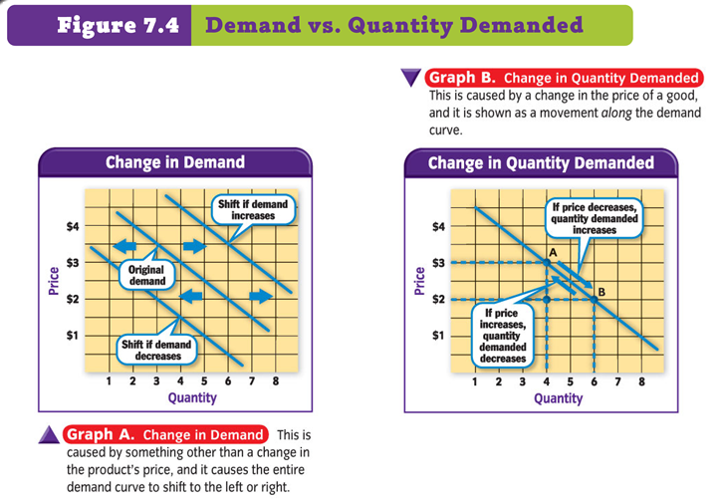

Slide 11
SECTION 2
DETERMINANTS of DEMAND
A.K.A. Factors of Change
Change in Population
Change in Income
Change in Tastes/Preferences
Substitutes
Complimentary Goods
Change in # of Buyers
Change of Expectations
Notes:
PAGE 180-181
POPULATION *Increase = Increase in demand
INCOME * Increase = Increase in demand
TASTES/PREFERENCES * varies depending on how preferences change
SUBSTITUTES * Price for subs decreases demand for original decreases
COMPLEMENTARY GOODS * Digital Cameras and Memory Cards are complementary goods
*Price for Camera Decrease Demand for Cameras AND Demand for Memory Cards Increase
Keep in mind…
Shift Right = Increase
Shift Left = Decrease

Slide 12
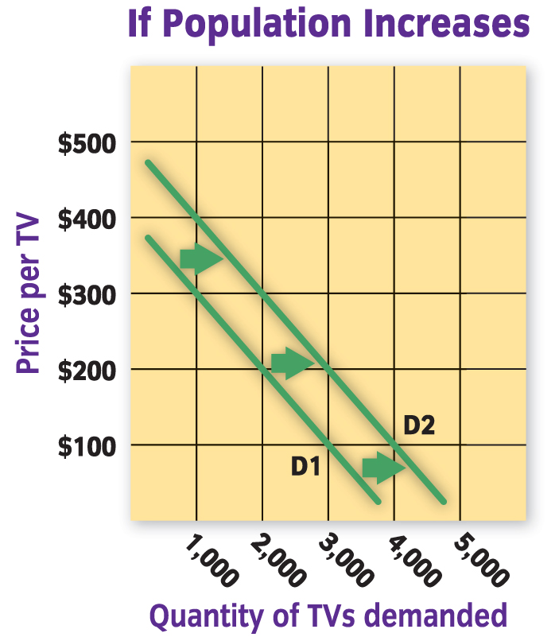
1. Population
D1 – represents the original demand for TV’s
D2 – represents the demand after the population increased
If population decreased, demand would also decrease
Notes:
COMMON SENSE CHECK
The more people that live in an area the more demand there will be for all the “every day items” we use
Vegas…at one time the fastest growing city in the US
Demand for pretty much everything they needed was constantly shifting right
Schools, Roads, Hospitals, Stores, Parks, Gas Stations, etc.

Slide 13
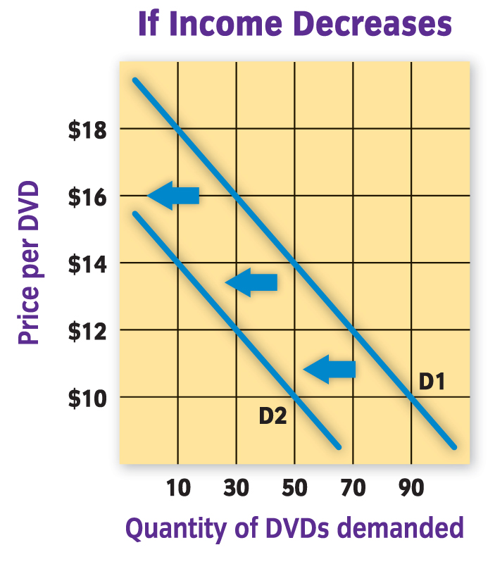
2. Income
If Income decreases, demand also decreases.
Notes:
COMMON SENSE CHECK
If you have less money you will have to cut spending somewhere to adjust for the decrease
Would you continue to spend the same amount on fast food and other items if your boss cut your hours in ½?

Slide 14
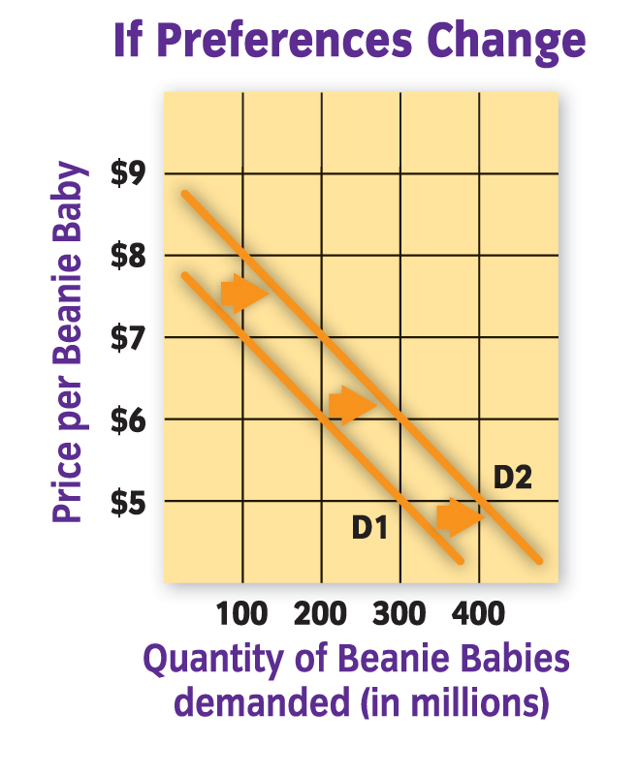
3. Tastes & Preferences
*This refers to what people like and prefer to choose.
This Beanie Baby graph represents the demand in the early 1990’s. As the popularity soared the graph moved right.
Eventually demand died down, and the curve shifted back to the left.

Slide 15
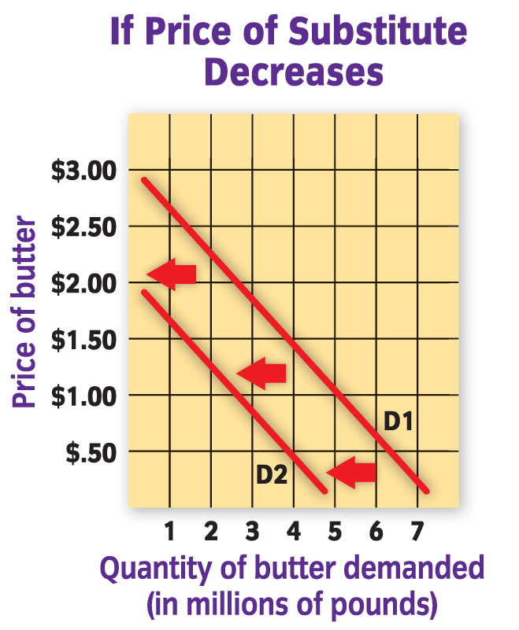
4. Substitutes
Determined by availability & price of substitute
Think it through!
If the price of the substitute decreases, then you’ll buy that instead of the original item.
Vice versa:
If the price of the substitute increases, you’ll be more of the original item.
Notes:
COMMON SENSE CHECK
When gas started to increase people began to purchase smaller more efficient cars
What happened to the demand for bigger gas guzzling cars like SUVs and trucks?

Slide 16
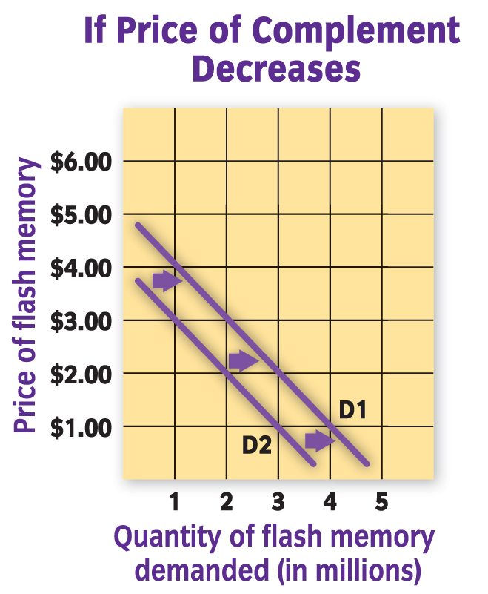
5. Compliments
*Things that are bought and sold together
If the price of one decreases, the demand of BOTH complimentary items increases.
This examples shows:
If the price of a digital camera decreases, the demand of the camera AND the flash memory increases.
Notes:
COMMON SENSE CHECK
As we approach a holiday weekend (such as Labor Day) if gas prices increase what will happen to people’s vacation plans?
Will they travel as far as they might have if gas prices were lower?
If not…what will happen to the demand of hotel rooms at popular tourist locations?

Slide 17
SECTION 2
DETERMINANTS of DEMAND
A.K.A. Factors of Change
Change in Population
Change in Income
Change in Tastes/Preferences
Substitutes
Complimentary Goods
Change in # of Buyers
Change of Expectations
Notes:
CGE Continued
-On their graph have them label the line D1
-Draw two more lines (one on each side of D1) and label D2 (left) & D3 (right)
Name off factors of change (students should write them down) after each factor student needs to write if the line would shift to D2 or D3 for the ORIGINAL product and why.
-New company starts selling a similar product at ½ price (substitute) – D2
-You receive a raise at work (income) – D3
-You know the product will go on sale next week (expectations) – D2
-You find a new product that you like more than the current one (change in tastes)
PASS OUT THE SUPPLY/DEMAND SHIFT WORKSHEET…have students work indivdually to complete

Slide 18
SECTION 2
PRICE ELASTICITY OF DEMAND: How much consumers respond to a given change in price.
ELASTIC DEMAND
Rise/Fall in Price GREATLY affects demand
Consumers are flexible about buying items that have ELASTIC DEMAND.
They can get by without them if price gets too high
INELASTIC DEMAND
Rise/Fall in Price has LITTLE TO NO affect
Items are “must have” for the consumer
Notes:
PAGE 182-184
NAME EXAMPLES OF ELASTIC/INELASTIC GOODS/SERVICES
List on the board
Continue to next slide to see examples

Slide 19
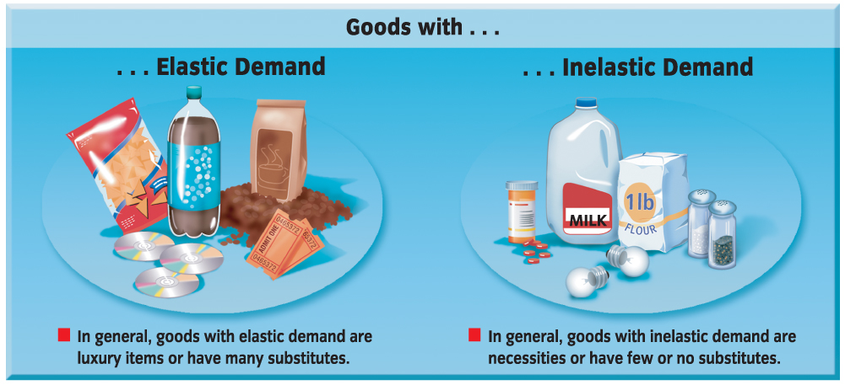
Examples
Elastic Demand
Inelastic Demand
Luxury items, vacations, high-end electronics, even coffee are examples of elastic goods/services and have a very elastic demand.
Staple foods, medicine, spices have an inelastic demand. A price change has little impact on the quantity demanded by consumers.

Slide 20
Figure 11

Slide 21
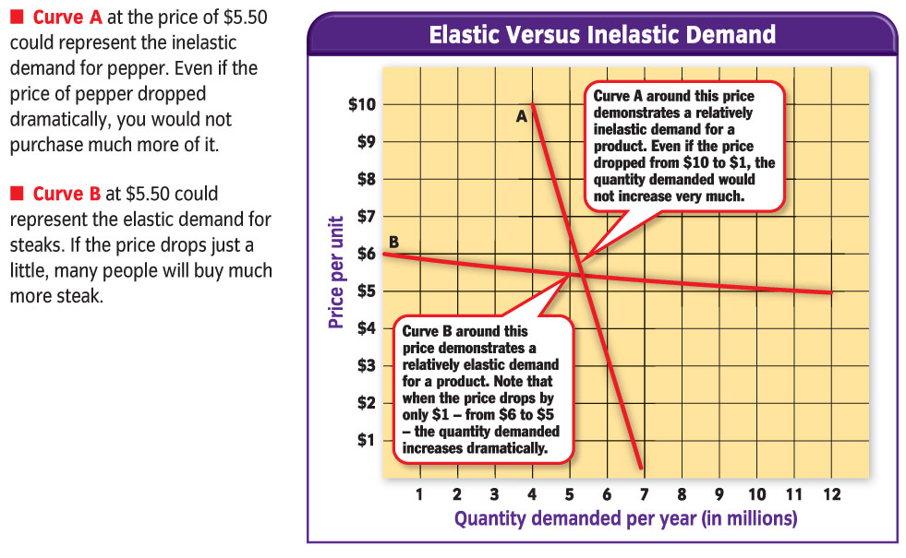
Notes:
CGA Reflection
Think back to the graph you created earlier/yesterday…was your demand for pop elastic or inelastic?
Did it look more like graph A or graph B on this slide?

Slide 22
DFS Trans 2

Slide 23
SECTION 3
SUPPLY CURVE: A line showing the quantity supplied of a good/service at each possible price. Slopes upward…
Notes:
PAGES 188-89
Figure 7.7

Slide 24
SECTION 3
LAW OF SUPPLY: Economic rule stating quantity supplied & price move in the same direction
Price has an direct affect on supply
PROFIT INCENTIVE is directly related to Supply
Notes:
PAGE 187
How does profit motivate the law of supply?
-People are in business to make money
-The more money to be made the more items they will supply

Slide 25
Profits and the Law of Supply
To understand pricing, you must look at both demand and supply.
The law of supply states that as the price of a good rises, the quantity supplied also rises. As the price falls, the quantity supplied also falls.
The higher the price of a good, the greater the incentive is for a producer to produce more.
Supplied
Supplied
Notes:
REMEMBER…LAW OF SUPPLY IS PROFIT DRIVEN!!

Slide 26
SECTION 3
DETERMINANTS OF SUPPLY:
Price of Inputs
Number of Firms in the Industry
Taxes
Technology
Any time the COST to the business INCREASES, then the COST of production INCREASES, and supplies will SUPPLY FEWER goods
Any time the COST to the business DECREASES, then the COST of production DECREASES, and supplies will SUPPLY MORE goods
Notes:
PAGE 190-191

Slide 27
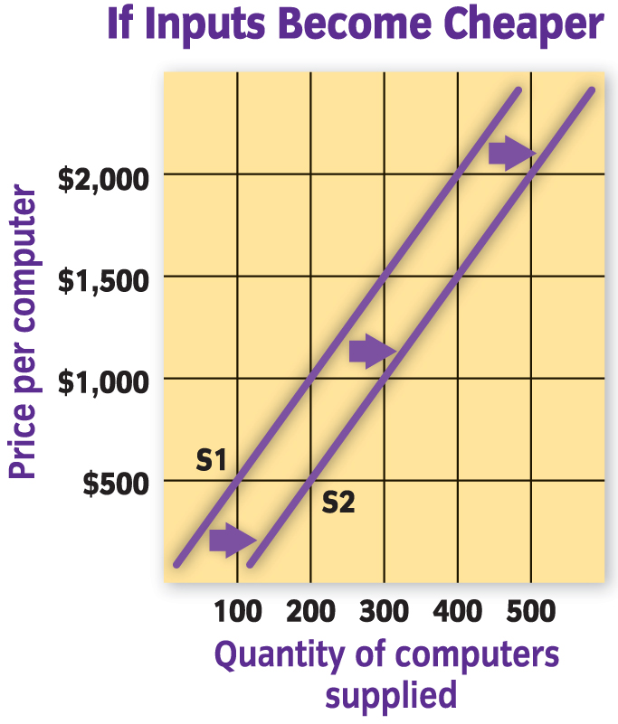
1. The price of inputs
Examples of Inputs (Anything that goes in to making a product):
raw materials
wages (labor)
land
Price of Inputs increases
Supply Decreases
Price of Inputs decreases
Supply increases
Notes:
Inputs –Items used to create the product/provide the service
-Change in price = change in supply
-decrease in input = increase in supply

Slide 28
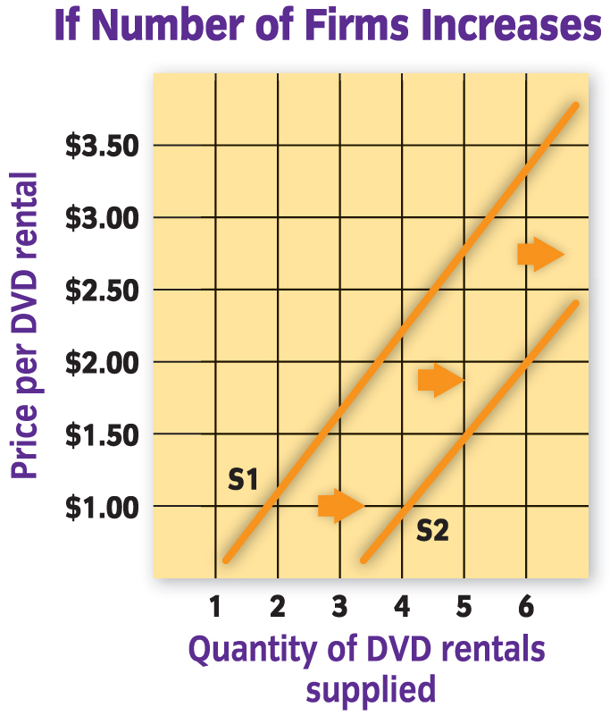
2. The number of firms in the industry
Examples:
Businesses opening & closing
# of Businesses increases
Supply Increases
# of Businesses decreases
Supply decreases
In a free-market economy, sellers enter and leave all the time
Notes:
# of Firms –More firms in the field INCREASES supply of that product/service

Slide 29
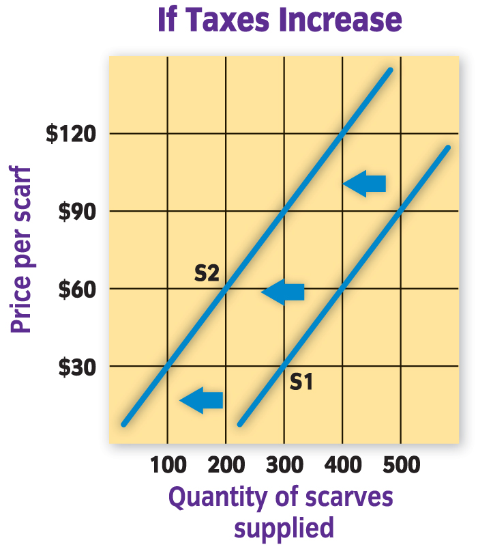
3. Taxes
Taxes increase
Supply decreases
Notes:
Taxes –More taxes = less supply

Slide 30
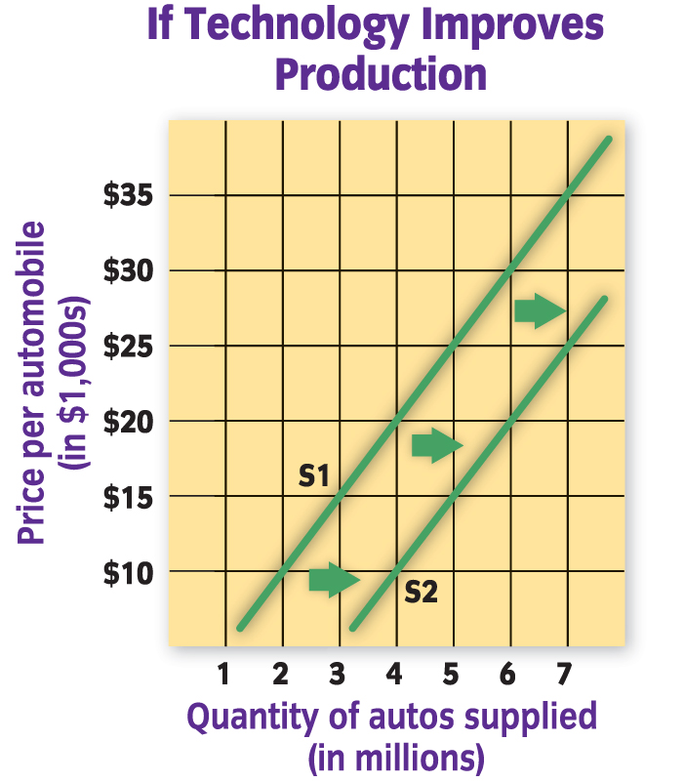
4. Technology
Any increase in technology with increase supply
Notes:
Technology –Improvements in technology = increases in supply

Slide 31
SECTION 3
MOVING THE SUPPLY LINE
CHANGE IN SUPPLY
Caused by something other than a change in price
Shift of the WHOLE Supply Curve
SUPPLY INCREASE line shifts RIGHT
SUPPLY DECREASE line shifts LEFT
MOVING ALONG THE SUPPLY LINE
CHANGE IN QUANTITY SUPPLIED
Caused by a change in Price
Shift ALONG the Supply Curve
PRICE + /SUPPLY + = Moves Right
PRICE - /SUPPLY - = Moves Left
Notes:
SEE FIGURE 7.8 p 192
ASSIGNMENT:
-Increase Demand/Supply worksheet
-Students are to read the headline and decide how it has an impact on supply/demand.

Slide 32
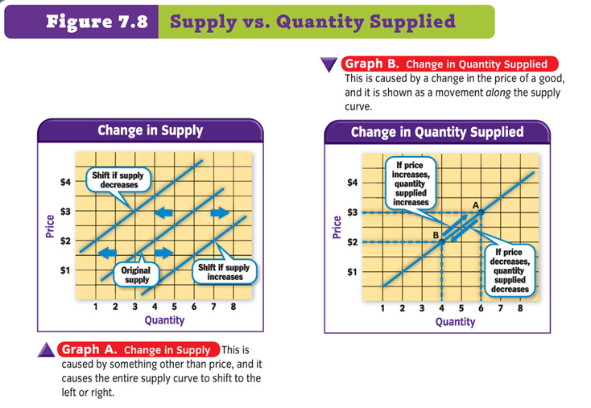

Slide 33
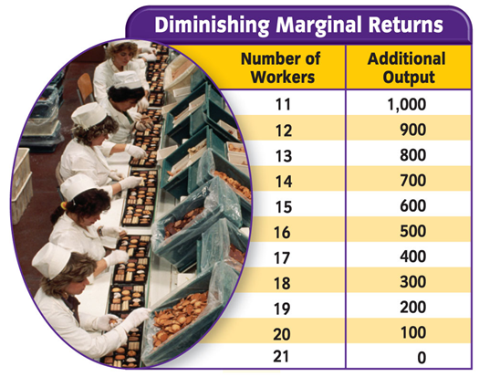
LAW OF DIMINISHING RETURNS:
Adding units of ONE factor of production INCREASES total output
After a certain point, the extra output will continue to increase but the rate will diminish
Notes:
Say what???
-Basically just like diminishing utility where eventually buying one more item will not have an effect on your life DIMINISHING RETURN means eventually it will not be as profitable to produce that additional unit
STUDENT EXAMPLE (p. 192 “R”)
Have you ever stayed up very late to do your homework? Did you get less work done as you grew more tired? At what point did you decide to go to sleep? Why?
Eventually you realized that you would be better off going to bed and starting fresh the next day because you were not properly using your resources. Right?

Slide 34
SECTION 4
EQUILIBRIUM PRICE: Price at which the amount producers are willing to supply is equal to the amount consumers are willing to buy
Increase in Equilibrium Price
When Demand increases & Supply stays the same
When Supply decreases & Demand stays the same
Decrease in Equilibrium Price
When Demand decreases & Supply stays the same
When Supply increases & Demand stays the same
Notes:
Page 195
-Figure 7.10
We have talked a lot about the supply line and the demand line…but now it is time to put the two together.
When we do this we find the EQUILIBRIUM PRICE (MARKET CLEARING PRICE)
This is the price where the most consumers and producers will be happiest.

Slide 35
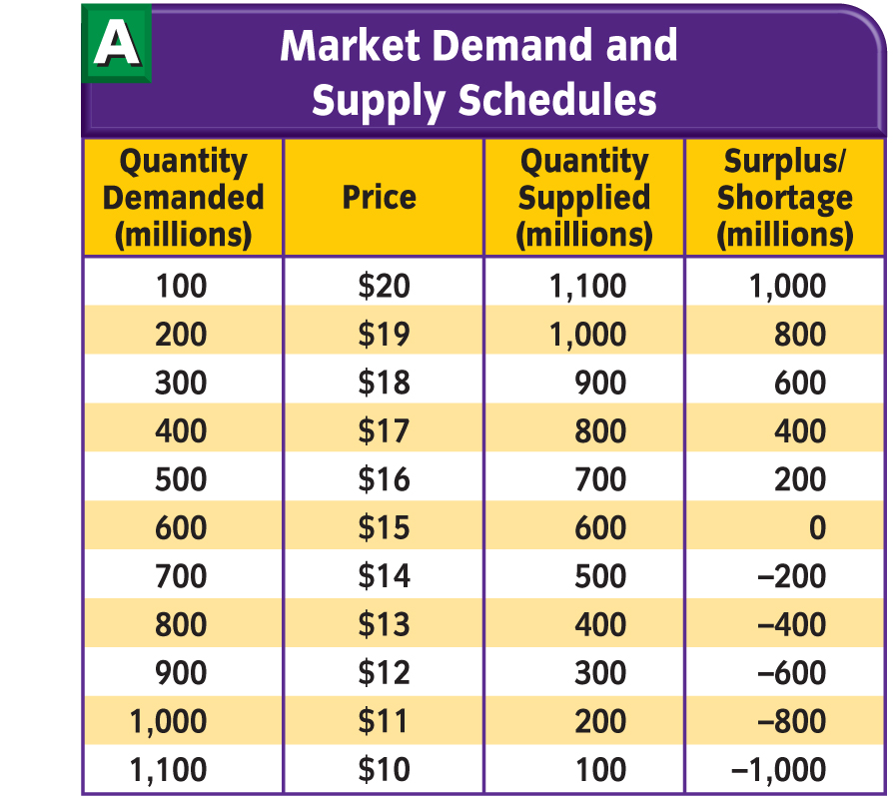
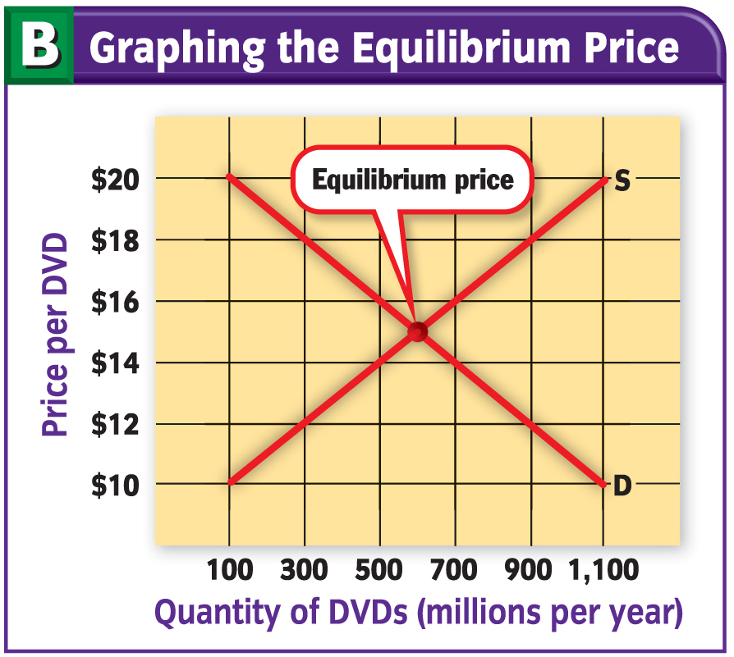
Notes:
Bring up the Demand/Supply chart first and have the students graph
They should start at $10 and increase by $2 increments
They should start at 100 and increase in 200 increments
After they have had a chance to draw it themselves show the graph
Discuss why it is this way. What is the significance of the center point where they meet?
Go to next slide for definition

Slide 36
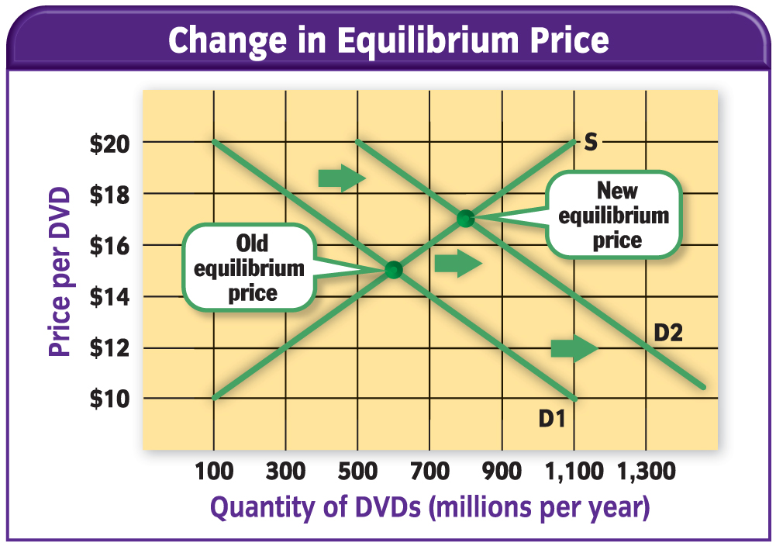
Notes:
Using the different determinants from supply and demand have the students determine what happens to the equilibrium price when different things happen.
Have student erase their LCS boards and draw a generic supply/demand line
Use different “headlines” that might force either demand or supply to move
What happens to the graph?
What happens to the Equilibrium Price?

Slide 37
SECTION 4
SHORTAGE: Quantity demanded is greater than quantity supplied at the current price
SURPLUS: Quantity supplied is greater than quantity demanded at the current price
An unrestricted market economy will eliminate shortages/surpluses on its own
Notes:
Page 197
What happens if producers do not sell at the ideal equilibrium price???
Utilize the JA supply/demand chart to illustrate these terms
How would the market eliminate shortages/surpluses on its own?
Shortages
New businesses would pop up to help serve the unfulfilled needs of society
Price would rise to eliminate the demand from those that could not afford it at the new price
Surpluses
Price would fall…items will go on sale
Companies will stop production of items that are not selling fast enough
Some companies might even close if they cannot find a way to divert their existing resources from the non-moving product…ENTREPRENEURSHIP!!

Slide 38
Graph of Equilibrium Price
Surplus
S1
Price
Equilibrium Price→Supply = Demand
D1
Quantity
Shortage
Notes:
ANOTHER GRAPHICAL DEPICTION
Surplus means producers are making too much for the amount of demand
Shortage means producers are not making enough for the amount of demand

Slide 39
PRICE CONTROLS
PRICE CEILING: Legal maximum price that may be charged for a good/service
RATIONING
Government limits how much of an item we can receive
BLACK MARKET
Illegally high prices charged for items in short supply
PRICE FLOOR: Legal minimum price below which a good/service may not be sold
More common than price ceilings
MINIMUM WAGE
Notes:
Price Controls are another way that the government has become involved in our “market economy”
By setting these controls they are attempting to help us the consumers, but at the same time may be making it difficult for businesses (and then also in the long run for consumers) to reach appropriate equilibriums prices.

Slide 40
Notes:
Page 198

Slide 41
Concept Trans 1

