Slide 1
Business Economics
What is Economics?

Slide 2
CHAPTER OBJECTIVES
Understand scarcity and the importance of choices in our economy
Know the difference between trade-offs & opportunity cots
Understand the importance of a production possibility curve & how it works
Know what an economic model is and how economist use them to explain and predict behaviors in our economy

Slide 3
What is Economics?
The study of how individuals, families, businesses, and societies use limited resources to fulfill their unlimited wants
MICROECONOMICS– deals with behavior and decision making by small units such as individuals and firms (such as…)
MACROECONOMICS– deals with the economy as a whole or large units (such as…)
Notes:
SECTION 1
P6

Slide 4
Why do we study economics?
We need to be informed!
As CONSUMERS it helps us use our limited resources wisely
What are our Limited Resources as Consumers?
TIME & MONEY
As CITIZENS we need to keep our government accountable
What can we do if we do not agree with government choices?
VOTE FOR CHANGE!

Slide 5
New Vocab – Put it in Your Notes!
NEEDS – Things we must have to survive.
Can you name the 3 needs we all must have met?
Food, Shelter, and Clothing
WANTS – Things people do not need to survive, but can be used to enhance their lives
Examples:
Car, Computer, Stereo, Haircut
Can one person’s wants be another person’s needs?
How?
Notes:
AN ECONOMIST WOULD SAY…anything other than what people need for basic survival is always a WANT.

Slide 6
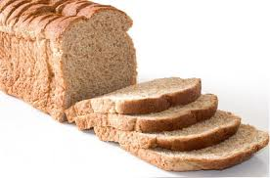
Want or Need?

Slide 7
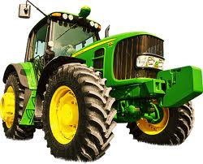
Want or Need?

Slide 8
Vocabulary – Already in Your Notes
SCARCITY– Basic economic problem resulting from unlimited wants vs. limited resources
Each decision WE MAKE has an aspect of scarcity
People do not & cannot have enough income and/or time to satisfy their every want.
Examples to discuss – Gasoline – Water – Diamonds
ALWAYS EXISTS
SHORTAGE– Temporary restriction of resources due to an unforeseen event
Example:
Hurricanes, Floods, Droughts, War all might cause unforeseen restrictions on resources
Notes:
P7
Scarcity…
Is seen at both the individual level as well as the economic level
ALWAYS EXISTS due to competing alternative uses for resources
Shortage Examples
Hurricane Andrew & The Florida Orange Crop (1992)
Hurricane Katrina & Gas for Vehicles (2005)
The Summer Water Shortage in Lincoln (2012)

Slide 9
Factors of Production  1 & 2
FACTORS of PRODUCTION – Resources needed to produce goods and services
LAND – Natural Resources that exist without human interference
A.K.A. – NATURAL RESOURCES
Examples:
Surface Land, Fish, Animals, Trees, Minerals, Water
LABOR – Work people do to produce goods & services for a business
A.K.A. – HUMAN RESOURCES
Notes:
P9
WRITE DOWN EXAMPLES FOR EACH RESOURCE!

Slide 10
Factors of Production  3 & 4
3. CAPITAL – Previously manufactured goods used to make other goods or services
Examples:
Machines, Buildings, Tools
Increases Productivity
PRODUCTIVITY – Amount of output that results from a given level of inputs (land, labor, capital, and entrepreneurship)
4. ENTREPRENEURSHIP – Development of new businesses, products, or services
Always has an element of risk!!
Notes:
P10

Slide 11
Factors of Production  5
5. TECHNOLOGY – Utilizing new methods for producing goods & services more efficiently
Examples of Innovation in History –
Industrial Revolution
Henry Ford’s Assembly Line
Computers replace typewriters
Invention of the Internet
Internet used by Commerce
Cellphones replace land line phones
Smart phones replace standard cellphones
Can you think of others???
Notes:
P8

Slide 12
Goods vs. Services
GOODS
SERVICES
Tangible items that people can buy & sell
Clothing, Food, Tables, Cars, DVDs
Activities that are done for you by someone else
Hair cut, medical examination, car wash, seeing a movie at a movie theater
Notes:
P8

Slide 13
Do They Provide A “Good” or “Service”?
Business | Good | Service | Both
Trader Joe’s
Chipotle
Star Tran
Time Warner
Marcus Movie Theatres
Barnes & Noble
Williams Cleaners
United States Postal Service
X
X
X
X
X
X
X
X

Slide 14
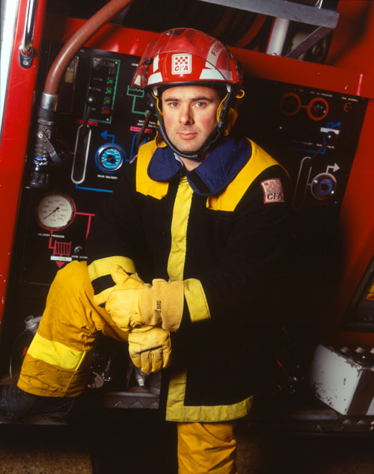
What type of resources are these?

Slide 15
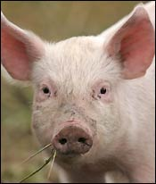
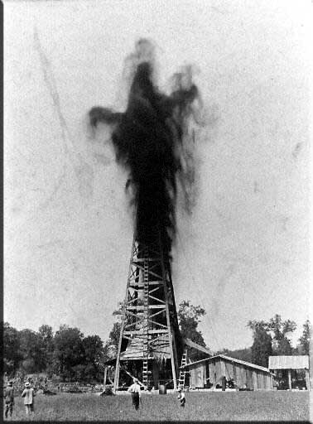
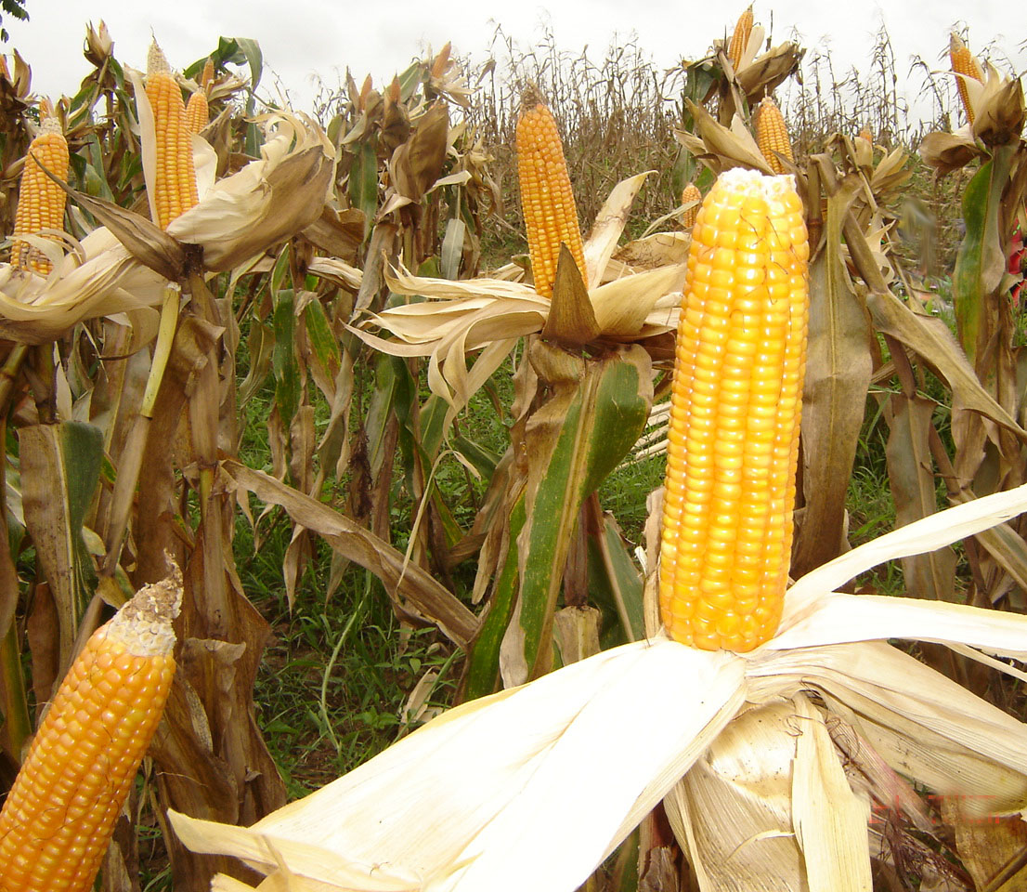
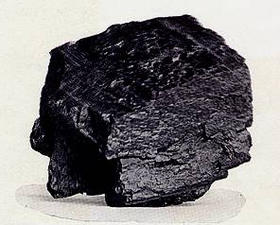
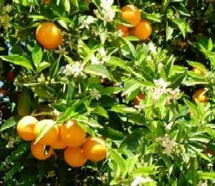
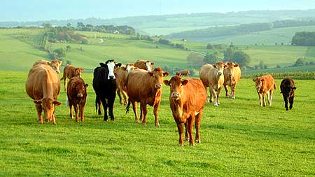
What type of resources are these?

Slide 16
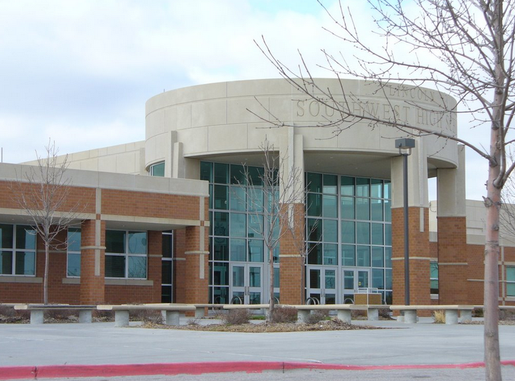
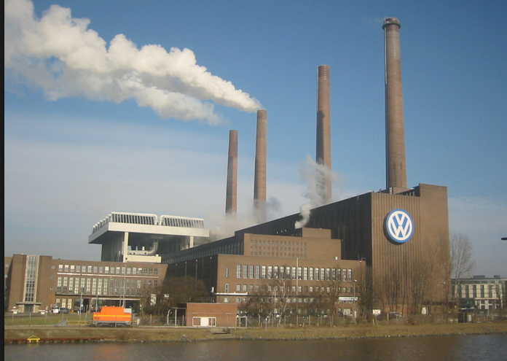
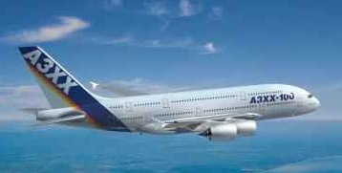
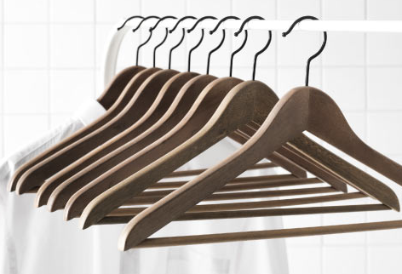
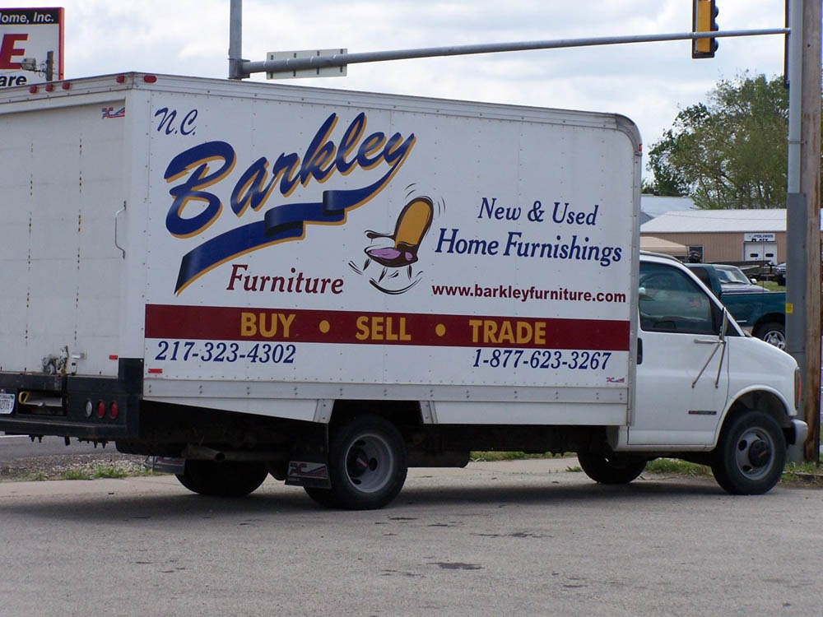
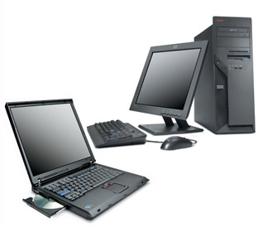
What type of resources are these?

Slide 17
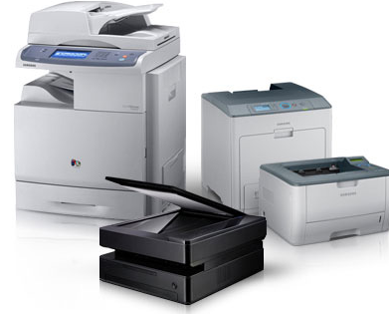
What type of resources are these?

Slide 18
Which Resource Was Not Named?
ENTREPRENEURSHIP
Name Some Examples…
Starting A Business
New Product for Existing Business
New Marketing Idea to Bring in New Customers

Slide 19
Group Activity  Part I
You group is going to establish a new business. You can decide between either a T-Shirt Company or a Pizza Shoppe. Come up with the following:
A name for your company
A description of your company (what type of products will you offer to your customers)
Create a list items you need to run this business
You must name something from each of the 5 Factors of Production. List them in the following colors:
LAND
LABOR
CAPITAL
ENTREPRENEURSHIP
TECHNOLOGY

Slide 20
QUICK QUIZ!!
Identify these items as wants or needs?
5. What is the economics?
6. What is scarcity?
1
2
3
4
Notes:
Want
Need
Want
Want but fulfills a need
The study of how people use limited resources to fulfill their wants
The basic economic problem resulting from limited resources and unlimited wants

Slide 21
SECTION 2 – Economic Decisions Always Involve a TRADE OFF…
TRADE-OFF – Sacrificing one good or service to purchase or produce another
Most of our “trade-offs” involve sacrificing our time or money
Example:
If you choose to buy an iPad, you are exchanging your income for the right to own the iPad
You might also sacrifice other things
Can you think of scenarios where you might sacrifice something other than time or money?
What are some recent trade-offs you have made?
Notes:
SECTION 2 ****
P15
Additional examples:
- MONOPOLY ~ You trade one piece of property for another
Getting a new car ~ You might trade in your old car PLUS some money to get a new car
Going to college ~ You trade in your chance to make money now for the opportunity to get an education and hopefully a better job and more money later.
Security ~ After 9/11 there has been tighter security at airports…what are we sacrificing?

Slide 22
…and Those Trade-Offs Have a Cost
OPPORTUNITY COST – The value of the single next best alternative given up for the alternative that was chosen
Think of it as the runner-up item!!
Notes:
P16
Opportunity Cost Example…there might be multiple movies you could see with your $10…you narrow it down to two movies; a comedy and an action film. You choose the comedy…the action film would be your Opportunity Cost!!
Government…might have to decide between spending tax money on schools or on roads…whichever one they choose the other one is the Opportunity Cost.

Slide 23
Production Possibilities Curve
Shows the maximum combinations of goods/services that can be produced in a certain amount of time with a given amount of resources
Can be used in all aspects of our economy
Personal Life
Business
Government
Notes:
p17

Slide 24
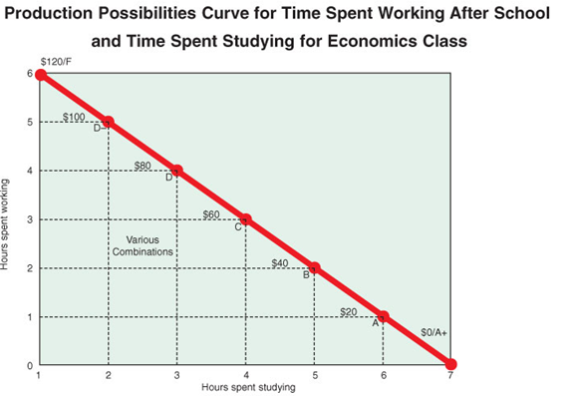
Notes:
According to the graph, in what two ways can students spend their time?
How would students benefit from spending time on each of these activities? What would their Opportunity Cost be for choosing one over the other?

Slide 25
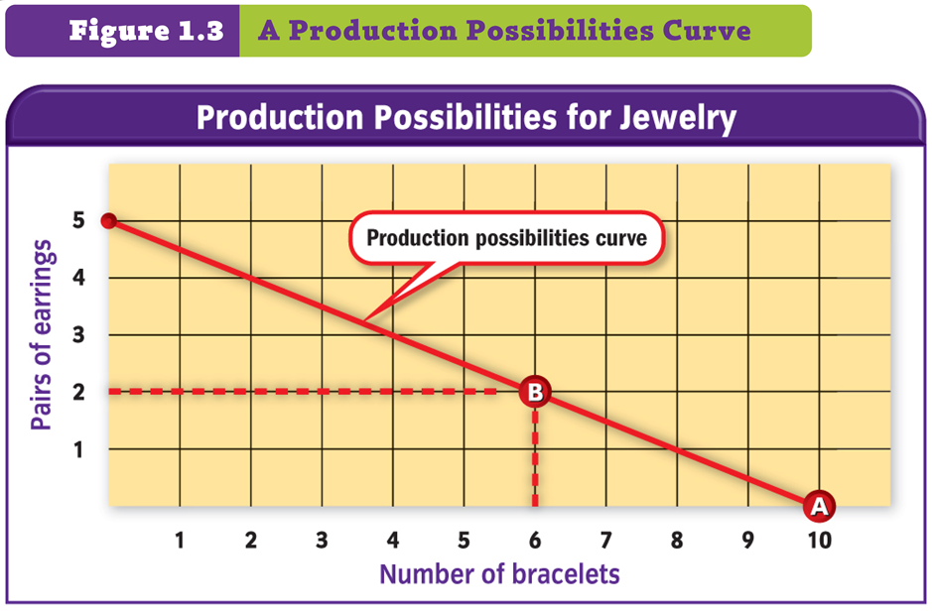
Notes:
SCENARIO ~ See p17 in the book
Additional info to help illustrate ~ tell the students you charge $12 for earrings and $8 for a bracelet. How does that effect their decision to make earrings over bracelets?
Currently making 10 bracelets ($80)
Thinking about making 2 pairs of earrings…what is the opp. cost? (4 bracelets / $10)
Making 4 less bracelets x $8 = $32 less in profits from bracelets not sold
2 earings x $12 = $24 in profits from earing sales
$32 - $24 =$8 less in sales from earings rather than bracelets
Should you make earrings? What are you missing out on if you only sell bracelets?

Slide 26
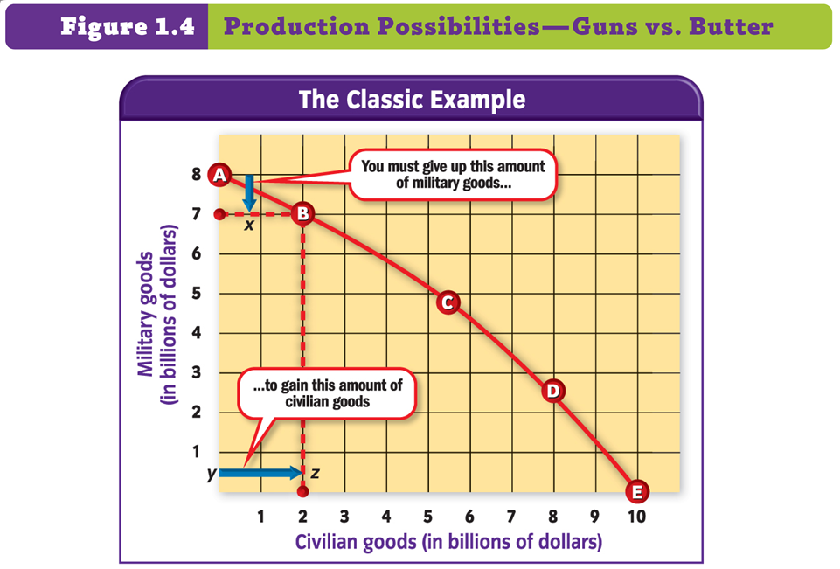
Notes:
P18
What would it be like if the government only produced Civilian Goods (point E)?
Would be hard to defend ourselves against other nations
What would it be like if the government only produced Military Goods (point A)?
Would not have public schools
Would create more of a barrier between classes
Roads would not be very good
No Social Security, Medicare, Welfare, Unemployment

Slide 27
Group Activity  Part II
Return to the group you were in for the t-shirt/pizza project
Your company is thinking about adding a new item to their production process. CREATE A LIST of possible trade-offs associated with this decision.
Create a Production Possibilities Curve
SHIRTS/PIZZAS | HATS/CALZONES
500 | 0
400 | 175
300 | 300
200 | 350
100 | 400
0 | 500
Notes:
Treat it as a PROs & CONs list
What are the benefits to selling the new item?
What are the benefits to sticking with just one item?

Slide 28
Section 3 – Economic Models
ECONOMY – The production & distribution of goods/services in a society
ECONOMIC MODEL – A theory or simplified representation that helps explain & predict economic behavior in the real world
A VISUAL REPRESENTATION of consumer, business, or other economic behavior
Relate to the way individuals (as consumers) and business people react to changes in the word around them
Notes:
SECTION 3****
P20
Models do not show every detail and relationship that exists about a problem; only the basic factors needed to analyze the problem

Slide 29
Economic Models
Steps to creating an economic model:
Gather Information/Facts
Discard the facts that are not relevant
Develop a theory/hypothesis
HYPOTHESIS – An assumption involving two or more variables that must be tested for validity
Create an Economic Model
Test the Model
Requires additional research above the initial information gathered.
Revise Model
If research shows the original economic model was incorrect a new model would need to be made.
Notes:
P22-23

Slide 30
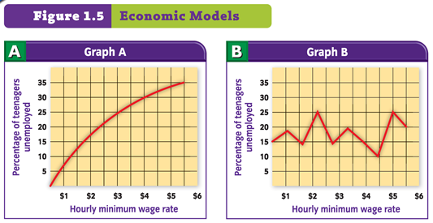
An Economic Theory: Teenage Unemployment increases when the Minimum Wage increases
WHICH GRAPH SUPPORTS THE THEORY LISTED BELOW?
Notes:
P23
EXAMPLE: If a theorist wants to know why teenage unemployment rises periodically they might gather facts that show a correlation to the rise in teenage unemployment and the rise in minimum wage.
SEE GRAPHS
If the information he gathers shows Graph A then his theory would be correct
If the information he gathers shows Graph B then his theory would be incorrect and he would need to look for other variables.

Slide 31
Group Activity  Part III
Return to your group and discuss the following:
LISTEN to the scenario
GRAPH the information
ANSWER the following:
Should your company INCREASE, DECREASE, or KEEP CONSTANT the current production levels of your product? Why?
Teenager’s Average Hourly Rate | Percent of Income used for Purchases
$3 | 5%
$6 | 18%
$9 | 30%
$12 | 38%
$15 | 49%
Notes:
Scenario:
The hourly rate being paid to teenagers is scheduled to increase in two months. You have heard that when the hourly rate a teenager is paid increases they spend a higher percentage of their income. Should you…
Increase Production
Decreasae Prroduction
Keep Production the Same
EXPLAIN YOUR ANSWER!

Slide 32
Interpretation is not always Black & White
Economist deal with FACTS
An economist’s background, political point of view, opinion & even religious beliefs
May influence how they interpret those facts
EXAMPLE:
REPUBLICANS & DEMOCRATS usually follow different Economic Theories
Effect which Economic Theory they may use when looking at the facts
The Science of Economics is
Not used to judge whether a government policy is good or bad
Used to inform us as to the likely outcome of the policies
Notes:
P24
Discuss Figure 1.6 on this page

